Slide 1
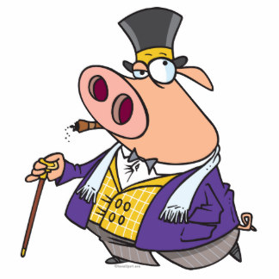
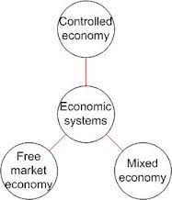
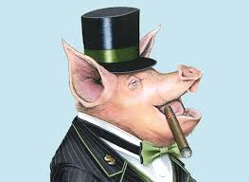
Economic Systems & How the Government influences how I make money.
Mr. Kilbourn

Slide 2
Quick Review:
Take out a sheet of paper and answer the following questions:
What are Goods?
What are Services?
What are Resources?
What is Scarcity?

Slide 3
Economic Systems - The method used by a nation to use its resources to produce and distribute goods and services for peoples needs and wants.
Or, How the government tells us what we can get and how to get it!

Slide 4
All Economic Systems Must Consider the Following 4 Questions:
What goods and services to produce?
How will they produce them?
Who will get them?
How much will they produce now, and how much later?
Each economic system answers these questions in a DIFFERENT WAY.

Slide 5
Types of Economic Systems
There are 3 basic types of economic systems:
Traditional
Command
Free Market
and
Mixed

Slide 6
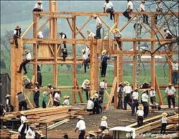
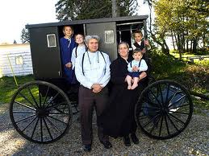
1. Traditional Economy
Economic questions are answered by habits and customs (the way it has always been done)
Children work the same jobs parents worked, often farming or hunter/gatherer
Fear Change!
Ex. Eskimos, the Amish,
Pigmies, Bush People

Slide 7
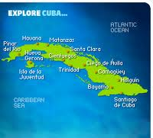
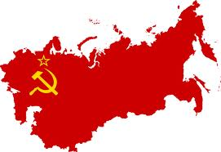
2. Command Economy
The government answers the basic economic questions
Advantages: able to act quickly in emergencies, provide for all people equally
Disadvantages: Inefficient, no incentive to work hard or be creative
Ex. Communist Countries (China, Vietnam, North Korea, former Soviet Union, Cuba)

Slide 8
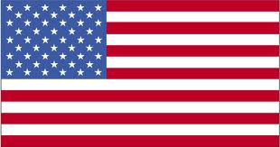
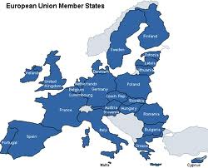
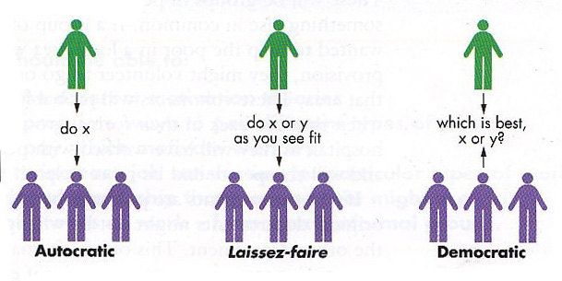
3. Free Market Economy
Economic questions are answered by individual buyers and sellers.
Supply and demand influence economy
People act out of self interest; motive for profit (money) drives the economy
Also known as FREE ENTERPRISE or CAPITALISM
Ex. The United States, Western
Europe, Japan

Slide 9
Do y because that’s how Grampa did it
Do x… now!
Do x or y as you see fit
Command Economy
Free Market
Laissez Faire Economy
Traditional Market Economy

Slide 10
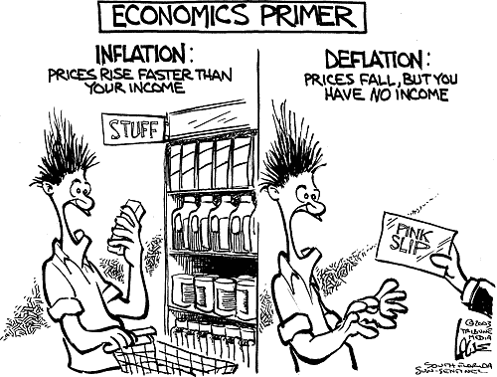
Mixed Economy
No economy is pure market, pure command, or pure traditional.
Elements of each appear in all economies.
some more than others

Slide 11
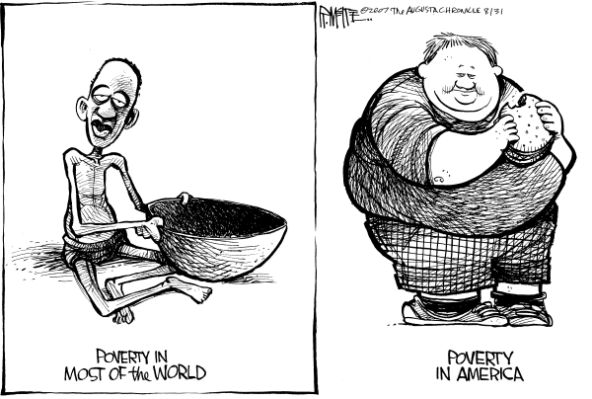
American Mixed Economy
While the United States is mostly a free market economy, it does have elements of a command economy.

Slide 12
Features of American Free Market Economy
Economic Freedom: individuals have the right to choose
Competition: more than one producer of good/services insures choice
Private Property: individuals have the right to own their own property, including business

Slide 13
Features of American Free Market Economy (cont)
Self-Interest: individuals make
decisions based on what is best for them
Voluntary Exchange: individuals may freely buy and sell goods
Profit Motive: individuals are driven by a desire to profit (make money)

Slide 14
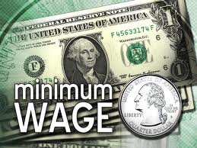
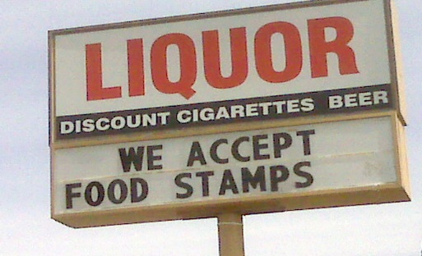
Features of American Command Economy
Government regulation of some business practices
Ex. Wages, labor hours, safety practice.
Government limits certain choices
Ex. Cannot buy or produce certain goods/services
Government provides aid to the weak & needy
Ex. Welfare and Food Stamps

Slide 15
My Pizzeria
How would my pizzeria function under different economic systems?

Slide 16
My Pizzeria in a Free Market
I answer the basic economic questions!
I determine how much cheese and pepperoni goes on the pizza
I determine the quality of the cheese and pepperoni
I set my employees wages
I set my business hours

Slide 17
My Pizzeria in a Command Economy
The government answers the basic economic questions
The government sets the amount of cheese and pepperoni on each pizza
The government determines quality of cheese and pepperoni
The government sets employees wages
The government sets business hours
Problem: What does the government know about pizza?

Slide 18
My Pizzeria in a Mixed Economy
The Government and I both answer the basic economic questions
I determine the amount of cheese and pepperoni on the pizzas; government determines the quality of cheese and pizza
I set employee wages; government sets minimum wage for employees
I determine business hours; government determines whether I am safe to be open or not

