Slide 1
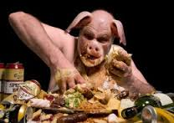
Your Role as a Consumer
Mr. Kilbourn

Slide 2
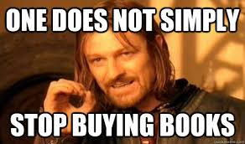
Consumption, Income, and Decision Making
Consumer - a person who purchases goods and services for personal use
If you buy stuff, for any reason, you’re a consumer

Slide 3
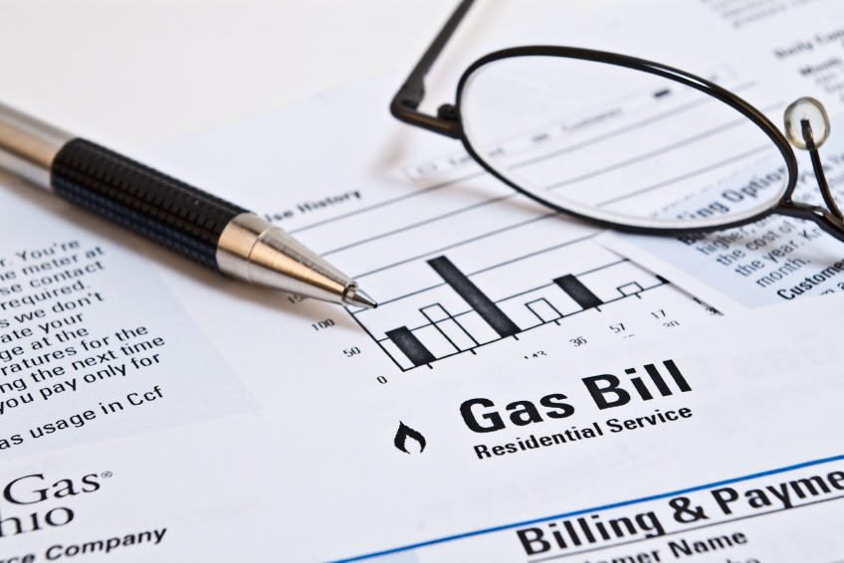
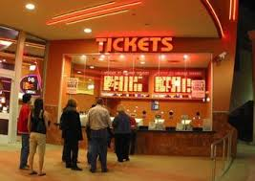
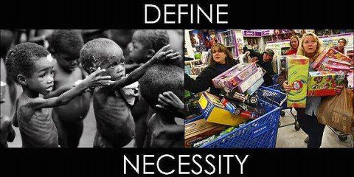
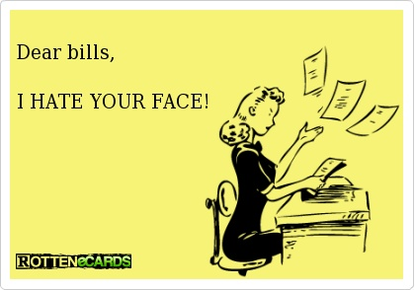
Disposable and Discretionary Income
Your role as a consumer depends on your ability to consume
Disposable Income – income/money remaining after taxes
This money is usually spent on needs like food, clothes, and housing.
Discretionary Income – income/money remaining after all needs have been bought or paid for
This money is usually spent on wants/luxury items or saved.

Slide 4
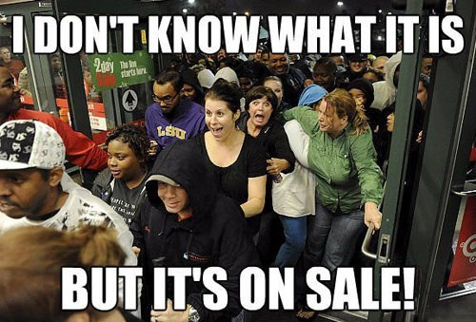
Decision Making as a Consumer
To buy or not to buy
Basic, but always should be considered
Do I really need this? What are the trade-offs?
Scarce Resources – Once you decide to buy something at least two scarce resources are involved.
Time and money
Time is spent deciding what to get, which is the best for my money, where to buy, etc.
Money... Nothing is free.

Slide 5
Opportunity Cost - The benefit, profit, or value of something that must be given up to acquire or achieve something else.
In general, the higher the quality the higher the cost and the lower the quality the lower the cost.
Rational Choice – the alternative that has the best perceived cost
When making consumer decisions based on opportunity cost then you are making a careful yet rational choice.
These choices involve getting the best-quality item that is the least expensive comparably.
You make rational choices when you make purchases that you believe can best satisfy your wants and needs.

Slide 6
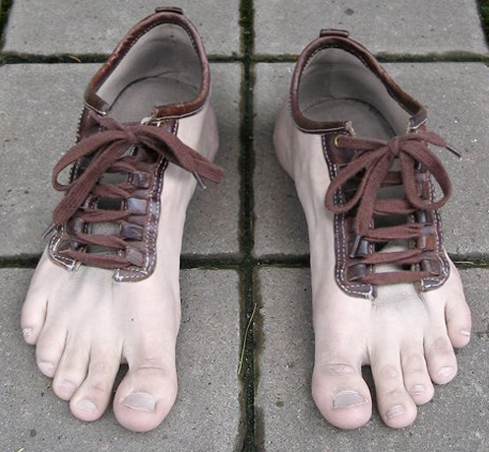
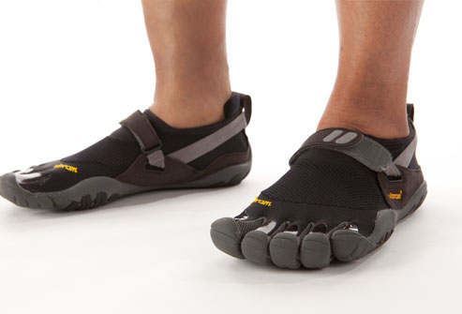
List the 3 most major or expensive purchases that you have most recently made.
Explain why you think you did or did not apply rational choices when making each of those purchases.

Slide 7
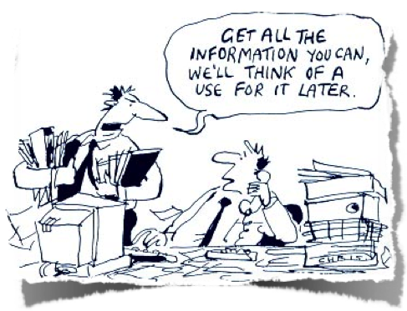
Gathering Information
How much information do you need?
Information is costly because it involves your time
Obtain only as much information as is worthwhile
The value of your time and effort spent gathering information should not be greater than the value you receive from making the best choice of product for yourself.

Slide 8
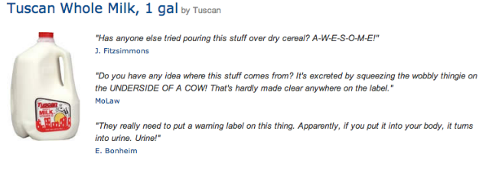
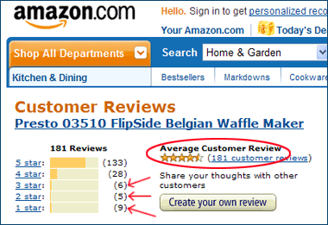
Developing a Consumer Knowledge Base
As you shop for different products you will begin to develop a consumer knowledge base.
Information you obtain looking for and buying one product will likely help you make better consumer decisions in the future
The more you speak to salespeople the more skilled you will get at getting accurate and pertinent information from them
*use the internet and see what real people say about the product

Slide 9
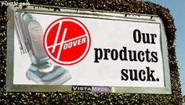
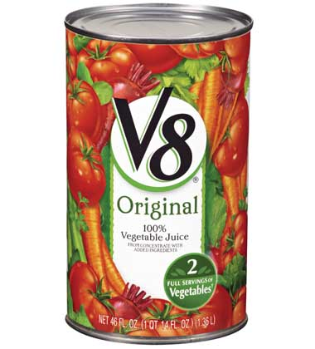
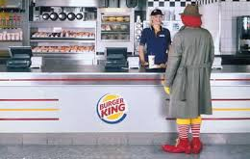
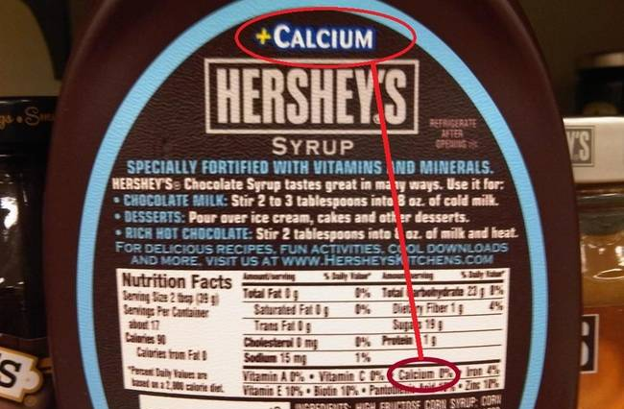
Using Advertising Wisely
Advertising is everywhere… beware
Competitive Advertising – advertising that attempts to persuade consumers that a product is different and superior to others
Informative Advertising – beneficial advertising that gives consumers information about a product
Bait & Switch – false advertising that attracts consumers with amazing products at great prices when said product is for whatever reason unavailable
The only purpose is to get consumers into the store with the hope that they will buy other products

Slide 10
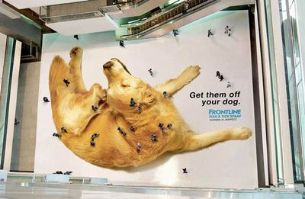
Checklist for Analyzing Ads
1. Does the ad only appeal to my emotions or does it provide facts?
2. What are the special features of the product? Do I need any of said features?
3. Does the ad tell me anything about operating costs?
4. Does the ad tell me anything about a product’s durability or ability to last?
5. Does the advertised price compare favorably with the price of similar products?
6. Is the advertised price the entire price, or are there extra costs in small print?

Slide 11
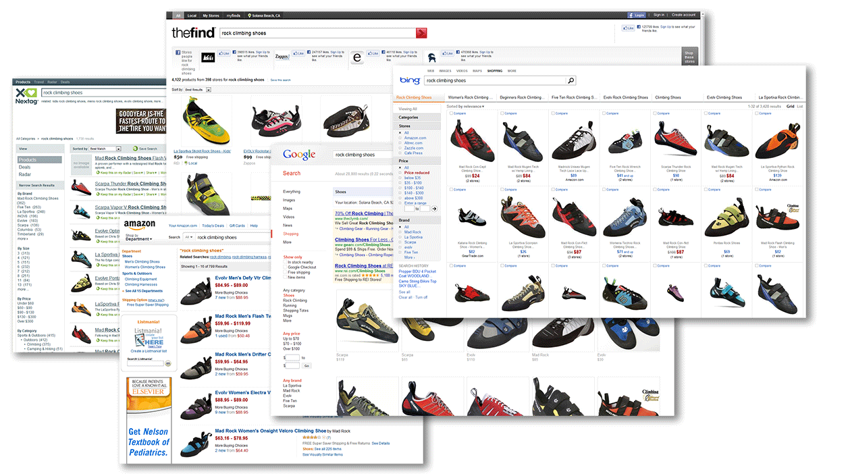
Comparison Shopping
After you have gathered the information about the make and model of the product you want, you must decide where to buy it
To efficiently comparison shop, read newspaper ads, use the google… different online stores (like Amazon, Overstock, Wayfair, Zulily) visit different stores.
* Look for warranties – some manufacturers guarantee their products and will replace them if they are faulty
* Look for quality – not everything is better because it is a brand name, ofttimes generic brands are just as good as brand names and cheaper

Slide 12
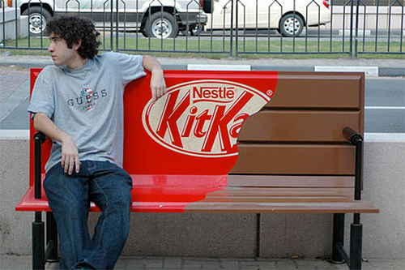
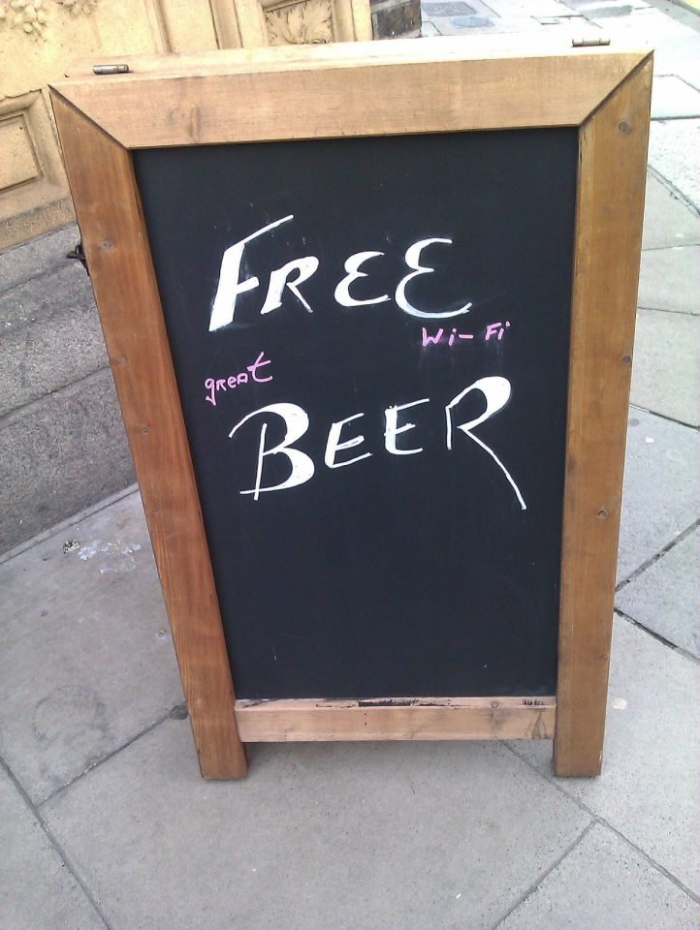
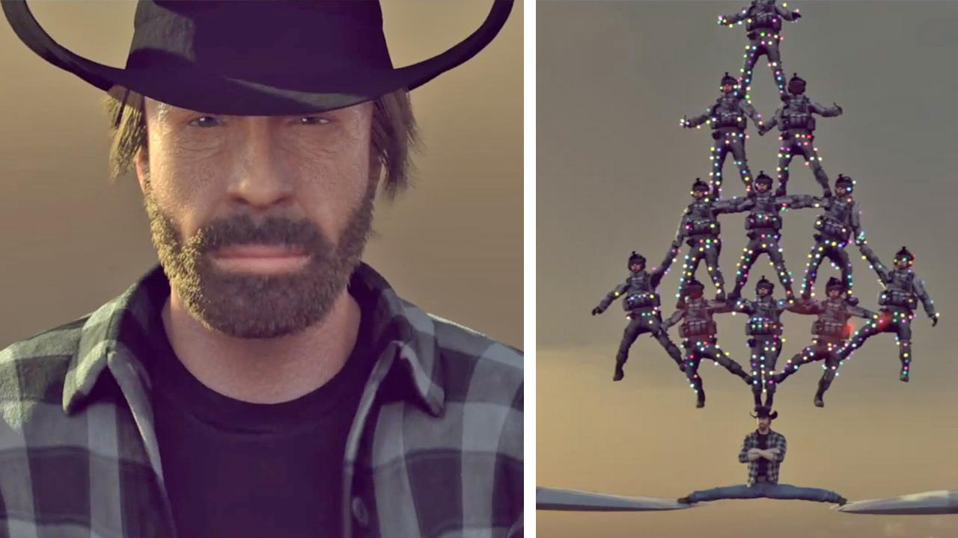
Think of an advertisement you have seen recently and describe it to me in writing. Then compare the ad by applying it to the 6 points on the checklist for analyzing ads.
Chuck Norris – Splits on a plane selling Christmas Lights spoofing JCVD

Slide 13
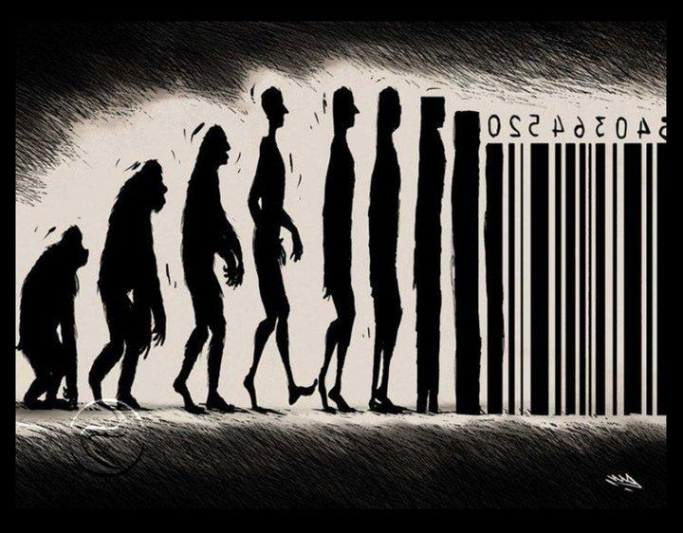
Consumerism - a movement to educate buyers about the purchases they make and to demand better and safer products from manufacturers

Slide 14
Consumer Rights
As a consumer in this country, you have the right to:
Safety against any goods or services that could be dangerous to life or health
To be informed about products to better make rational choices
To choose, so that the market remains competitive
To be heard, so that consumer interests will be listened to
To obtain from the manufacturer adequate payment in money or goods for financial or physical damages caused by their products

Slide 15
Consumer Responsibilities
You not only have consumer rights, you also have 8 consumer responsibilities:
Report the problem immediately (if you try to fix it you may void the warranty)
State the problem and suggest a fair and just solution (usually a replacement or refund)
Include important documents such as receipts, warranties, or contracts
Describe all the actions that you have taken to try and correct the problem
Keep record of your efforts to get it fixed (names and dates)
Allow reasonable time for the problem to be solved after contacting new sources (give people adequate time to fix the issue before going to someone else to fix it)
If you have to contact the manufacturer yourself, try to do so in writing so that you can keep a copy (letter, e-mail, chat box)
Keep Cool and remember that the people you are dealing with are usually not the people that caused the issue.
* Ethical Manner – acting in accordance with moral and ethical convictions about right and wrong

Slide 16
Describe 2 examples of how you educated yourself about a product before buying it.

