Slide 1
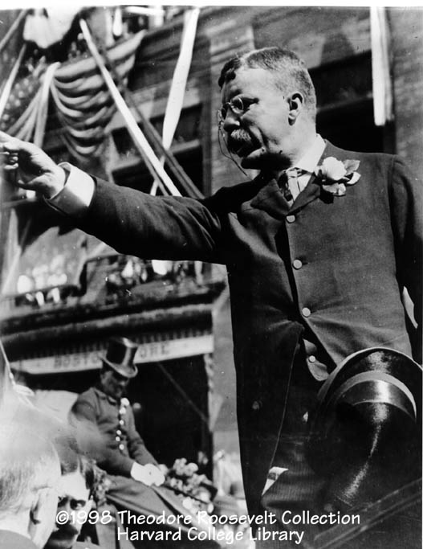
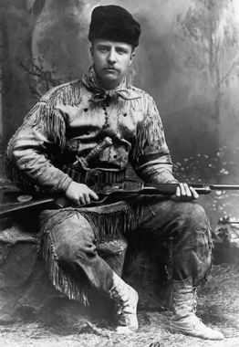
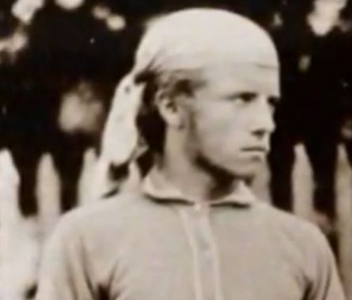
Roosevelt Becomes President
Assassination of McKinley in 1901
A “visible president”
Very charismatic

Slide 2
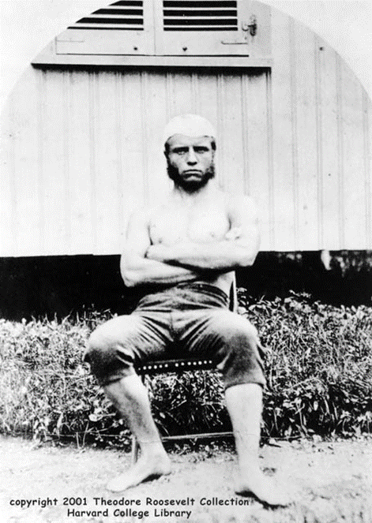
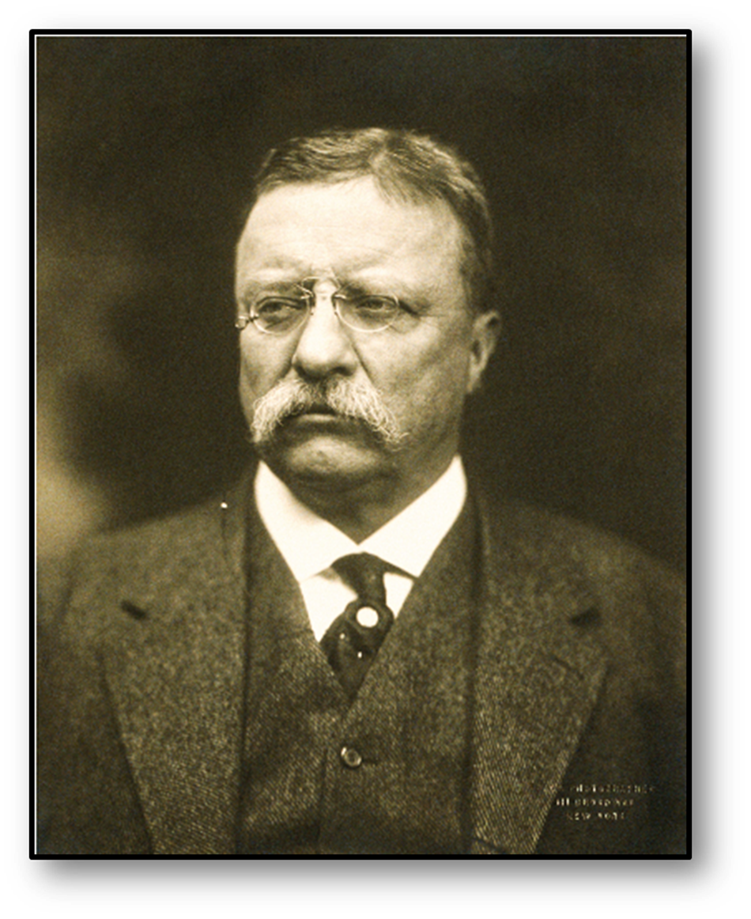

Slide 3
Theodore Roosevelt
After gaining several new territories in the Spanish-American War, America needed a way to get from the Atlantic to the Pacific Ocean without having to go around South America.
President Theodore Roosevelt believed that the solution was to build a canal in Central America.
He believed that this would help America’s economic (trading) and military (Navy) interests.

Slide 4
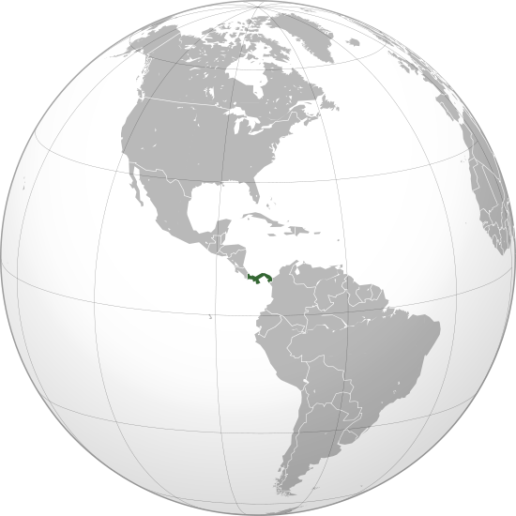
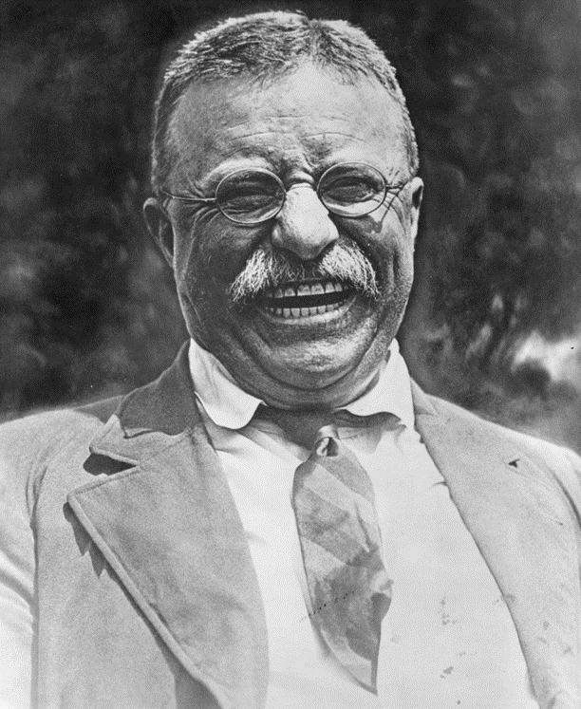
Theodore Roosevelt
Panama
© 2014 Brain Wrinkles

Slide 5
Panama Canal
In 1882, a French company had started to build a canal in Central America.
They soon stopped the project after yellow fever and malaria (carried by mosquitoes) killed many of the workers.

Slide 6
The Panama Canal:
By the early 20th century, many Americans understood the advantages of a canal through Panama
It would greatly reduce travel times for commercial and military ships by providing a short cut between the Atlantic and Pacific oceans

Slide 7
Building the Canal
In 1903, Panama was a territory of Columbia
The US backed a Panamanian rebellion against Columbia backed with 12 US warships
Within weeks The US and Panama struck a deal that allowed the US to build the canal (Panama gets 10 million plus $250,000 a year rent)
Colombia is SALTY and we pay them 25 million in 1921

Slide 8
Building the Panama Canal: 1904-1914
The French had already unsuccessfully attempted to build a canal through Panama
America first had to help Panama win their independence from Colombia – which it did
Construction of the Canal stands as one of the greatest engineering feats of all-time
Cost- $380 million Workers– Over 40,000 (5,600 died) Time – Construction took 10 years

Slide 9
Panama Canal
Doctors taught the workers how to combat the diseases.
Workers drained swamps, covered supplies with tents, and put in new sewers to stop the spread of diseases.

Slide 10
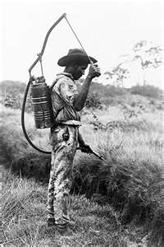
Struggles Building the Canal
Mosquito Spraying
Disease was rampant while building the canal (Yellow Fever, Bubonic Plague, Dysentery, and Malaria)
Inadequate housing (Houses covered in mold and guano)
The work was painstakingly slow

Slide 11
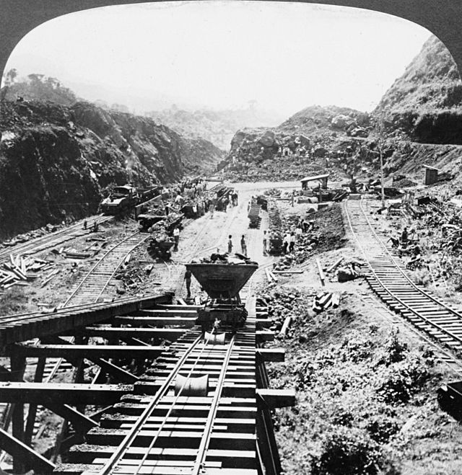

Slide 12
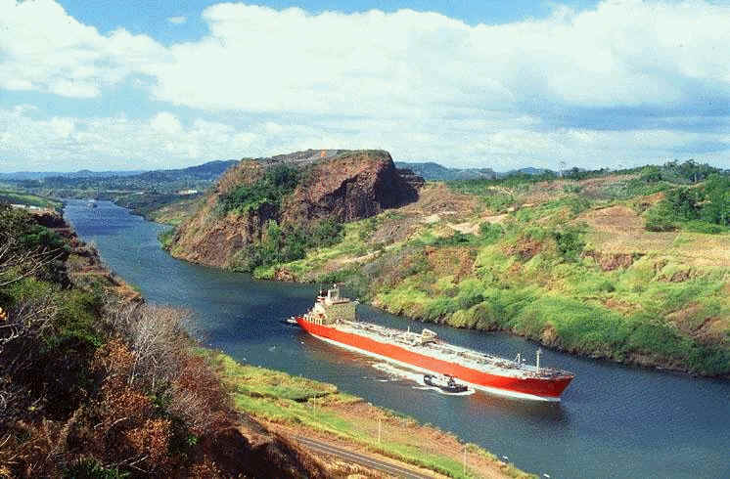

Slide 13
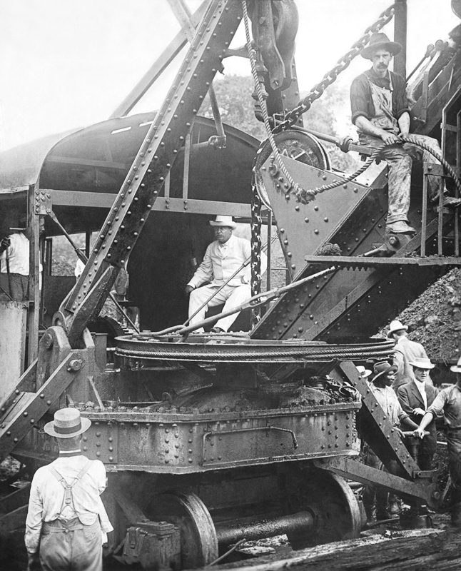
President Theodore Roosevelt Sitting on a Steam Shovel at the Panama Canal - 1906
© 2014 Brain Wrinkles

Slide 14
Panama Canal
When the Panama Canal opened in 1914, it was a huge shortcut between the Atlantic and Pacific Oceans eliminating the long trip (7,900 miles) around Cape Horn, the southernmost tip of South America.
It is 45-60 feet deep.
Americans now had more access to world trade.
The US Navy could defend the country’s interests all across the globe.

Slide 15
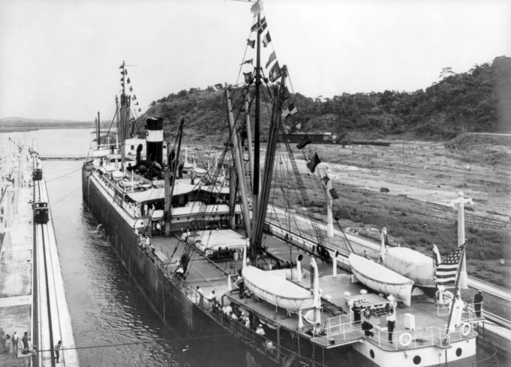
First Ship to Pass through the Panama Canal -1914

Slide 16
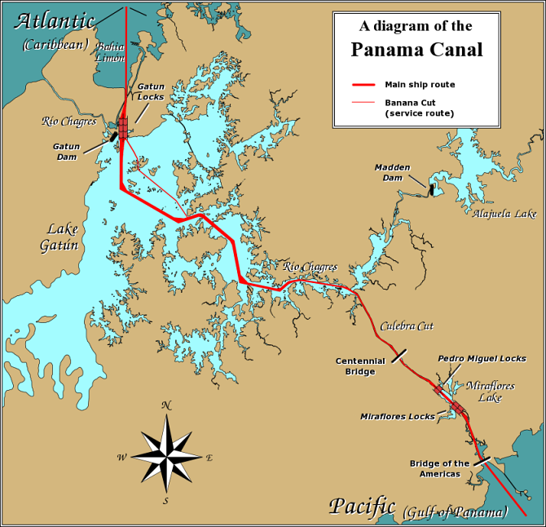
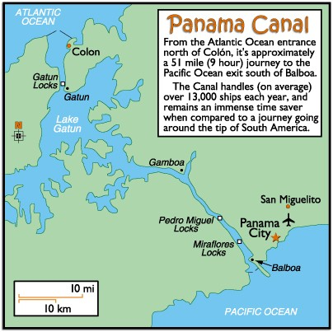

Slide 17
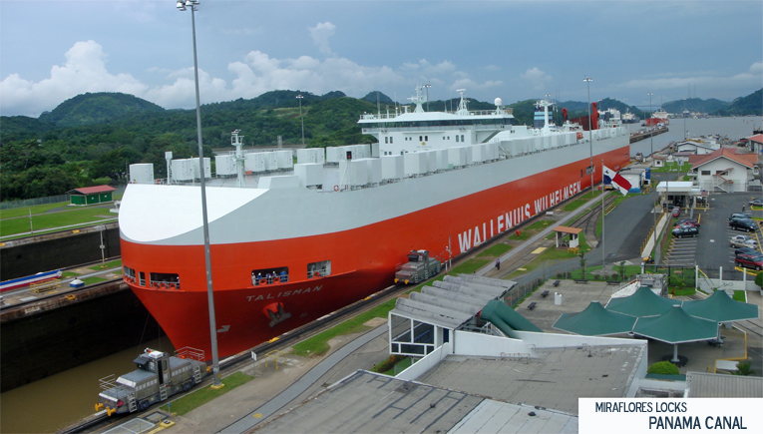
A Ship Passing Through the Canal

Slide 18
America As A World Power:
Two events signaled America’s continued climb toward being the #1 world power
1) Roosevelt negotiated a settlement between Russia and Japan who had been at War – his successful efforts in negotiating the Treaty of Portsmouth won Roosevelt the 1906 Nobel Peace Prize
2) Construction of Panama Canal

Slide 19
The Roosevelt Corollary:
In 1904, President Roosevelt added the Roosevelt Corollary to the Monroe Doctrine.
Monroe Doctrine (1823 that stated US did not want European influence in South America
The Roosevelt Corollary said that the US would now use force to protect it’s economic interests in Latin America.

Slide 20
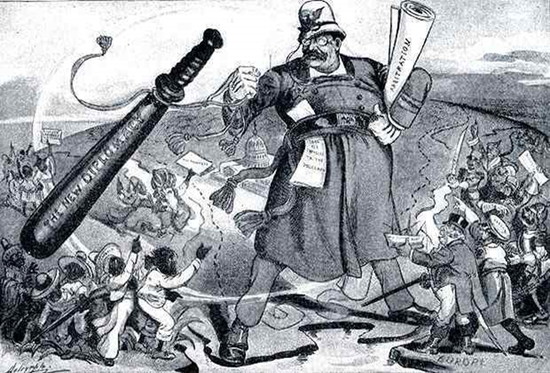
BIG STICK
Roosevelt coined the phrase “Speak softly and carry a big stick, and you will go far” during this time.

Slide 21
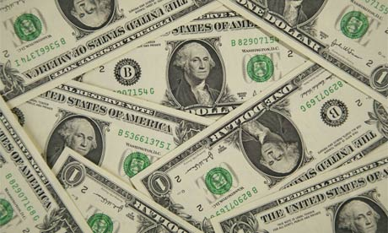
Dollar Diplomacy
Just like other nations in the world that were practicing imperialism, the US was nervous that other nations would become more powerful. Many Latin American countries were heavily indebted to European banks. *(now Chinese)
Dollar Diplomacy –US government loans made to foreign countries (favors) to pay off debt
This allowed us to control others things though (taxes on import and exports)
This helped keep European powers out of the Caribbean because they had US backing.

Slide 22
Sum it All Up: What Did America Accomplish During This Time Period?
1. Expanded its access to foreign markets in order to ensure the continued growth of the domestic economy.
2. Built a modern Navy to protect its interests abroad.
3. Exercised its international police power to ensure dominance in Latin America.

Slide 23
Emigration

Slide 24
Emigration
One of the largest human migrations in history happened at the turn of the century.
Many people left their home countries to come to the United States.
This is called emigration – leaving your homeland to make a long journey to a new country.
A person who moves to a new country is an immigrant.

Slide 25
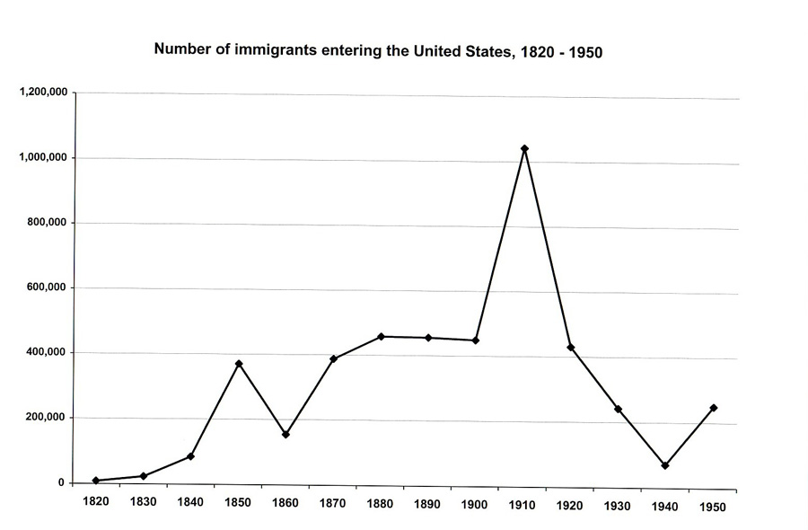

Slide 26
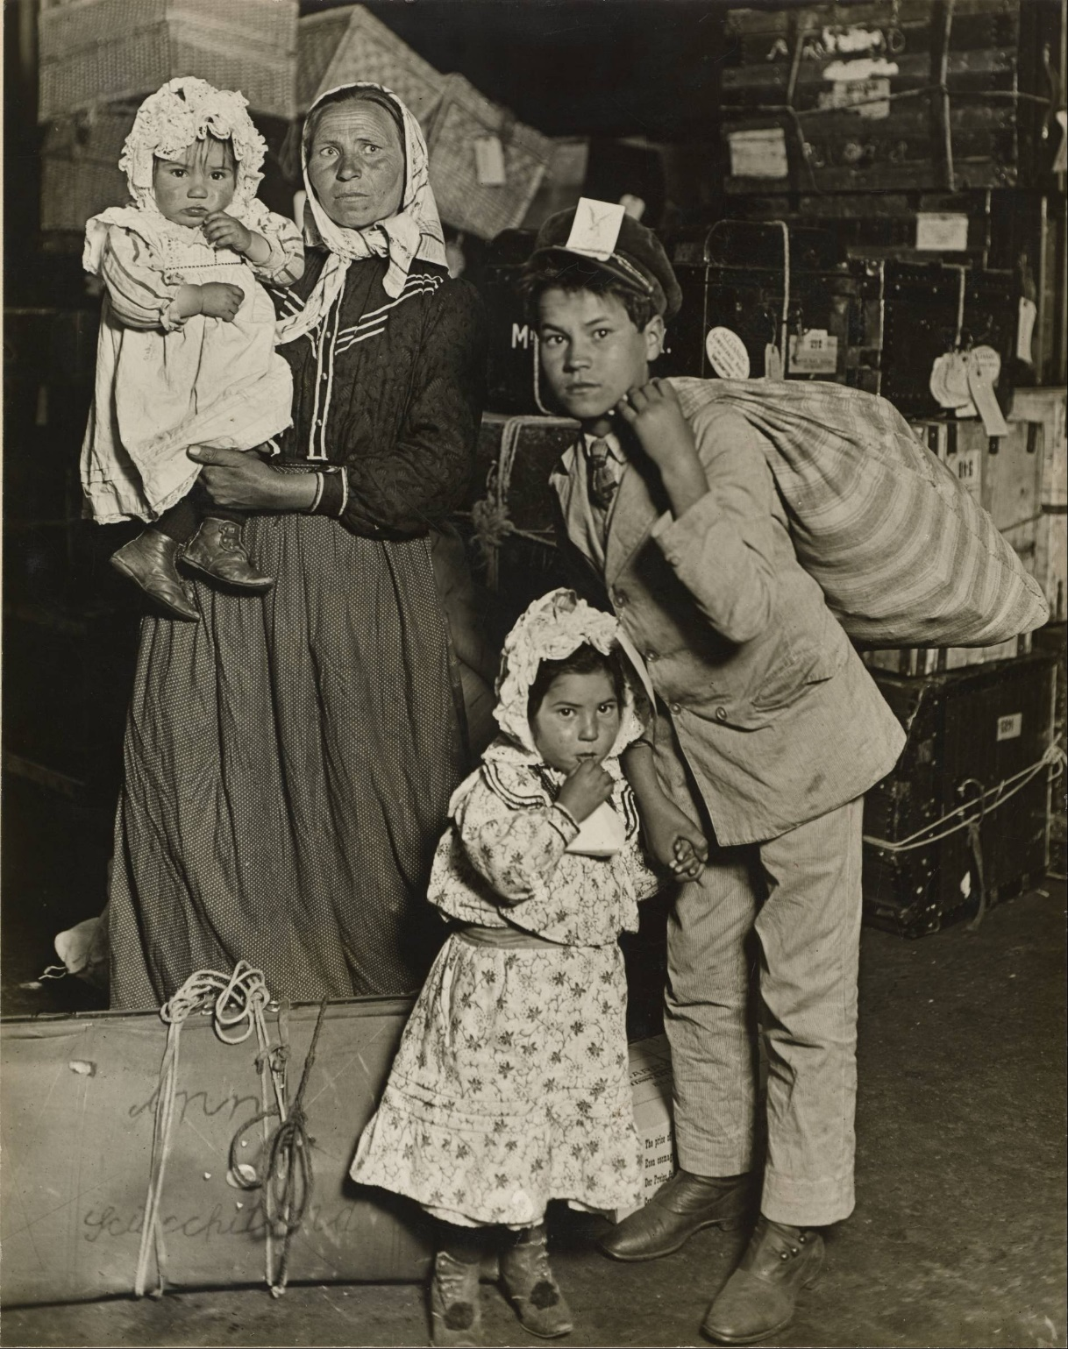
Slavic Immigrant Family in the Baggage Room of Ellis Island, 1905

Slide 27
A Better Life
Most immigrants came to America in search of a better life.
Most were poor and wanted to escape Europe’s rigid class system.
If you were born poor in Europe, you had little chance of moving into the middle or upper class.
They believed that class didn’t matter as much in America because if you worked hard, you could find a better life… American Dream!

Slide 28
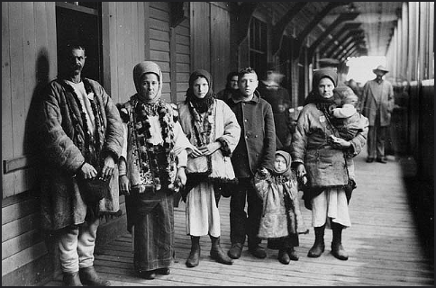
Immigrants from Spain, 1911

Slide 29
A Better Life
Immigrants were also trying to escape wars and persecution.
There were many wars in Europe during this time.
Many people were killed, homes were destroyed, young mend were forced to serve in armies.
People were also harassed because of their religious beliefs.
© 2014 Brain Wrinkles

Slide 30
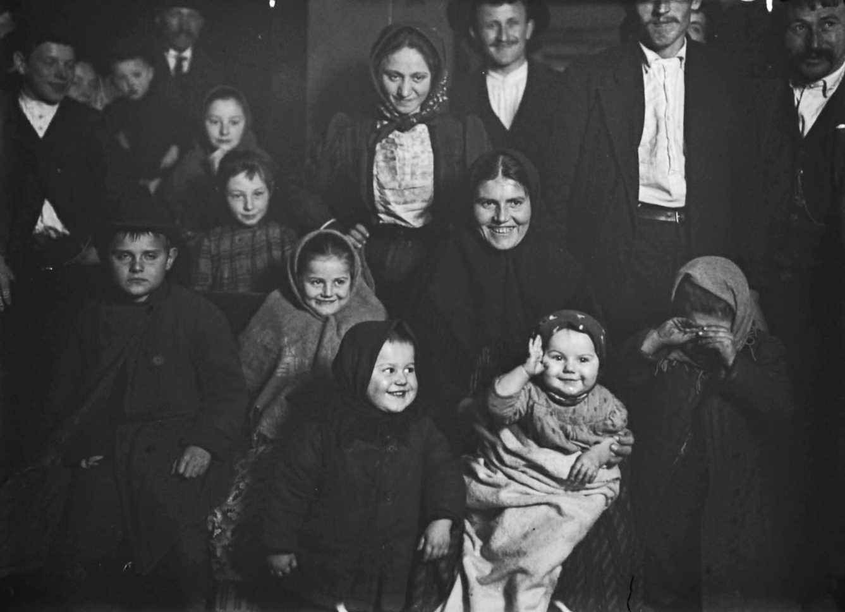
Hungarian Immigrants
1905

Slide 31
Where From?
Between 1860 and 1900, more than 13 million people emigrated to the US.
Most of the immigrants were from Western Europe (Germany, Great Britain, & Ireland).
Some came from Southern and Eastern Europe (Italy, Greece, Poland, & Russia).
Some came from Asia, especially China & Japan.
Some came from Mexico and Puerto Rico.

Slide 32
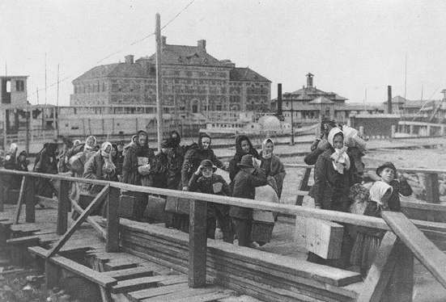
Immigrants Arriving at Ellis Island New York City, 1902

Slide 33
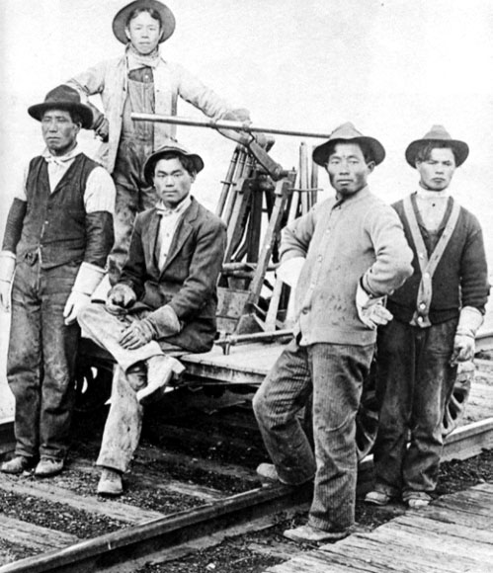
Japanese Immigrants in California

Slide 34
Big Cities
Some immigrants traveled to the Midwest, where they became farmers.
Most immigrants were so poor that they settled near the place where they came into the US.
They settled in America’s growing cities, like New York City, Chicago, & Boston.
They often settled in neighborhoods with other immigrants who spoke the same language and shared the same culture.

Slide 35
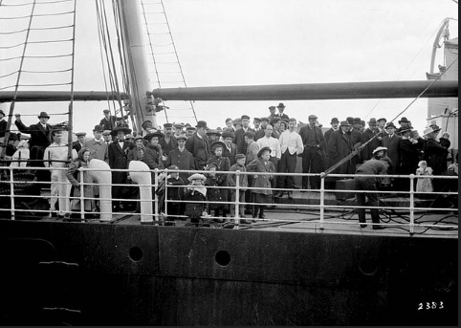
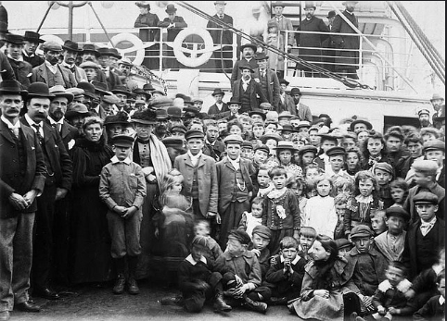
English Immigrants Waiting to Go Ashore, 1902

Slide 36
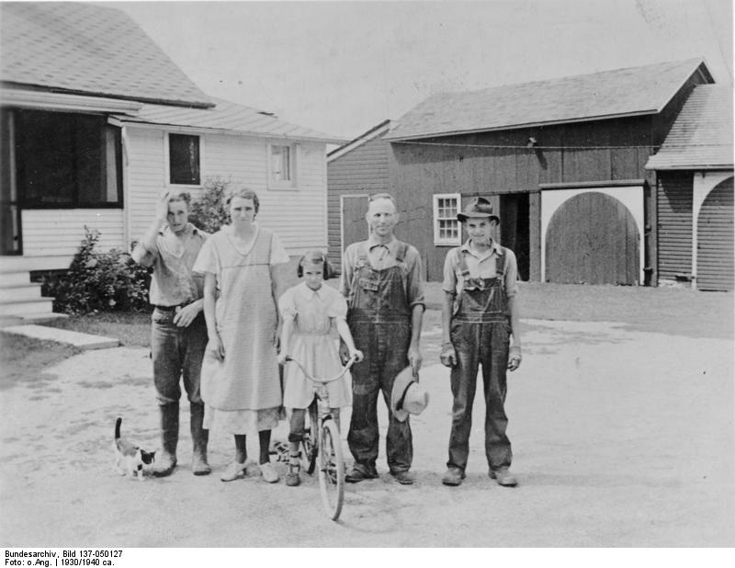
German Immigrant Family in the Midwest

Slide 37
President Roosevelt in the White House 1903

Slide 38
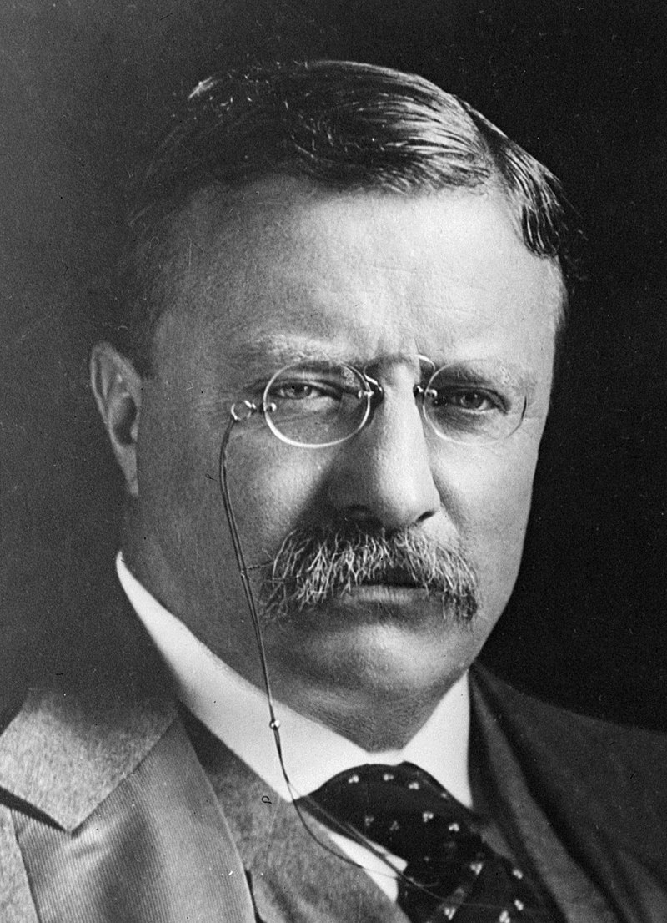
"Roosevelt was a great personality, a great activist, a great preacher of the moralities, a great controversialist, a great showman. He dominated his era as he dominated conversations... the masses loved him; he proved to be a great popular idol and a great vote getter.“
Historian Thomas Bailey

Slide 39
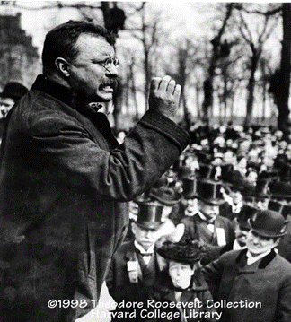
The Bully Pulpit
How things “ought to be”
A bully pulpit is a position that provides an opportunity to speak out and be listened to.
President Roosevelt referred to his office as a "bully pulpit", by which he meant a terrific platform from which to advocate an agenda.
Roosevelt used the word bully as an adjective meaning "superb" or "wonderful", a more common usage at that time.

Slide 40
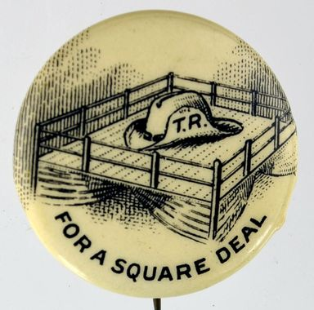
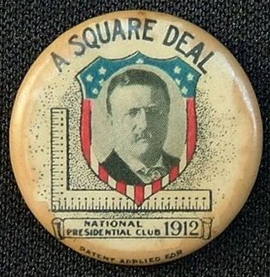
Square Deal
three basic goals: conservation of natural resources, control of corporations, and consumer protection.
Everybody has an unbiased absolute equal opportunity to succeed
"A 'Square Deal' for the Negro”
"A Square Deal for the South”
"A Square Deal for the Mormons"

Slide 41
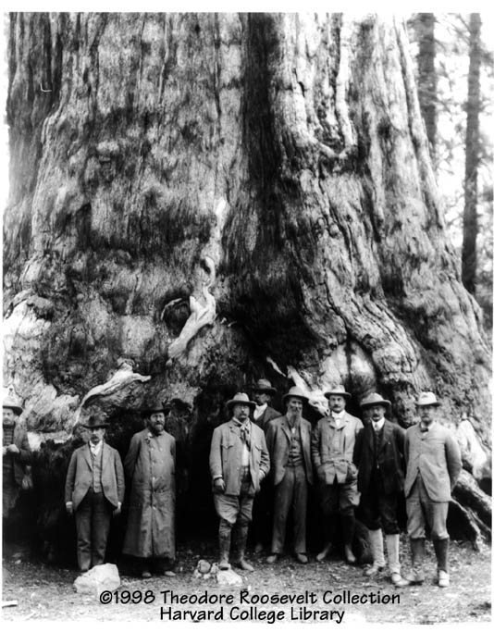
Roosevelt as Conservationist
National Parks, National Forests, game and bird preserves, and other federal reservations
230,000,000 acres
President Theodore Roosevelt at Yosemite in 1903.

Slide 42
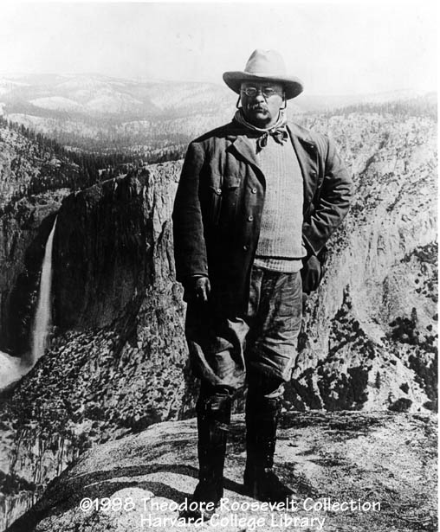
Roosevelt and National Parks
"Leave it as it is. You can not improve on it. The ages have been at work on it, and man can only mar it."

Slide 43
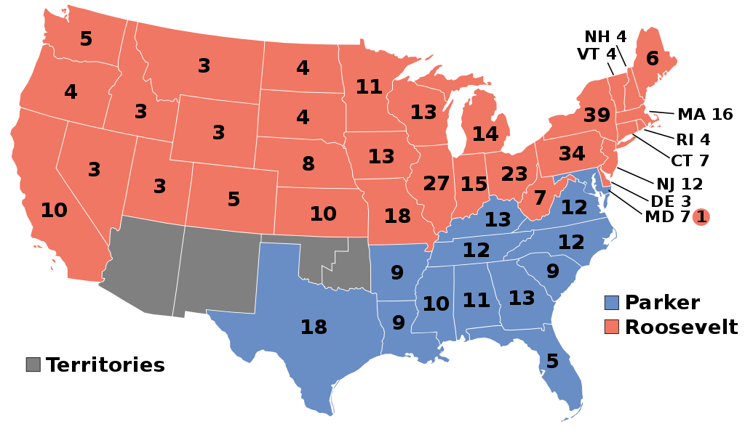
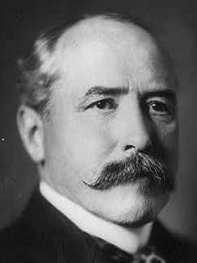
140
336

Slide 44
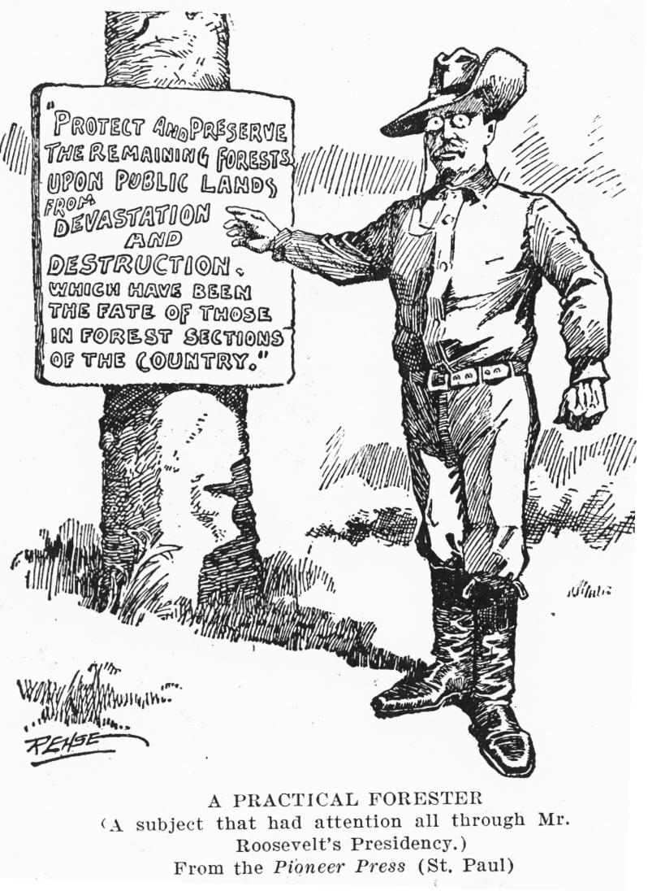

Slide 45
Attack on Laissez Faire
Worked to curb the power of trusts "within reasonable limits"
Roosevelt nicknamed the “Trust Buster”
Pure Food and Drug Act of 1906 (FDA)
Meat Inspection Act of 1906
8 hour days

Slide 46
Attack on Laissez Faire
Abolished slavery in Philippines
Safety requirements in businesses
Worker’s Compensation
Housing Commission to regulate quality Buildings
Federal Welfare for work

Slide 47
More Square Deal
Union Veterans receive 50% disability at age 62 regardless of health
Many new taxes for additional education funds
Rural Free Delivery postal Service
Elkins Act imposed heavy fines to RR businesses

Slide 48
Teddy Saves Football
Meeting of the Big Three
American Football Rules Committee was formed
Read handout… Answer
Who are the big 3?
How did Teddy change football?
How did Teddy save football?
Give 3 crazy facts you didn’t know before this.

Slide 49
Presidential Firsts
First to invite an African American to a White House dinner
First to have Secret Service protection
First to win Nobel Peace Prize for his work towards ending the Russo-Japanese War
Fighting over Manchuria after Boxer Rebellion
First to take trip outside the United States

Slide 50
More Presidential Firsts
First to give an open invitation to the press
First to be submerged in a submarine
First to own a car
First to have a telephone in his home
First to be allowed to operate the light switches in the White House

Slide 51
Teddy Mentors and Grooms Taft
After the 1904 election, Roosevelt stated that he would not run for president again.
Teddy asks country to elect his mentee and likeminded friend
Once Taft was elected in 1908, he based his administration on a more conservative business-centric and limited-government form of Republicanism.
This was in direct conflict with Roosevelt’s progressive vision for America.

Slide 52
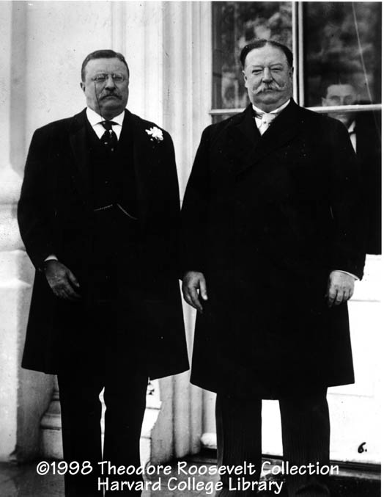
Roosevelt Hand Picks Taft
Theodore Roosevelt with incoming President & friend William Howard Taft on Taft's inauguration day in 1909.

Slide 53
Roosevelt & Taft
Roosevelt, displeased with his former protégé’s approach, ran for president in 1912 to unseat Taft.
When he couldn’t build significant support among Republicans, formed the Progressive, or Bull Moose Party.

Slide 54
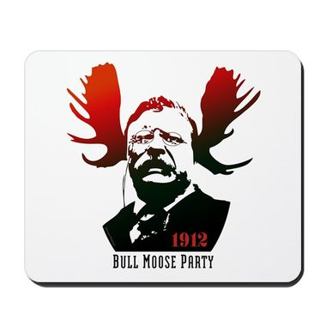
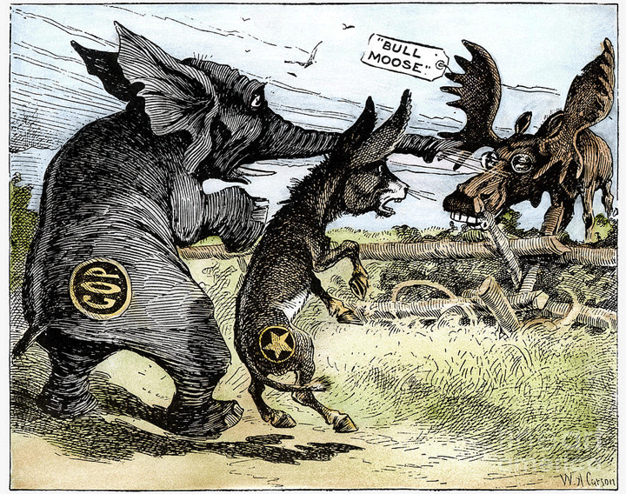
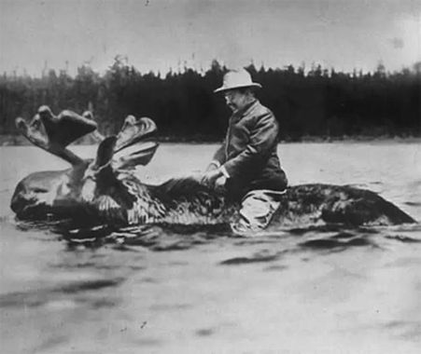
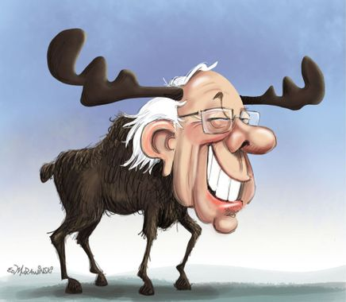
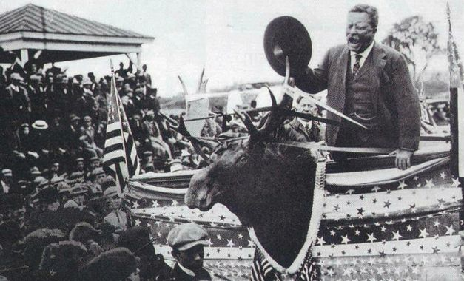
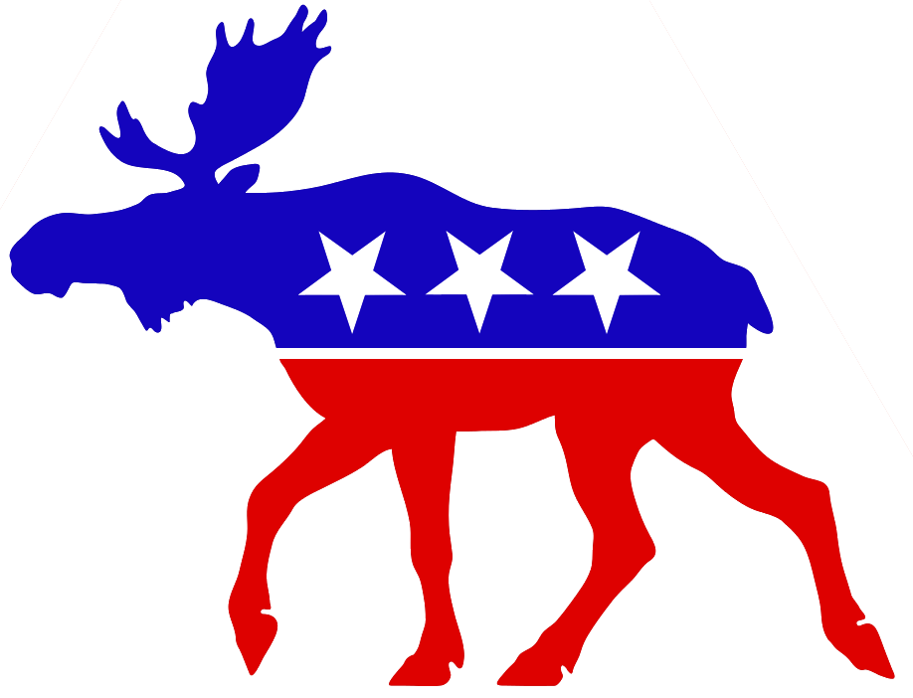

Slide 55
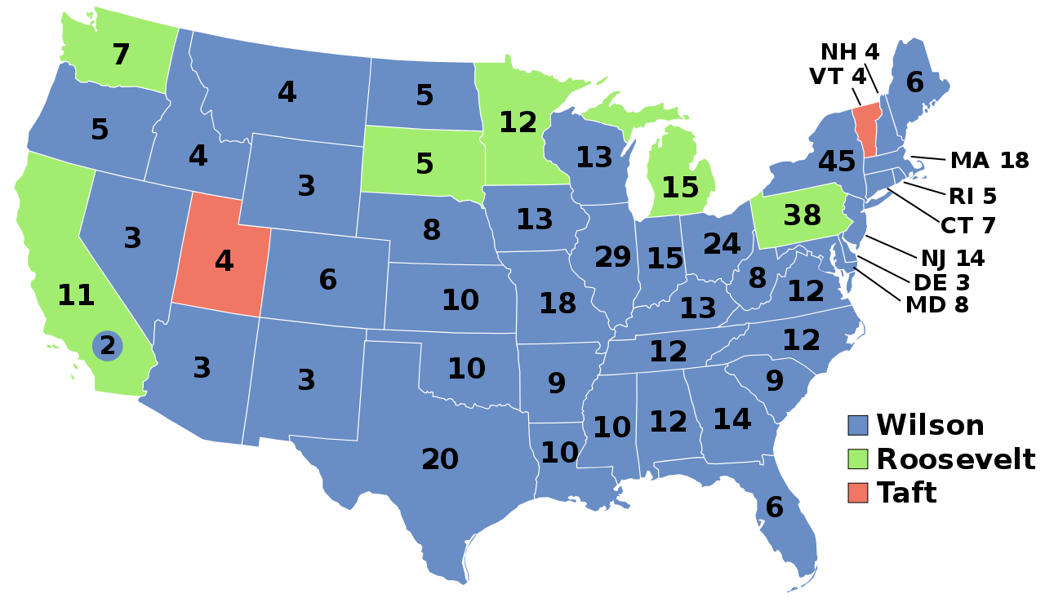
435
88
8

Slide 56
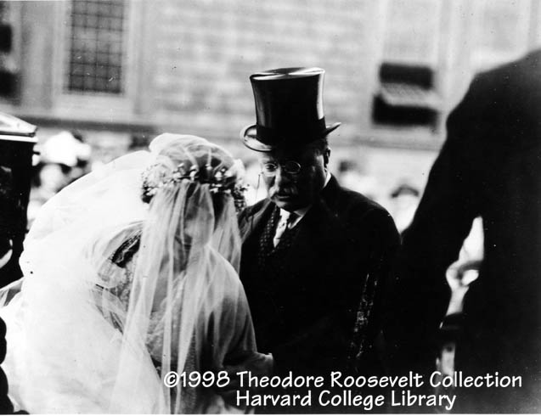
Roosevelt Loses to Wilson
The split resulted in the election of the Democratic contender, Woodrow Wilson in 1912.
Life goes on
Daughters Wedding

Slide 57
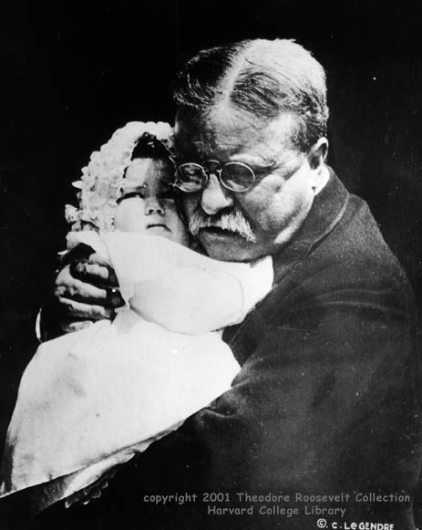
An Older Theodore Roosevelt
Agony over the death of Quentin in World War I
"Grandfather" Roosevelt hugs baby granddaughter Edith Roosevelt Derby, 1918.

Slide 58
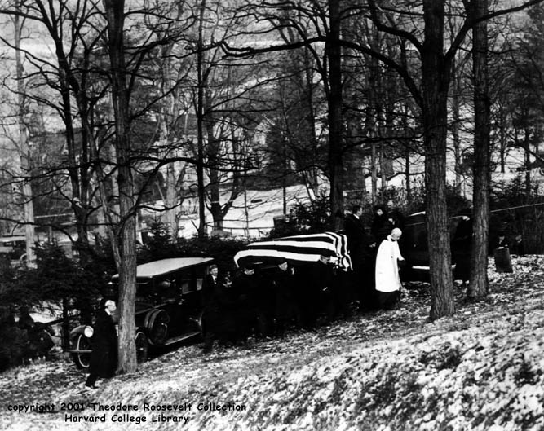
"The old lion is dead."
Photo shows the burial of Theodore Roosevelt, January 1919 in Young’s Memorial Cemetery, Oyster Bay, NY.

Slide 59
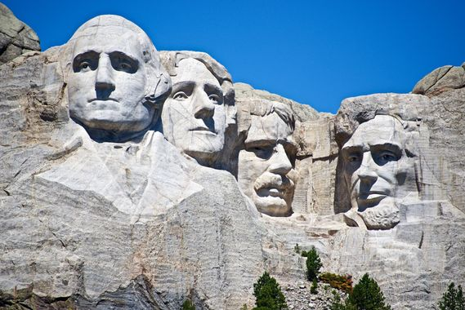

Slide 60
Legacy
Roosevelt was "a strong, effective executive whose policies foreshadowed the welfare state.“ & “If Roosevelt fell short of the first rank of president, he qualified for that ambivalent rating of 'near great.”
Historian Lewis L. Gould
Hero to modern Liberals
A 2018 poll of the American Political Science Association ranked teddy as the fourth greatest president in history, after George Washington, Abraham Lincoln, and Franklin D. Roosevelt.

