Slide 1
7th Grade World Geography
The Elements of Culture
Mr. Kilbourn

Slide 2
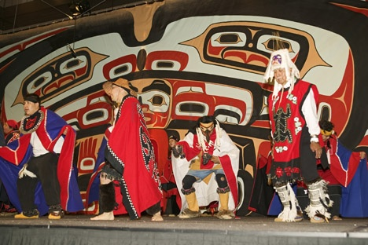
Defining Culture
Knowledge, attitudes, behaviors shared over generations is culture
Society is a group that shares geographic region, identity, culture
An ethnic group shares language, customs, common heritage

Slide 3
Culture Change and Exchange
Innovation is creating something new with existing resources
- Example: weaving baskets from reeds to solve storage problem
Spread of ideas, inventions, patterns of behavior called diffusion

Slide 4
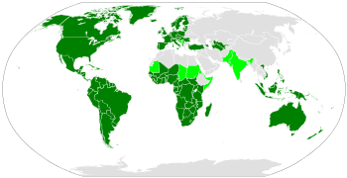
Culture Change and Exchange
Spread of ideas, inventions, patterns of behavior called Diffusion
Latin Alphabet

Slide 5
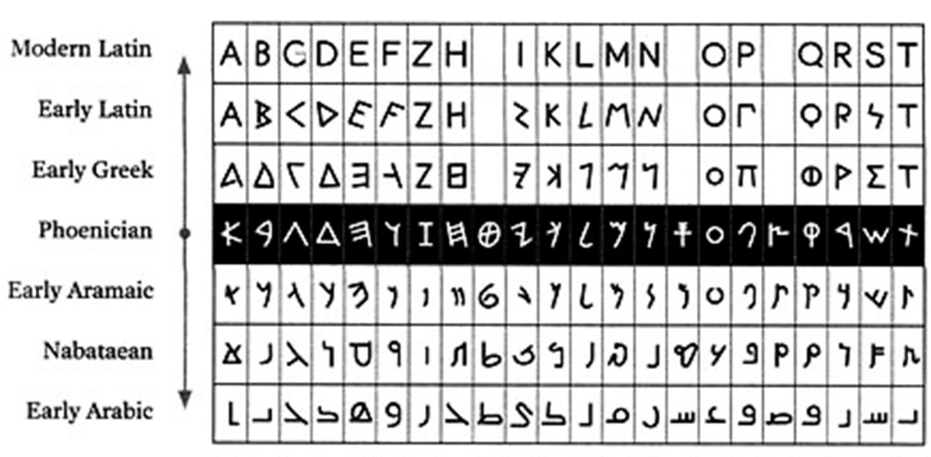
Culture Change and Exchange
Cultural Hearth—site of innovation; origin of cultural diffusion
- Example: Nile River civilizations in Africa
Acculturation—society changes because it accepts innovation

Slide 9
Language
Language enables people within a culture to communicate
Language helps establish cultural identity & unity
Language can also divide people, cause conflict

Slide 10
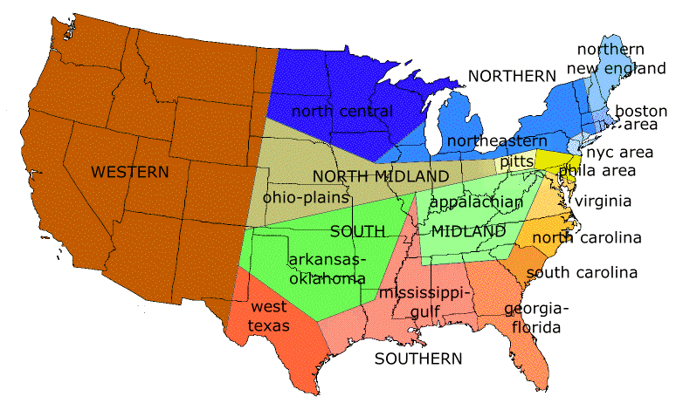
Language
Between 3,000 and 6,500 languages worldwide
- Similar languages belong to same language family
- Dialect—a version of a language, like Southern drawl
Language can spread via trade routes, migration

Slide 12
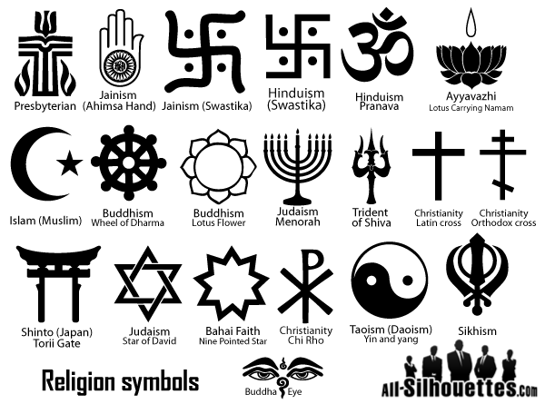
Religion
Religion—belief in supernatural power that made, maintains universe
Monotheistic faiths believe in one god
Belief in many gods called polytheistic
Animistic, or traditional, faiths believe in divine forces of nature
Religion spreads through diffusion and conversion
- Conversion—some religions try to recruit others to their faith

Slide 13
Major Religions
Judaism - Monotheistic; holy book called the Torah
Christianity -Evolved from Judaism; based on teachings of Jesus Christ
- Largest religion—2 billion followers worldwide

Slide 14
Major Religions
Islam - Monotheistic; based on teachings of Prophet Muhammad
- Followers, called Muslims, worship God, called Allah
- Holy book called the Qur’an

Slide 15
Major Religions
Hinduism - Polytheistic; evolved in India around 5,000 years ago
- Hindu caste system has fixed social classes, specific rites/duties
Buddhism - Offshoot of Hinduism; evolved around 563 B.C. in India
- Founder Siddhartha Gautama, called the Buddha, or Enlightened One
- Rejects Hindu castes; seeks enlightened spiritual state, or nirvana

Slide 16
