Slide 1
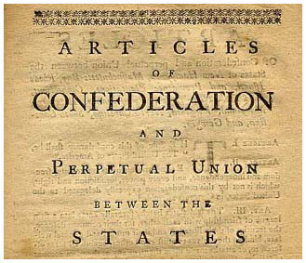
The Articles of confederation. Meh.
Mr. Kilbourn

Slide 2
Need a government…
Since the colonies were at war
Wanted a league of friendship among the states.
  Just left a strong central government, they wanted something different
Created a weak central government
More power t0 the states
The Articles of Confederation were ratified (approved)

Slide 3
The Articles of Confederation (AoC)
Created a unicameral legislature (one chamber)
Congress settled problems between states
Each state had one vote, regardless of size or pop.
The executives were chosen from congress
The national government only had those powers specifically listed such as
  Make war
  Maintain an army
  Missing something?

Slide 4
Not allowed to do that
The states had no intention of giving up power to any central government
Created problems
  The national government could not tax the states, borrow money from them, or ask for either…
    If you don’t have money, what can you do?
  Could not regulate trade
  The states did not have to follow laws made by the congress… State supersedes Federal
  State courts interpreted national law

Slide 5
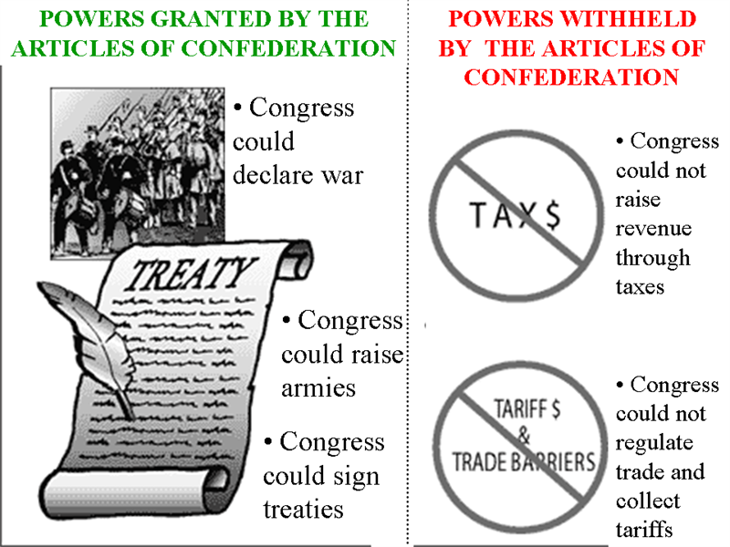

Slide 6
Ok, you got something right
Individual states gave up claims to western lands
  Ordinance of 1785 – allowed for the survey of the western lands (Toledo War)
  Ordinance of 1787 – divided the land into territories and set rules for becoming a state
Created a peace between the US and GB

Slide 7
C’mon people can’t we get along?
Soon states began to argue over boundaries and tariffs (taxes)
The national government owed lots of money
  This led to a depression
Shay’s rebellion (Massachusetts)
  Armed farmers marched to stop foreclosures
  Marched on the state capital
  Required the militia to put it down
Showed the need for a strong central govt.

Slide 8
Let’s do lunch
1785 - G W has a meeting with Md. and Va. to help settle a dispute
1786 - Virginia calls a convention to discuss trade
  All states were invited, only 5 showed up
  This highlighted problems with the AoC
Another convention in Philly was suggested
This sets the stage for a new constitution
  \o/ YAY!

Slide 9
GIT-R-DUN!
The convention began on May 25, 1787
  Every state except R.I. sent delegates
  74 were appointed
  55 attended
  39 signed
  Most of the delegates had political experience
George Washington’s presence showed people could trust the outcome
  He was chosen unanimously to preside over the convention
Madison is considered the father of the Constitution

Slide 10
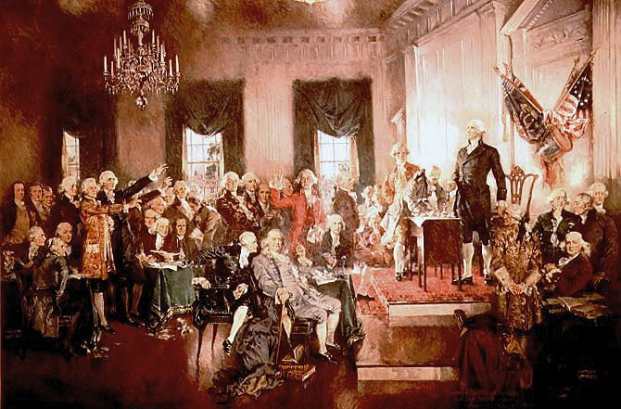

Slide 11
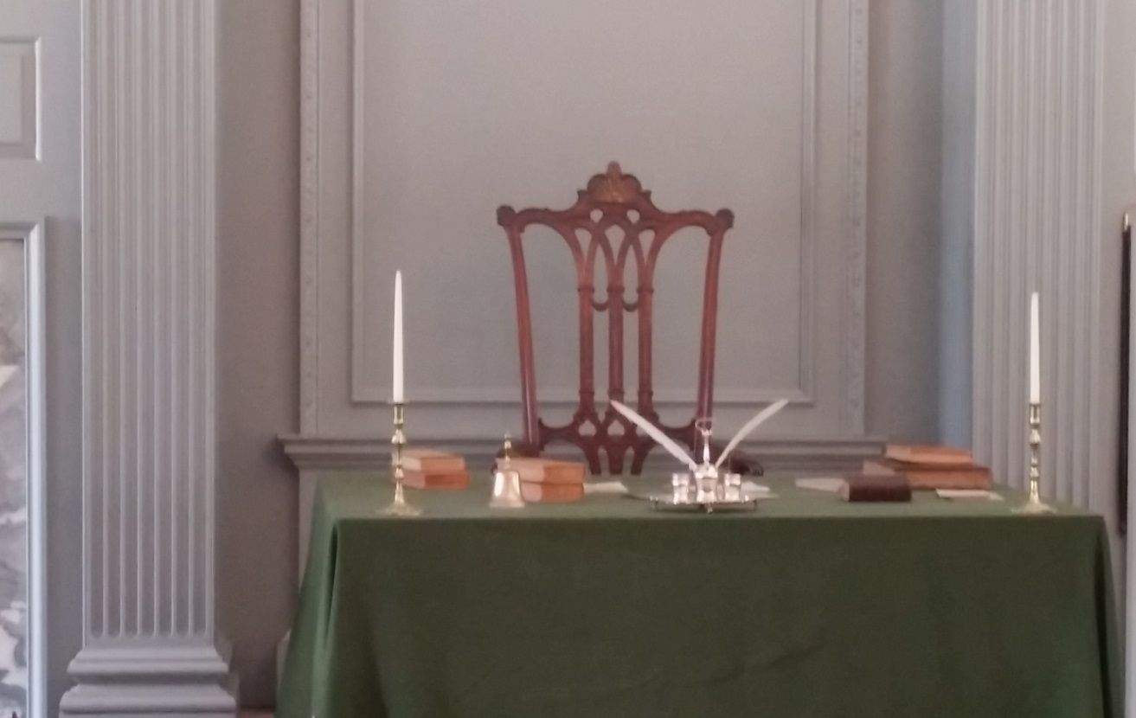
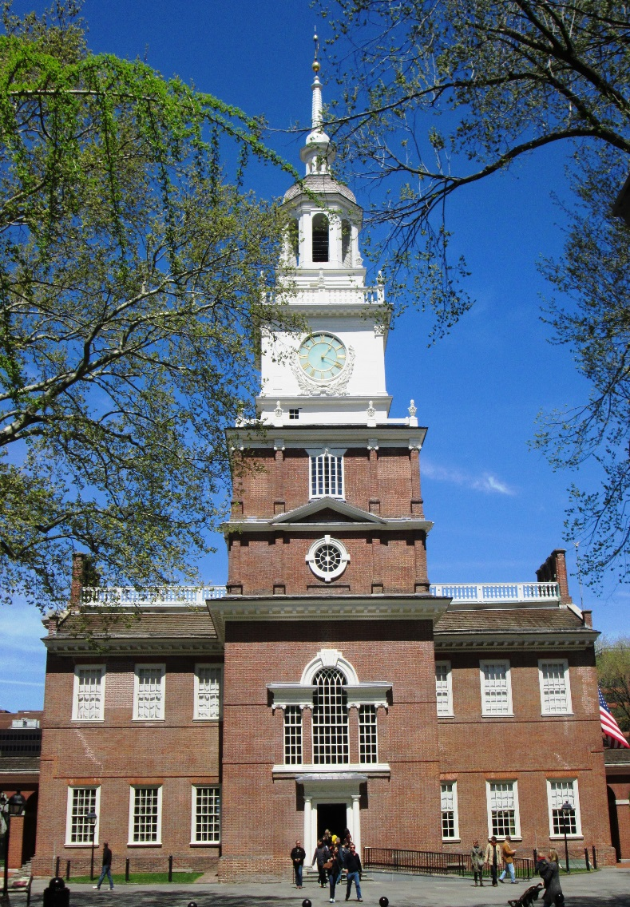
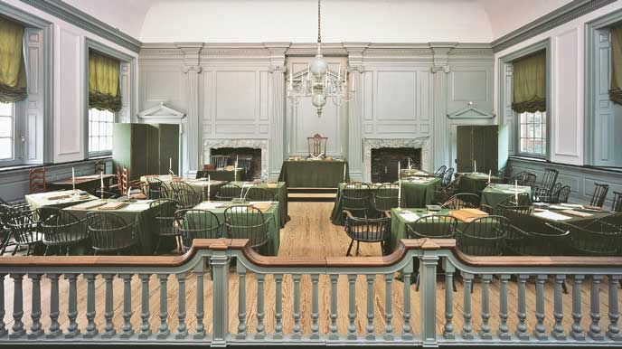
Independence
Hall

Slide 12
Harumph!
The delegates eventually agreed to abandon the AoC.
They favored
  Limited government
  Separation of powers
  Strengthened national government
While they agreed on basic issues there were bigger issues…

Slide 13
Choosing between the gorilla and the elephant in the room
One of the major issues was the representation in the new legislature
The Virginia Plan – proposed 3 major ideas
    Strong national bi-cameral legislature
    Lower house chosen by the people
  Upper chosen by the lower
  Strong national executive
  National judiciary chosen by legislature
Would give larger states more power
  Based on population

Slide 14
Choosing between the gorilla and the elephant in the room
The New Jersey plan
  Counterproposal to the Virginia plan
  Kept major features of AoC
  Unicameral legislature
  Gave power to tax
  Weak executive
  Equal Representatives per state regardless of size or population

Slide 15
Choosing between the gorilla and the elephant in the room
The main question became how would the states be represented.
  Should they be represented based on population?
    Virginia Plan
      Problem
  Should they all get the same number of representatives?
    New Jersey Plan
      Problem
Almost caused the convention to be broken up

Slide 16
I give a little, you give a little…
The Connecticut Compromise was introduced
Legislature would have two houses (bi-cameral)
  One house would be called the House of Representatives (H0R)
    All laws about money would start here
    Representation based on population
  Other house would be called the Senate
    Each state would get two members

Slide 17
Other compromises…
3/5 compromise – how to count slaves
  South – full count for reps, no count for tax
  North – no count for reps, count for tax
Congress could not ban slavery until 1808
Needed the south’s cooperation to pass the Constitution
So no ban on all slavery

Slide 18
Not again!
Arguments over the Constitution began again…
Federalists (C) v. Anti-Federalists (AC)
The F’s supporters came from the cities and merchants
The AF’s were mainly farmers

Slide 19
Yahuh, Nuhuh! Pinkie Swear
The AF’s argument against the constitution:
  Did not protect the rights of the people
    The F’s said the Govt did not have the power to do that
  Strong National Govt could harm the people and they demanded a Bill of Rights
F’s said:
  Strong government needed to protect the new country and provide order
  Rights are protected by the States
Pass the constitution and add BoR after.

Slide 20

All in favor say “Aye”
The Constitution came into effect when 9 states ratified it.
  NY & VA had not approved it yet
  N.C. initially rejected it but re-voted
Once it was all approved Congress met in NYC and GW took the oath of office.
Yaya… WPS!!!

Slide 21
