Slide 1
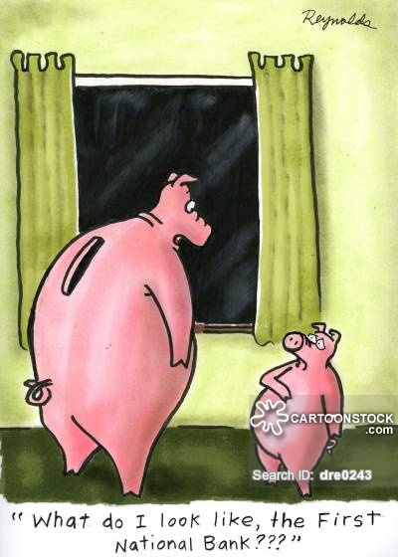
Going Into Debt
Mr. Kilbourn

Slide 2
Do you have any idea how much debt our country is in?
Stay tuned, this answer will come at the end of class.

Slide 3
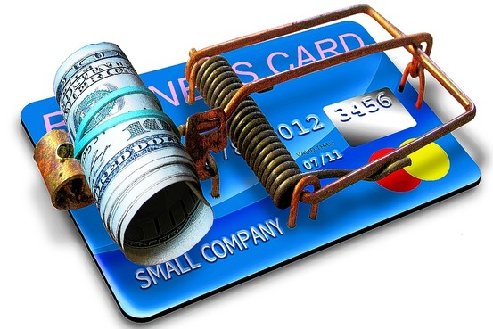
Americans and Credit
Credit – is the receiving of funds to buy goods or services with the promise to repay those funds in the future
Principal – amount of money originally borrowed in a loan
Interest – amount of money the borrower must pay for the use of someone else’s money

Slide 4
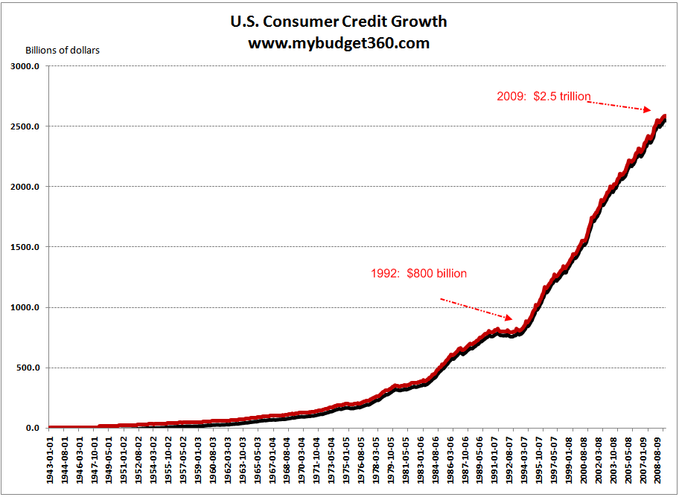
Installment Debt
Installment Debt – very common type of loan where you repay your loan with equal payments or installments over a period of time
Durable Goods – goods or items that have a life span of over 3 years
Automobile, Refrigerator, Washer, etc

Slide 5
Mortgage
Mortgage - Is an installment debt owed on real estate like a house, building, or land
Mortgages are the largest form of installment debt owed in this country

Slide 6
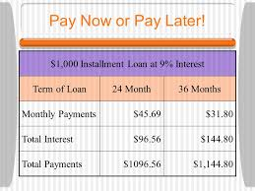
Length of Installment Period
Regardless of the type of installment debt the installment period is important in determining the size of the borrower’s monthly payments and the total amount interest that must be paid.
The longer the repayment period the smaller the monthly payments with the trade off being that the longer it takes to repay an installment debt, the greater the total interest will be.

Slide 7
Why People Use Credit
Ofttimes people buy with credit because they feel forced to buy an item immediately.
Deciding to use credit
The decision to use credit involves whether the satisfaction you get from the purchase is greater than the interest payment.
Is it worth paying $385 a month for 5 years on a $19,000 truck if it will only be worth $5,000 when I have it paid off for $23,100
1978 Ford Bronco

Slide 8
Checklist for buying with Credit
Do I really require this or can it wait till later?
If I pay cash, what will I be giving up that I could buy with this money?
Is this worth the interest I must pay if I do this?
Comparison Shop for the best credit deal.
Can I afford to borrow or use credit now?

Slide 9
Mike Huckabee
In January 2016, the U.S. national debt surpassed $19 Trillion
That’s $59,579.81 per man, woman, and child
$19,000,000,000,000

Slide 10
What are the advantages and disadvantages of repaying installment debt over a long period?

Slide 11
Sources of Loans and Credit:
Types of Financial Institutions
Commercial Bank – bank whose main function is to: accept deposits, lend money, and transfer funds. (Wide Range of services and Largest type of bank)
Savings and Loan Associations – Accept Deposits and Lend Money (usually focus on mortgages or Auto Loans and usually have better interest rates than Commercial Banks)
Savings Banks – set up to serve small savers that were overlooked by Commercial Banks (the poor): somewhat a thing of the past as a physical bank as many of these types of banks are now entirely online so that they can offer lower interest rates at the cost of offering less services

Slide 12
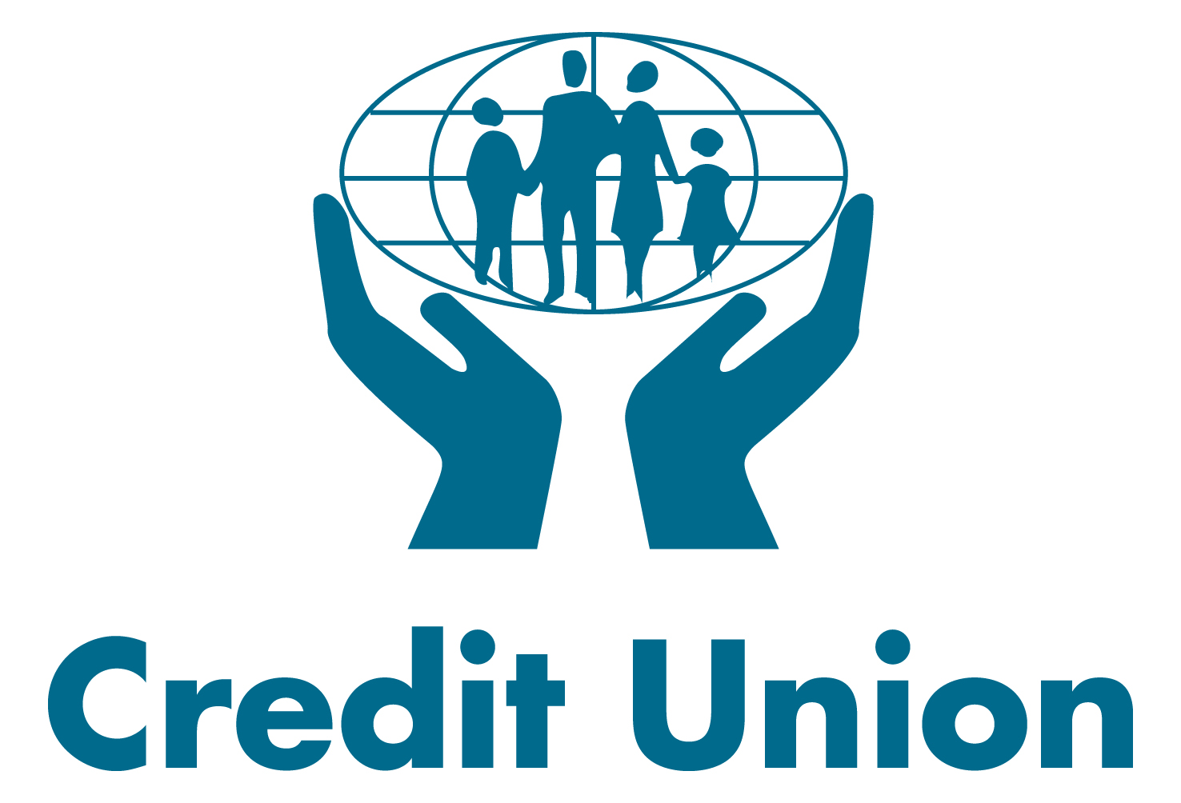
Types of Financial Institutions continued
Credit Unions – bank that is owned and operated by its members
FNBGF/ANSTAF – Checking Account is 72$ year… free at credit union if 400$ direct deposit, no paper statements, and 12 debits a month
Finance Companies – takes over contracts for installment debts for both businesses and individuals for a fee and at a higher interest rates

Slide 13
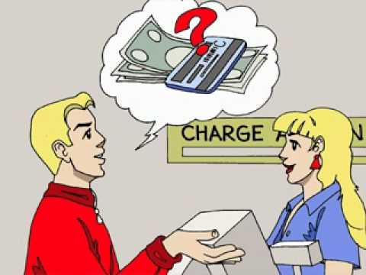
Charge Accounts
Regular Charge Accounts – credit extended by a company that will allow clients to receive goods/services with the promise that they will pay for them in full within a given time… 30 days
Revolving Charge Account – allows you to make additional purchases from the same store even if you have not paid the previous months bill in full. Usually you must pay a portion of say 1/5 of the amount due and the store will charge interest on the amount remaining at the end of the month.

Slide 14
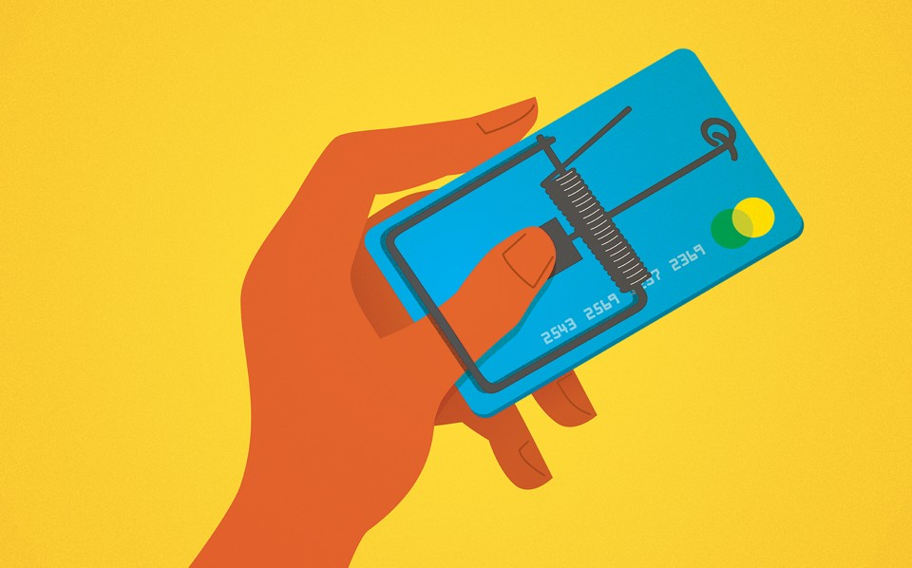
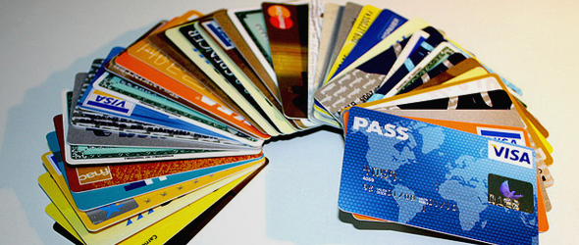
Credit Cards
Device that allows a person to make purchases on credit at many kinds of stores without paying cash

Slide 15
Finance Charges
Monthly amount due that includes all things… interest, membership fees, late fees, hidden charges, etc.
It is what you pay monthly with all fees included expressed in dollars & cents

Slide 16
Annual Percentage Rates (APR)
Finance Charge x 12
Cost of credit expressed as dollars and cents in 1 year with all costs included

Slide 17
Debit Cards
Not based on credit, debit cards transfer real funds electronically from a persons checking account directly to whoever is selling the goods/services that are being bought

Slide 18
What would be the APR if you charged $1,000 on a credit card whose interest rate was 20% with an annual fee of $30?

