Slide 1
National and State powers
Mr. Kilbourn

Slide 2
The powers, a review and beyond…….
Constitution grants three types of powers
Expressed
Implied
Inherent
Express (enumerated)
Specifically found in the Constitution
Articles 1-3
Are 27
Example “The Power to tax and spend for the defense and general welfare of the U.S.”

Slide 3
The powers, a review and beyond…….
Implied ➔ not specifically listed but depends on the expressed powers
Comes from Art 1 §8 Cl. 18
Allows the government expand its authority
The Bank's existence is a great example of implied powers: the Constitution doesn't say that Congress has the right to establish a bank, but its defenders claimed that one was necessary to carry out the Congress' power to collect taxes.

Slide 4
Inherent ➔ power that can be used because it’s the government
are those powers that Congress and the president need in order to get the job done right.
Example: an Executive Order
Reserved ➔ powers saved to the states
States have power over things not specifically granted or found in the constitution
Example: Education, Drinking Age, State Taxes, Licensing, etc.

Slide 5
Supremacy clause ➔State laws can’t conflict with federal law
States cannot use reserved powers to interfere with the constitution
Since local gov’t is a creation of the state they must follow the same rules as the state

Slide 6
Concurrent Power ➔power the state and federal government can both use
Example: the power to tax, build roads, establish bankruptcy laws, and to create lower courts
Denied Power➔ power that can’t be used
Example: deny Freedom of Religion, Speech, Press, Assembly, Speed & Public Trial, States cannot enter into a Treaty with a Foreign Nation, States cannot Print Money, States cannot tax the Federal Government, etc…

Slide 7
What the Feds do for the states
Provide Republican form of Government (Indirect Democracy)
i.e. representative gov’t
Enforced by congress
Allows representatives and senators to take their seat
Post civil war Congress refused to allow southern states to take their seats
Central Government must protect the states from attack (Provide National Security)
President has authority to send troops to put down domestic disorder when asked
No asking necessary when federal laws or responsibilities are violated

Slide 8
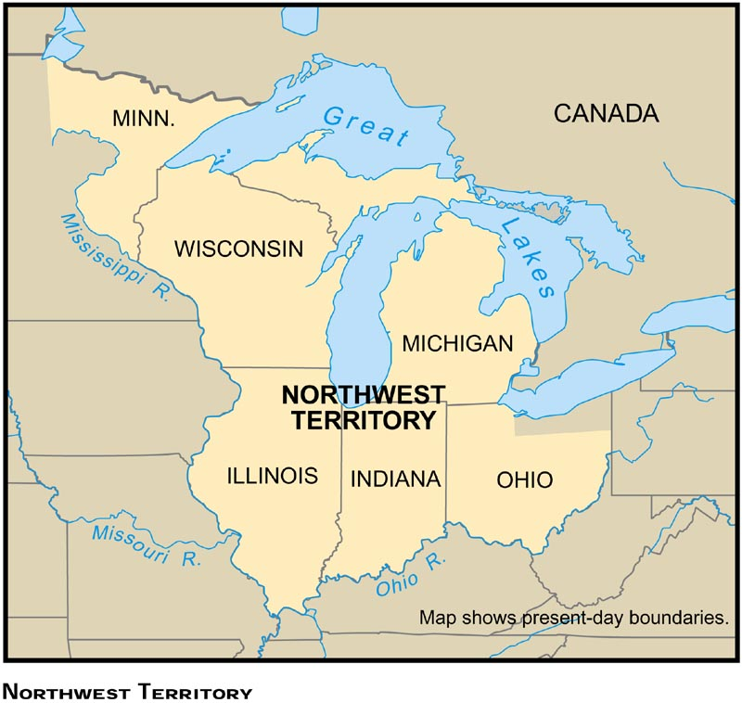
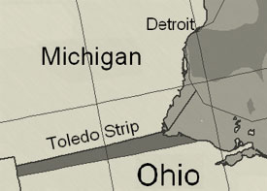
Territorial Integrity
Respect the boundaries of an existing state’s territory
Example: Cannot use existing state to make a new state w/o said states permission

Slide 9
Admitting a new state
This power is held by Congress but limited
Can’t use existing states without states permission
President can veto admission
Once a state is admitted it is considered equal to all others
Bound to support the constitution

Slide 10
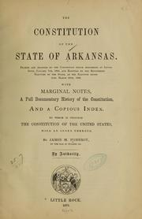
Admitting a new state
Procedure
Congress passes an Enabling Act
This allows the people to make a state constitution
President signs or vetoes the Enabling Act
People create the state constitution and vote on it
Constitution is submitted to Congress for approval
If Congress agrees an act is passed admitting the new state

Slide 11
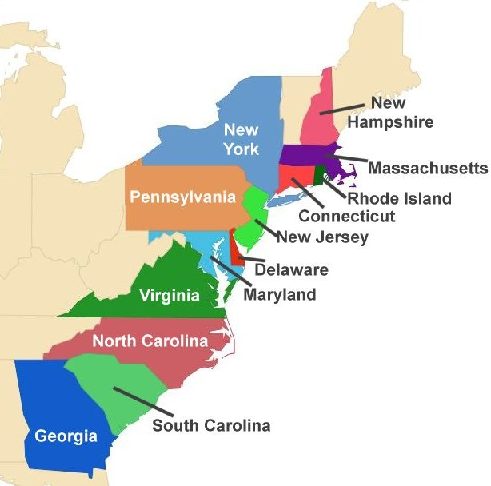
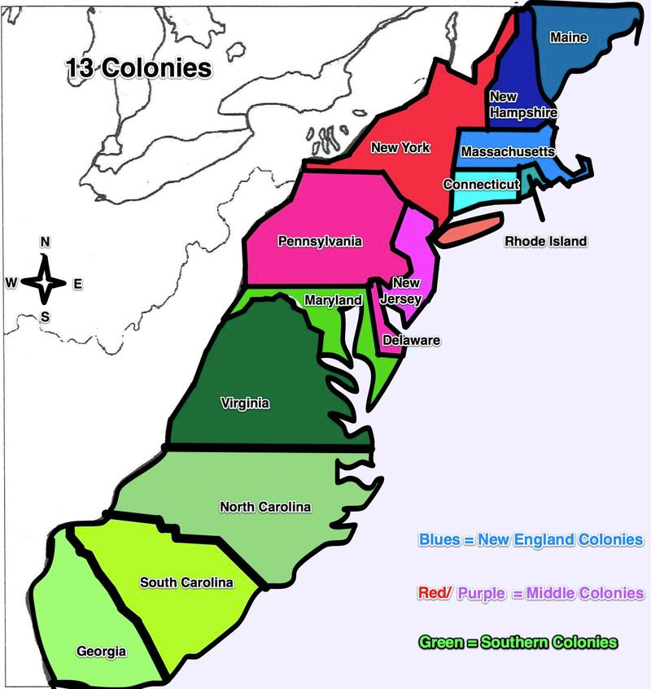
Exceptions to the rule
West Virginia
A minority of people in Virginia wanted to break away during the Civil War
Violation?
Said the minority was acting as the Virginia legislature and gave permission
Texas
Already independent
Admitted by a joint resolution of Congress
Alaska/Hawaii ➔ Created a constitution w/o Enabling Act. Admitted in 1959

Slide 12
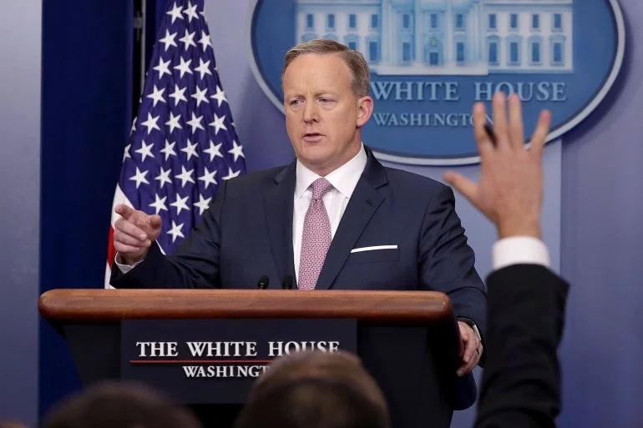
So what do the states do?
National Governor’s Association
Helps state policy making
Seminars/Publications on
Organizing the office
Dealing with the press
Help influence national policy by focusing on
Education
Welfare
Health care reforms

Slide 13
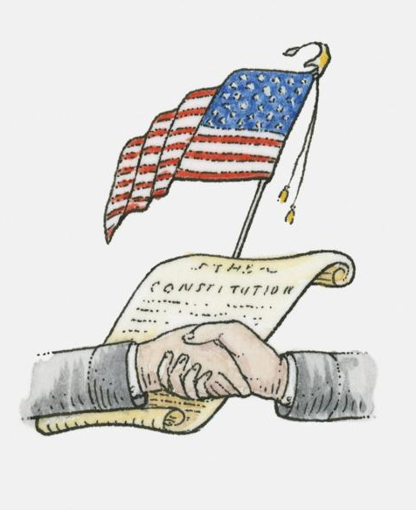
States gotta do this
Conduct and pay for national elections
States can set time/places/manner for the election of Congress
But Congress can alter this if they want
Help amend the constitution

Slide 14
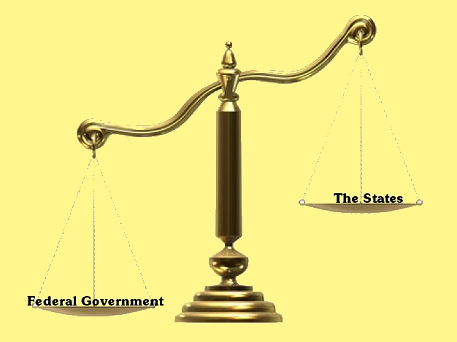
Role of the Courts in this
Federalism divide power, there are going to be disputes
The Supreme Court helps settle these
McCulloch v. Maryland 1819 ➔ When state laws conflict with Federal laws, the Federal wins. Also widened the power of Congress w/ implied powers
The balance has shifted over the years…
Federal judges can also review the actions of state and local officials

