Slide 1
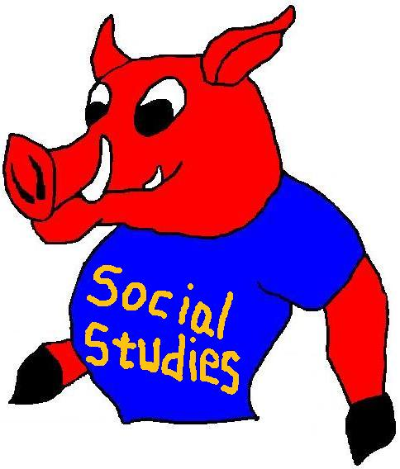
U.S. Politics
Voting, Political Parties, Mass Media
Mr. Kilbourn

Slide 2
Political Parties
There are many political parties in the United States today (Republicans, Democrats, Greens, Libertarians)‏
Political Parties were formed by people that held similar views on how the new United States government should be run.
First Parties: Antifederalist and Federalists
Today the two main parties: Republicans and Democrats

Slide 3
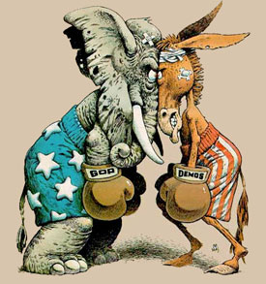
Elephant vs. Donkey
Republicans
Whites, Pro
Non-union workers
Small rural areas
Suburban/rural voters
Conservative groups are considered principle supporters of this party.
Limited Government
Limit govt. programs if govt. is seen as too big
Conservatives
Democrats
union members, metro areas
Minority Groups
Big government
involvement in socio economic affairs
Focus on rights to privacy and certain personal freedoms over other aspects of our govt.
Liberals

Slide 4
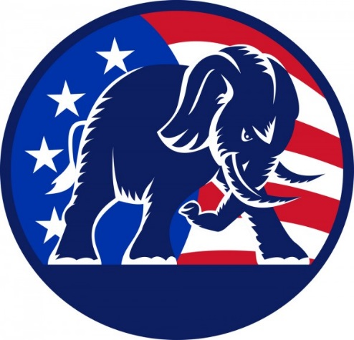
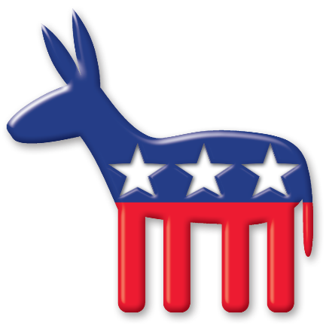
Both Parties
Both parties include individuals with widely differing ideologies.
Viewpoints can be similar and overlap.
Some controversial public policy issues, certain groups tend to go along with one political party or another.
In national elections, followers have changed parties causing party control to change in many areas.

Slide 5
Must be careful in analyzing differences between the two parties not to over generalize.
However, by studying trends due to certain events, one can identify general patterns of party composition.

Slide 6
Public Opinion
Attitudes held by significant number of people on matters of government and politics.
Expression of public opinion can take place in many ways: spoken, written, protests, film, etc.
Public opinion is formed by family, mass media, school, occupation, race, etc.

Slide 7
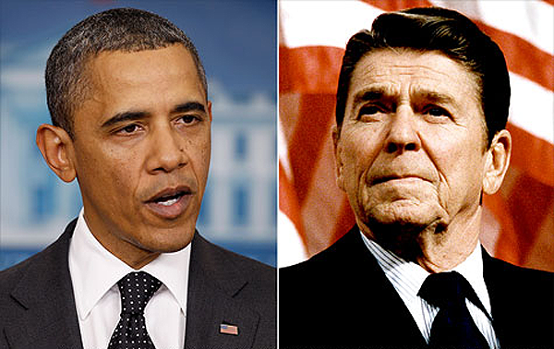
Mass Media
Means of communication that reach large, widely dispersed audiences simultaneously. It is used to influence people and present people with political information.
Newspapers, Internet, radio, TV, magazines
Sound bite: snappy reports that are short and sharply focused.
Public opinion can be measured through: elections, interest groups, polls, media

Slide 8
Interest Groups
They are private organizations that try to persuade public officials to respond to the shared attitudes of their members.
They stimulate interest in public affairs and serve as a vehicle for participation in the political process.
They use propaganda to influence
Lobby: put pressure on the legislature to change or make laws.

Slide 9
Types of Interest Groups
Business Groups ( U.S. Brewers Assoc)‏
Labor Unions (AFT)‏
Agricultural (National Grange)‏
Professional Groups (American Medical Assoc)‏
Religious Groups
Groups that promote a specific cause (Right to Life, Mothers against Drunk Driving)‏

