Slide 1
Chapter 15
Sports!
Ashley Jones, Mr. Kilbourn

Slide 2
Definition of Sport
for most people, sport consists of certain leisure activities, exercise, and spectator events
Sport- a set of competitive activities in which winners and losers are determined by physical performance within a set of established rules
-many forms of recreation do not involve sport.

Slide 3
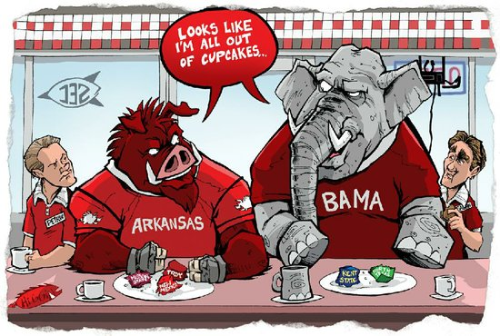
Sport as a Social Institution
Institutions fulfill certain basic needs and reflect the most important aspect of a society
The five most commonly recognized social institutions have been examined in preceding chapters: family, education, government, economic systems, and religion
Sports teach some of the basic values of society

Slide 4
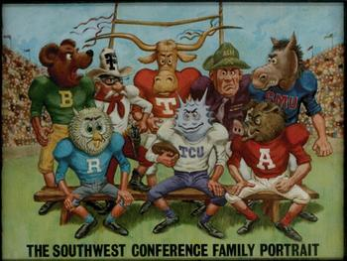
Sport Subcultures
the relationship between sport, society, and culture can also be seen in sport subcultures
sport subculture- a group with distinct roles, values, norms, and beliefs that is organized around a sport activitiy

Slide 5
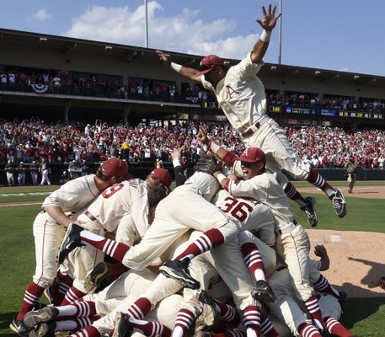
Theoretical Perspectives and Sport
Sport is a major social activity through which culture is created and reinforced
Sport teaches basic beliefs, norms, and values
Sport promotes a sense of social identification
Sport offers a safe release of aggressive feelings generated by the frustration, anxieties, and strains of modern life
Sport encourages the development of character

Slide 6
Does sport really promote social mobility??
Participating in sport increases the likelyhood of improving a person's place in the stratification structure
Whatever sport they play, college athletes tend to be better educated, earn more money, and have higher occupational prestige than their fathers
In these terms, college athletes as a whole are more successful than college students who do not participate in sport

Slide 7
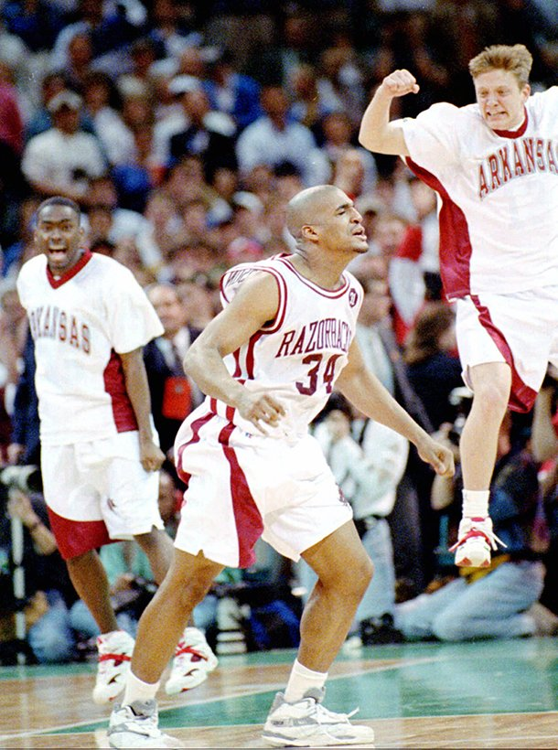
Sport and Racism
stacking-assigned of players to less central positions on the basis of race or the ethnicity
such discrimination has important economic consequences, because the positions occupied by most black athletes have high injury rates that cut careers short

