Slide 1
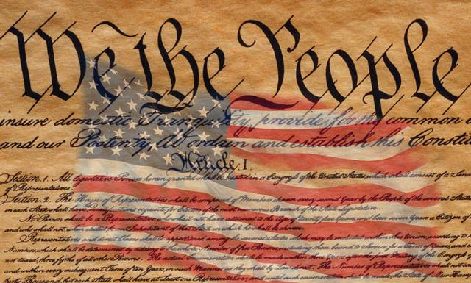
The Constitution and Federalism
Mr. Kilbourn

Slide 2
In the beginning
The Preamble
Explains why the Constitution was written
Lays out the beliefs what gov’t would do
Articles
7 Main divisions of the Constitution
Creates the branches of gov’t
Lists the powers of each branch

Slide 3
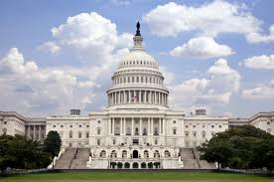
Article i
Creates the Congress
House Representatives
Senate
Procedure for making a law
Spells out the powers
What powers they don’t have

Slide 4
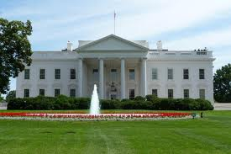
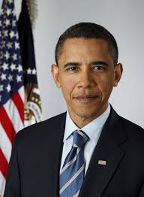
Article ii
Creates the executive branch
Power shall be vested in the President
Qualifications
Elections of the office
Powers

Slide 5
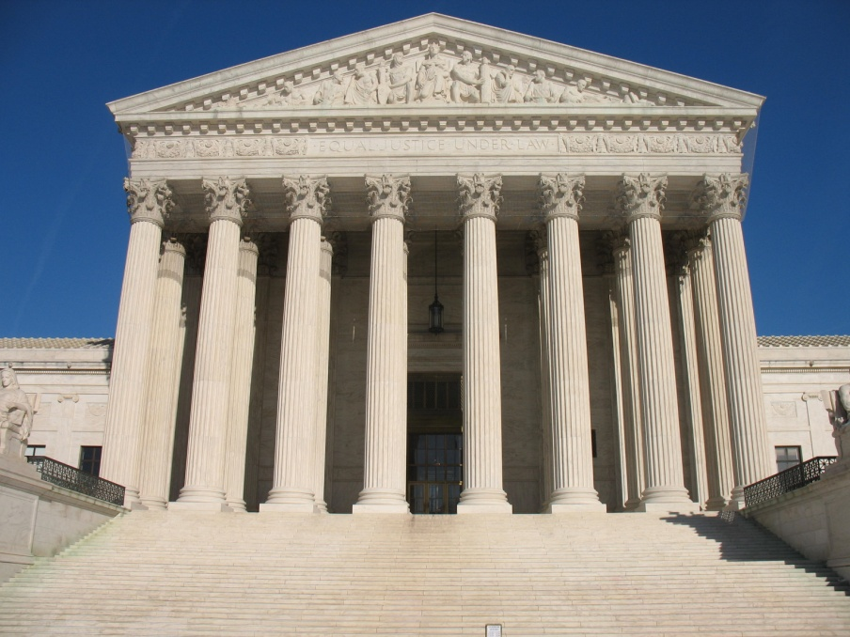
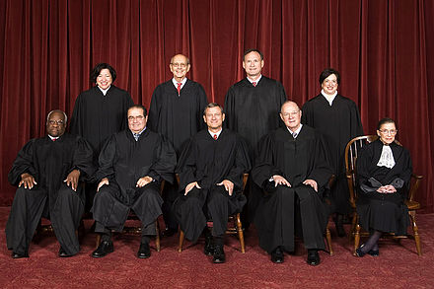
Article iii
Creates the Supreme Court
Congress to create lower courts as needed
States the jurisdiction of the Court
Authority to hear a case

Slide 6
Articles iv & v
IV describes the relations of the states to each other and to the Federal Gov’t
States recognize the legality of acts in other states
Admitting new states
V describes the amending of the Constitution

Slide 7
Article vi, Vii
The Supremacy Clause
Laws passed by Congress, under the Constitution, are superior to laws passed by the State
VII Constitution is in effect after 9 states ratify

Slide 8
6 Principles of the constitution
Popular Sovereignty
Consent of the governed
The people hold the ultimate power
Separation of Powers
Each Branch has its own powers and responsibilities
Checks and Balances
Each branch can check the powers of the others

Slide 10
6 Principles of the constitution
Federalism
Powers are divided or shared between the National and State gov’t
Exclusive powers
Concurrent power
Power can be either enumerated, denied, or delegated
Judicial Review
SCOTUS can declare a law unconstitutional
Comes from Marbury v. Madison
Limited Government
Can only use those powers given

Slide 11
Comparing systems of government

Slide 12
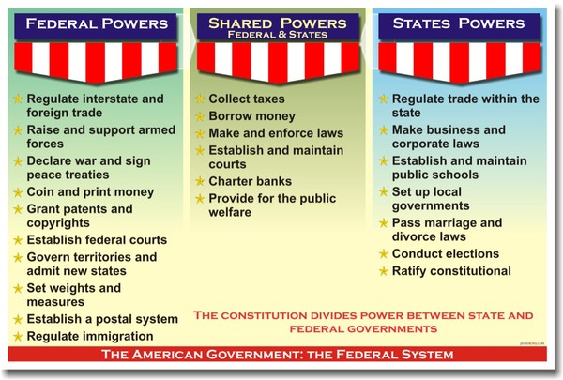
Powers

