Slide 1
The Family
Chapter 11

Slide 2
Family- a group of people related by marriage, blood, or adoption
ex. people living together in same household; sharing space
Nuclear Family- family structure
composed one or both parents and
children
ex. parents and children
Two types of family
Extended family- two or more adult
generations of the same family whose
members share economic resources
and a common household
ex. grandparents, grandchildren, aunts, uncles, or cousins

Slide 3
There are three arrangements of inheritance.
Patrilineal- descent and inheritance is passed through the male line
ex. the males get the objects in the family
Marriage- a legal union based on mutual rights and obligations
ex. marriage ceremony states that it is legal for them to start a family together
matrilineal- descent and inheritance is passed through the female line
ex. the females get the objects in the family
bilateral- descent and inheritance are passed equally through both parents
ex. the objects are split

Slide 4
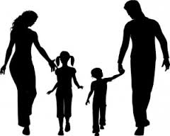
in the family who has authority??
patriarchy- the pattern in which the oldest man living in the household has authority over the rest of the family members
matriarchy- the pattern in which the oldest woman living in the household has authority over all other family members
equalitarian- family structure in which authority is evenly shared between the husband and wife

Slide 5
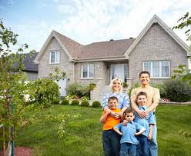
where do couples live??
patrilocal- refers to the pattern in which married couples live with or near the husbands’ parents
matrilocal- refers to the pattern in which married couples live with or near the wives’ parents
neolocal- refers to the pattern in which newly married couples set up their own households

Slide 6
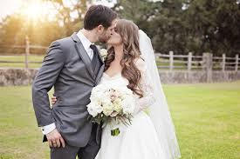
marriage arrangements
monogamy- a marriage consisting of one man and one woman
polygamy- the marriage of a male or female to more than one person at a time
polygyny- the marriage of one man to two or more women at the same time
polyandry- the marriage of one woman to two or more men at the same time

Slide 7
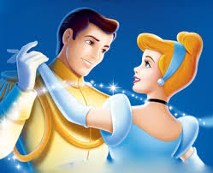
choosing a mate
exogamy- the practice of marrying outside one’s group
ex. different social classes
incest taboo- a norm forbidding marriage between close relatives
ex. marrying a close cousin
endogamy- marriage within one’s own group as required by social norms
ex. same social class, same race, or tribe
homogamy- the tendency to marry someone similar to oneself by personal choice
ex. marrying someone from the same social class
heterogamy- marriage between people with differing social characteristics
ex. marrying someone of a different race; ethnicity

Slide 8
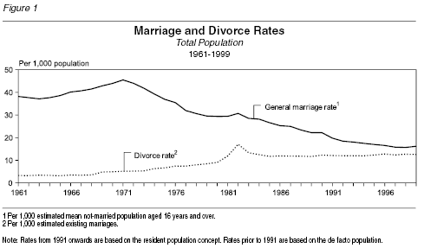
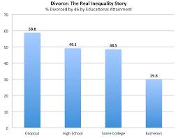
socioemotional maintenance- provision of acceptance and support
ex. where one is loved unconditionally and cared for
marriage rate- the number of marriages per year for every one thousand members of a population
divorce rate- the number of divorces per year for every one thousand members of the population

Slide 9
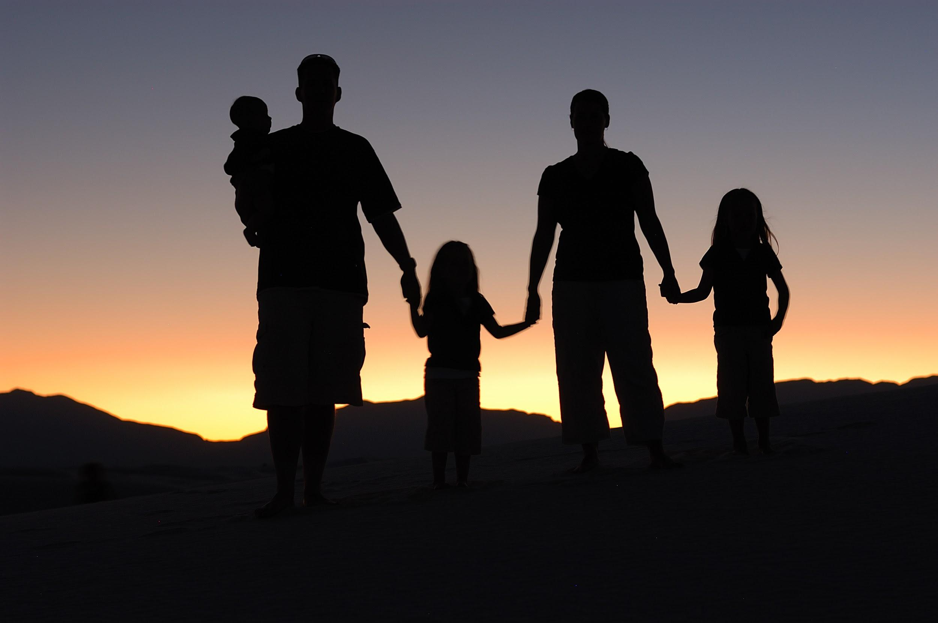
Other useless vocabulary
adolescents- youths from the ages of twelve to seventeen
ex. teenagers
boomerang kids- adult children who return to the home or origin or who continue to live with parents
ex. college dropout/high school dropout
cohabitation- a marriage like living arrangement without the legal obligations and responsibilities of formal marriage
dual employed marriages- marriages in which both spouses work outside the home
blended family- a family formed when at least one of the partners in a marriage has been married before and has a child or children from a previous marriage
ex. either having a step-father and step- brother or sister; having a step-mother and step-brother or sister

Slide 10
The
End

