Slide 1
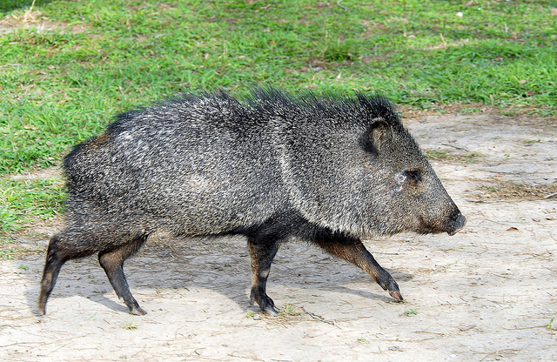
The Geography
of
Latin America
Mr. Kilbourn

Slide 2
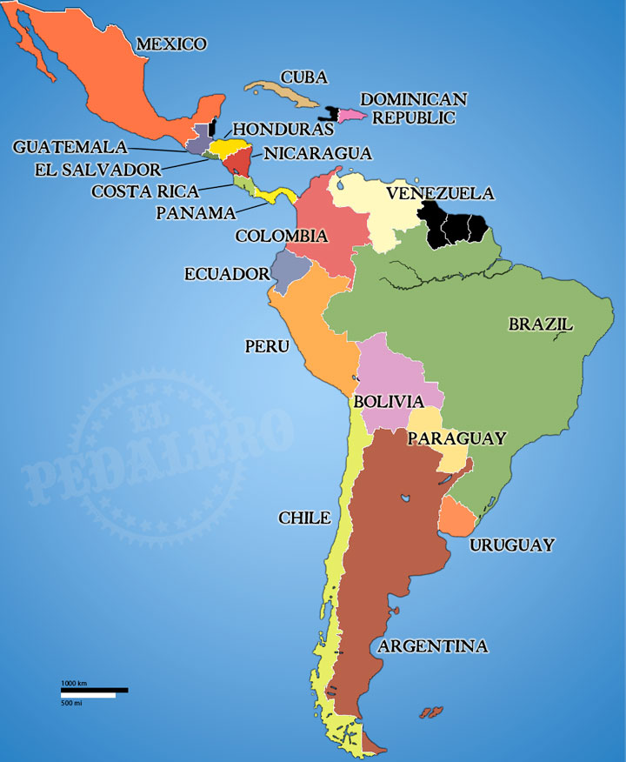
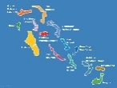
Bahamas
This is Latin America.
Latin America is NOT a continent.
Latin America is NOT a country.
Latin America IS a cultural Region.

Slide 3
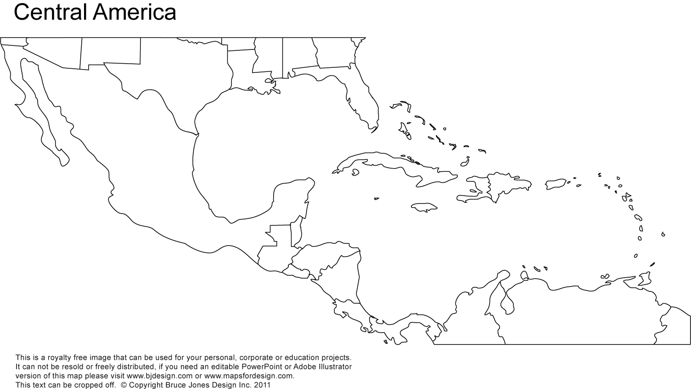
Mexico

Slide 4
Belize
Guatemala
Honduras
Nicaragua
Costa Rica
El Salvador
Panama

Slide 5
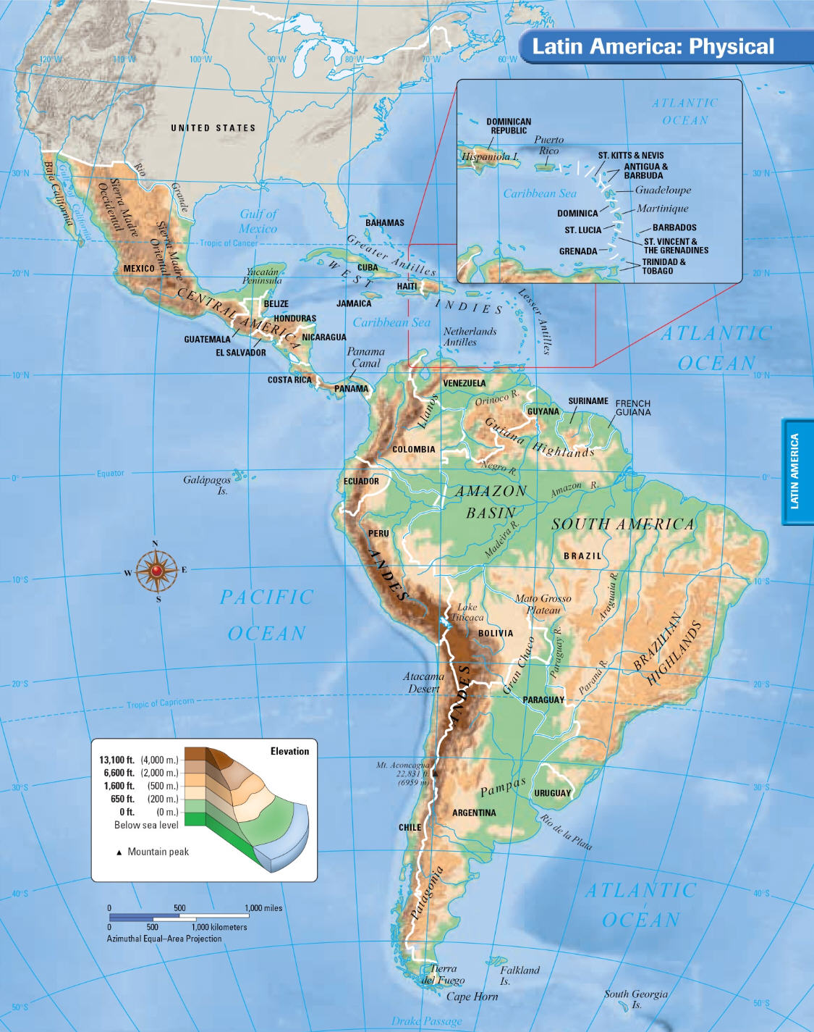
Latin America stretches for 5,500 miles from the Rio Grande River in Mexico to Cape Horn at the southern end of South America.

Slide 6
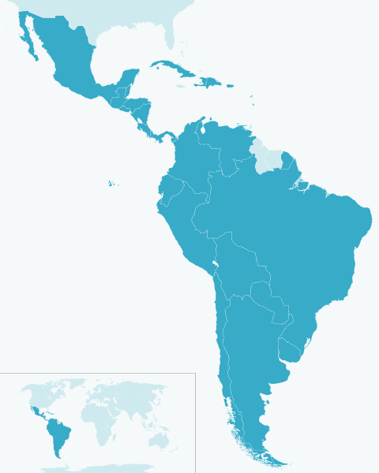
Latin America lies between the Pacific and Atlantic oceans. Both oceans are important trade routes for Latin America. The Caribbean Sea is another important body of water in Latin America.
CARIBBEAN SEA
ATLANTIC OCEAN
PACIFIC OCEAN

Slide 7
The Rio Grande
The Rio Grande is a good example of how a river can be a physical barrier between two countries. Part of the Rio Grande is a border between the United States and Mexico.

Slide 8
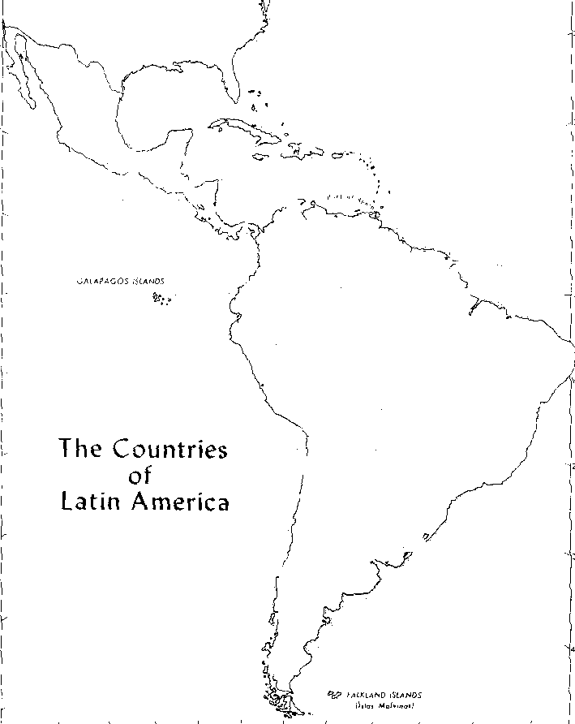
Subregions
There are two sub-regions of Latin America.
“MIDDLE AMERICA”
-Mexico
-Central America countries
-Island nations in the Caribbean
SOUTH AMERICA
-12 countries
-2 foreign ruled territories

Slide 9
Bahamas
Puerto Rico
Cuba
Dominican Republic
Jamaica
Haiti

Slide 10
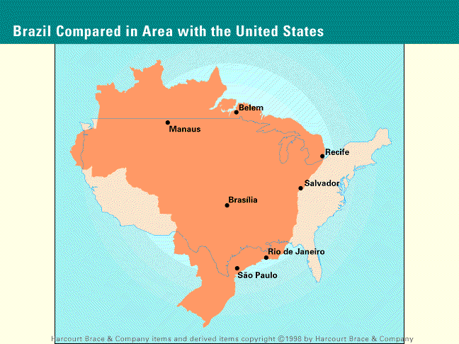

Slide 11
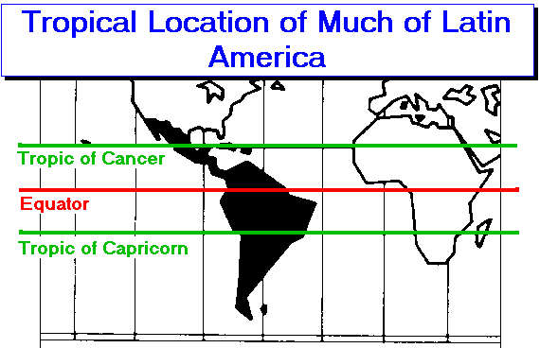
The Tropical Hemisphere

Slide 12
Most of the Latin America is made up of mountains or highlands.
HIGHLANDS - A mountainous or hilly section of a country
MOUNTAINS – land that is at least 2000 ft high

Slide 13
La Cordillera
Rocky Mountains
Sierra Madres
Andes
La Cordillera is the main mountain chain extending from the Rocky Mountains in Canada and the United States, through the Sierra Madres in Mexico and Central America, and along the western coast of South America. In South America, these mountains are known as the Andes.

Slide 14
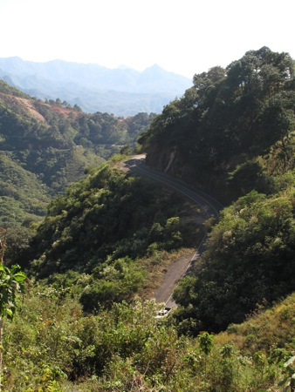
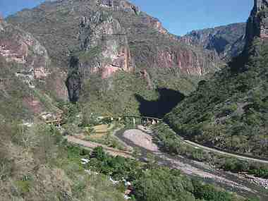
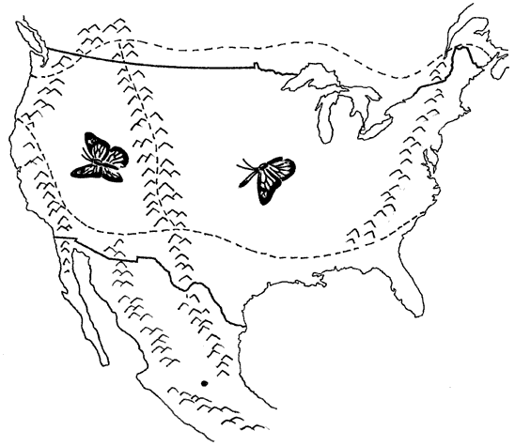
SIERRA MADRES
In Mexico the Sierra Madres mountains split into the Sierra Madre West and Sierra Madre East.
SIERRA MADRES EAST
SIERRA MADRES WEST

Slide 15
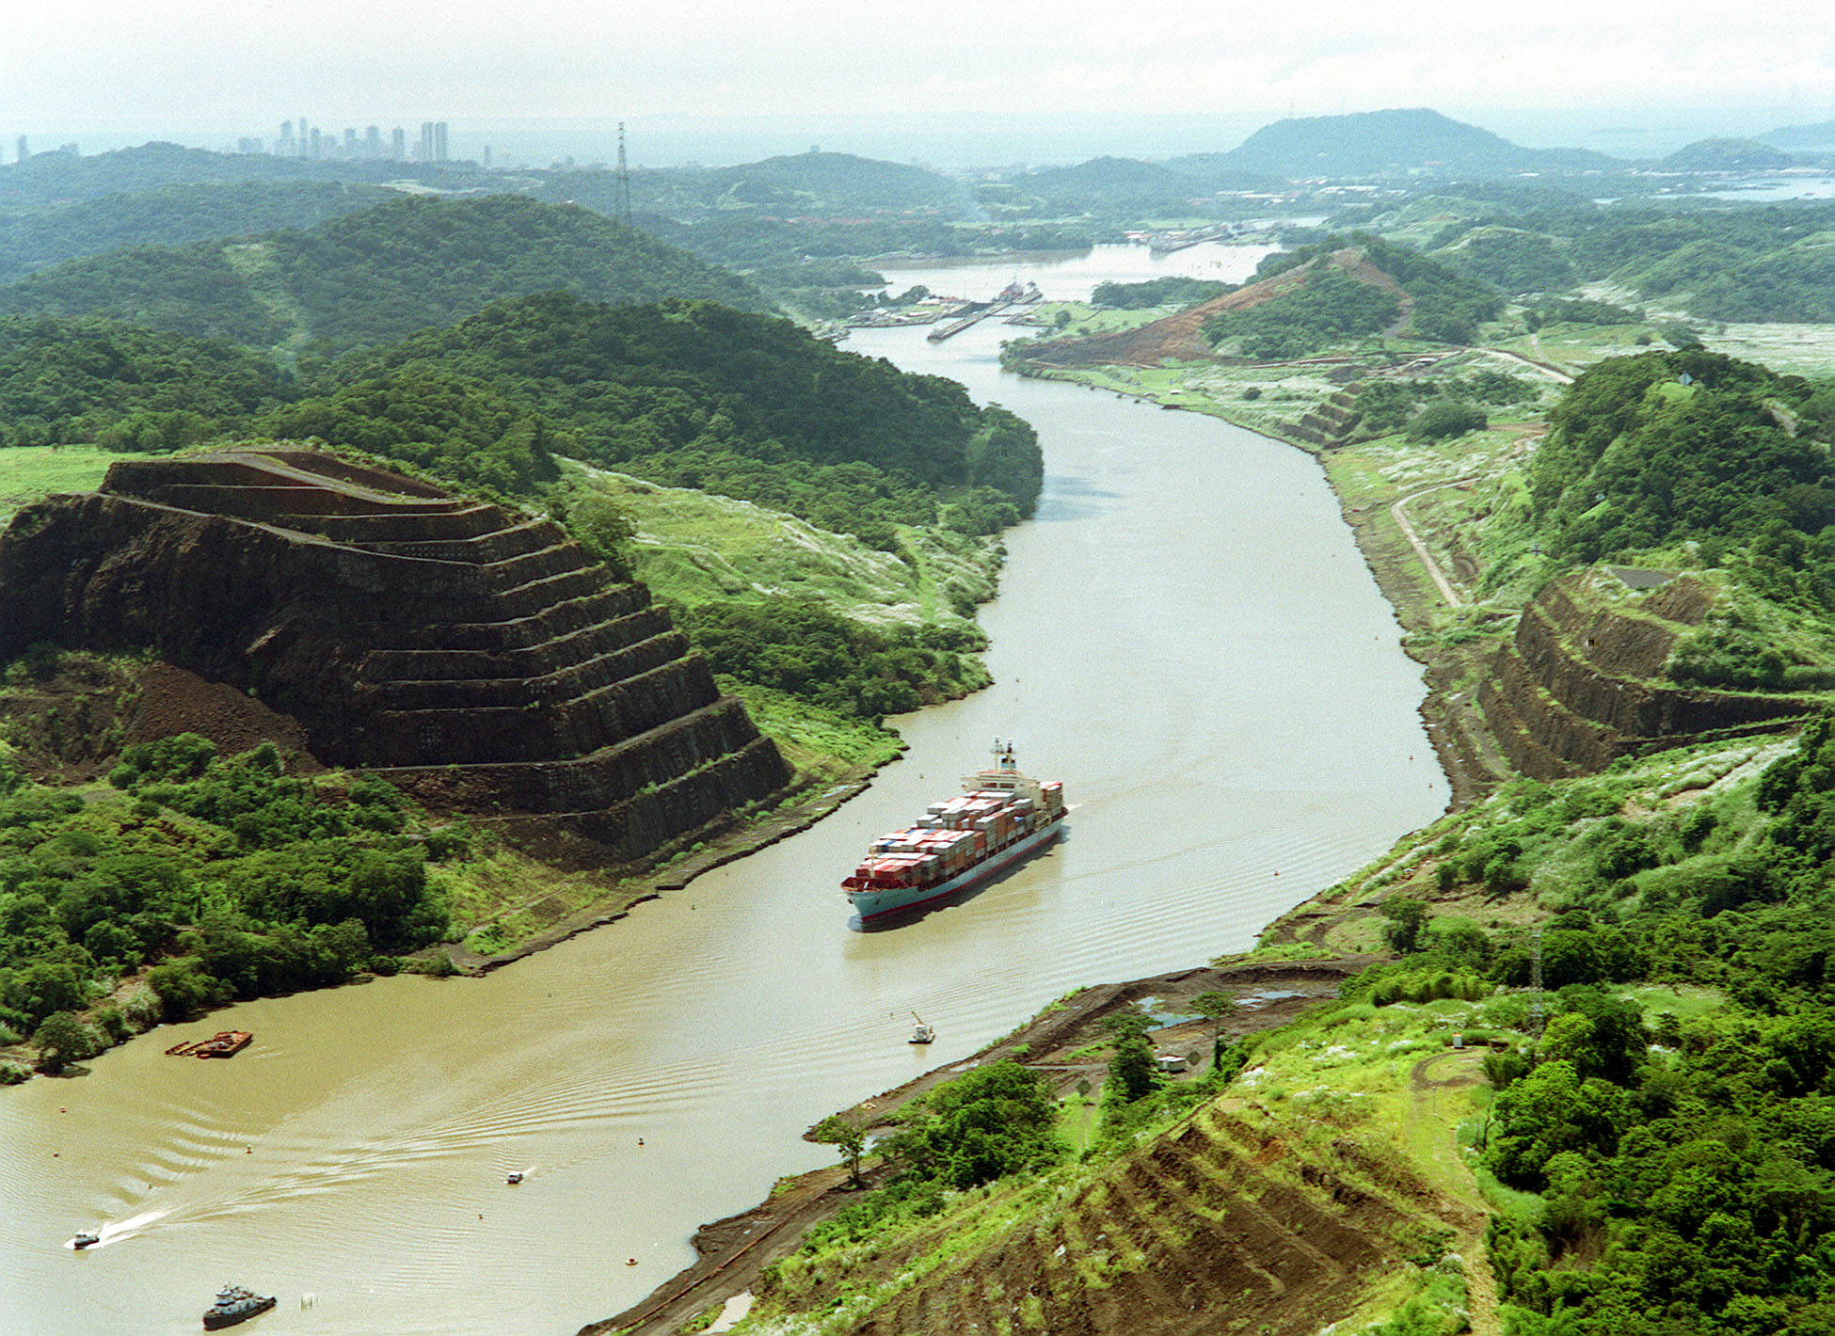
The Panama Canal

Slide 16
The Panama Canal
The Panama Canal is an important waterway that cuts through the isthmus of Panama. The canal is human made and was completed in 1914. The canal eliminated the long trip around Cape Horn, the southernmost tip of South America. It is 45 feet deep.

Slide 17
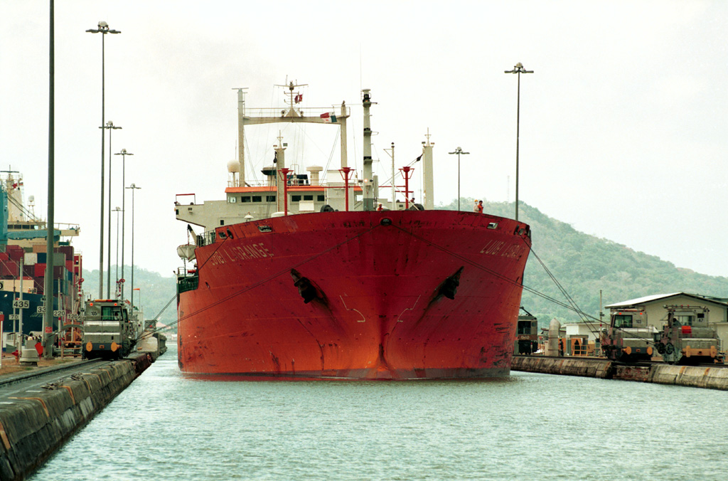
Going Through the Panama Canal

Slide 18
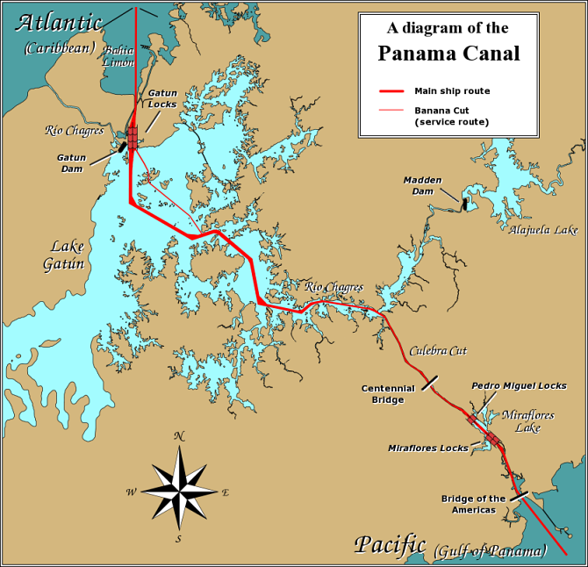

Slide 19
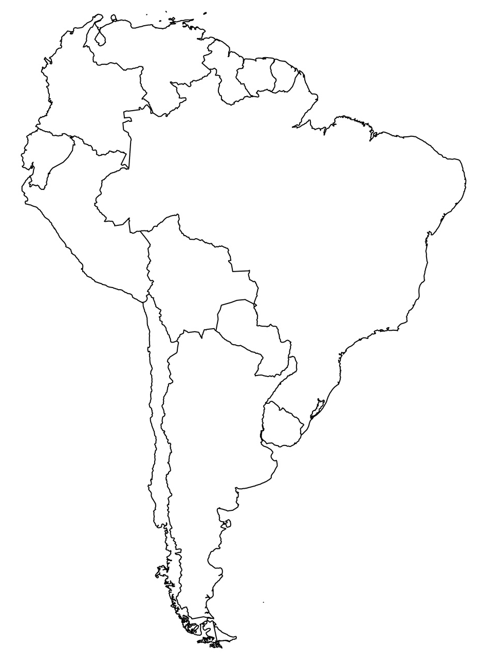
Argentina
Bolivia
Brazil
Chile
Columbia
Ecuador
French Guiana
Guyana
Paraguay
Peru
Suriname
Uruguay
Venezuela
13
8
11
7
5
6
3
10
2
9
4
1
12

Slide 20
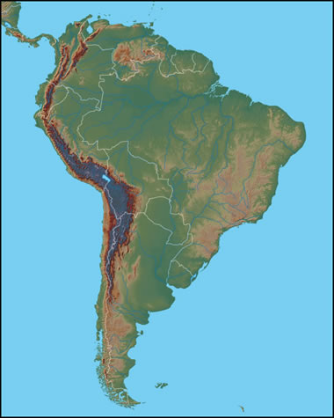
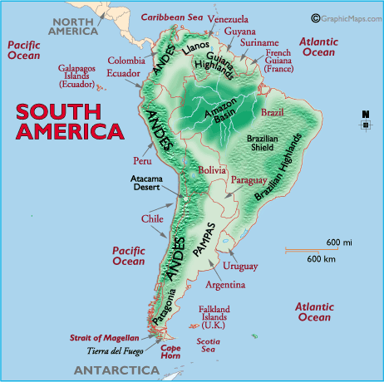
The Andes are the longest mountain range in the world and, the 2nd highest mountains in the world.
ANDES MOUNTAINS

Slide 21
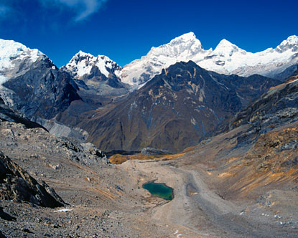
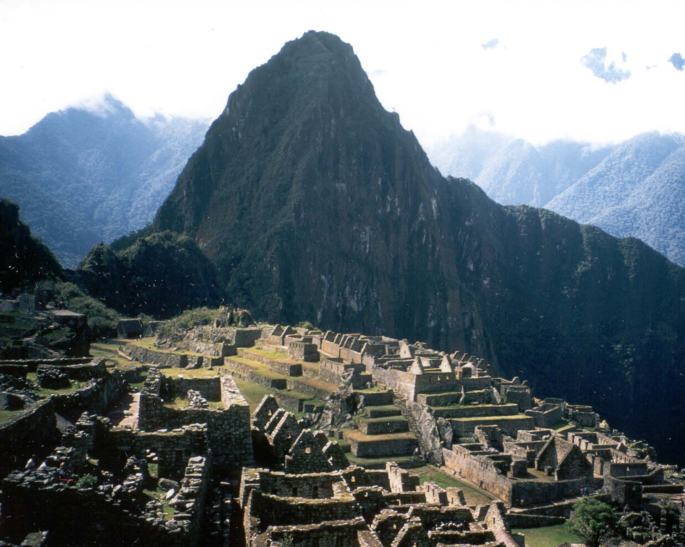
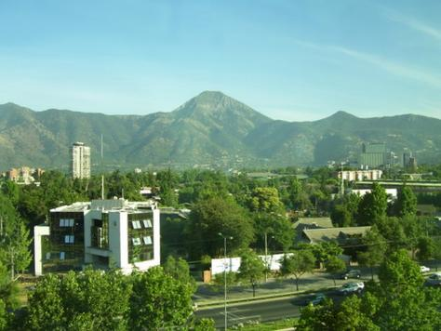
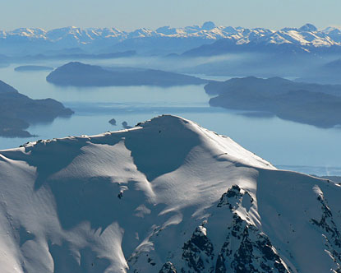

Slide 22
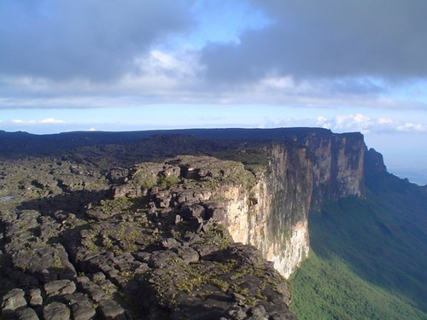
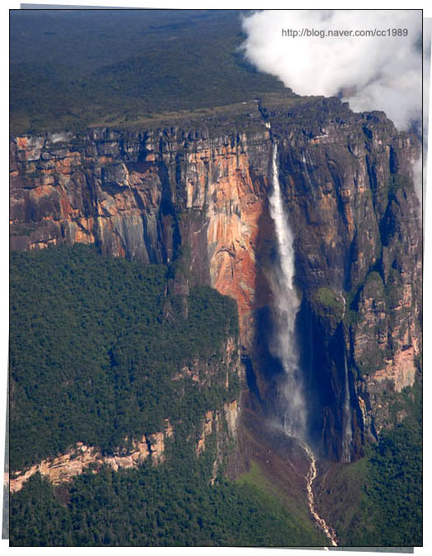
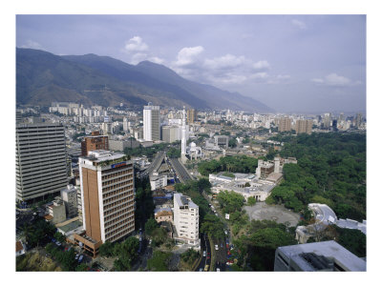
GUIANA HIGHLANDS

Slide 23
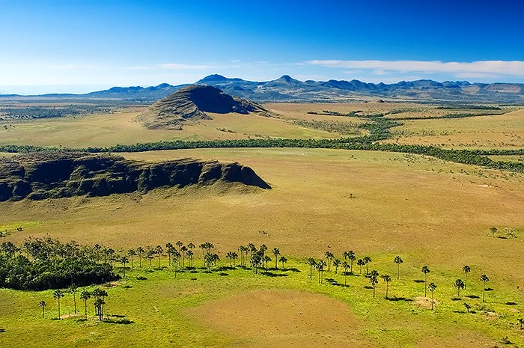
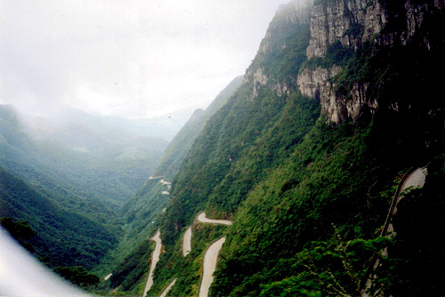
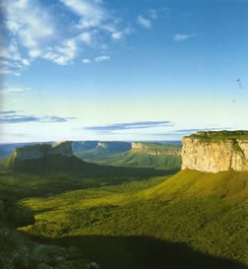
BRAZILIAN HIGHLANDS

Slide 24
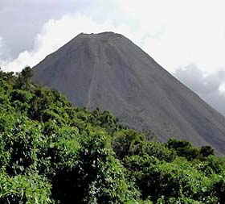
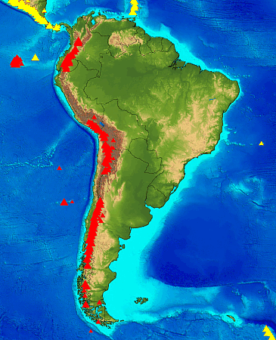
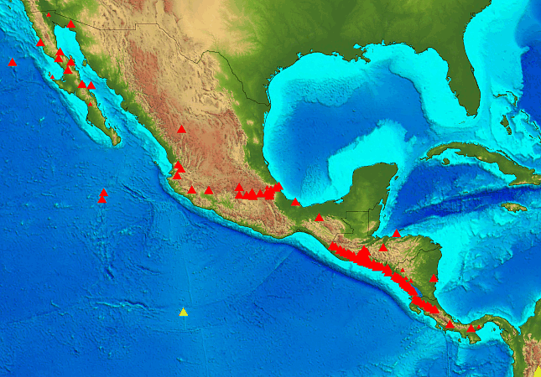
VOLCANOES

Slide 25
Natural Disasters
Latin America has many earthquakes and volcanoes because part of it is located on the Ring of Fire. In general, Peru, Ecuador, Chile, and the west coast of Mexico have many active volcanoes. The Caribbean Sea also has many volcanoes.

Slide 26
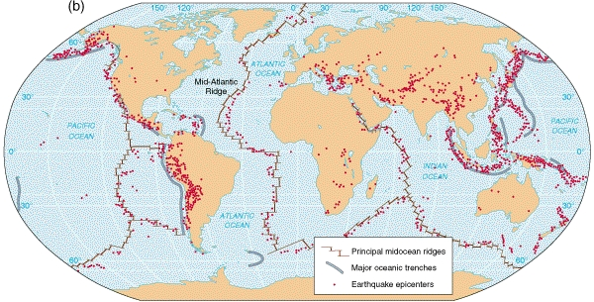
Earthquake Zones

Slide 27
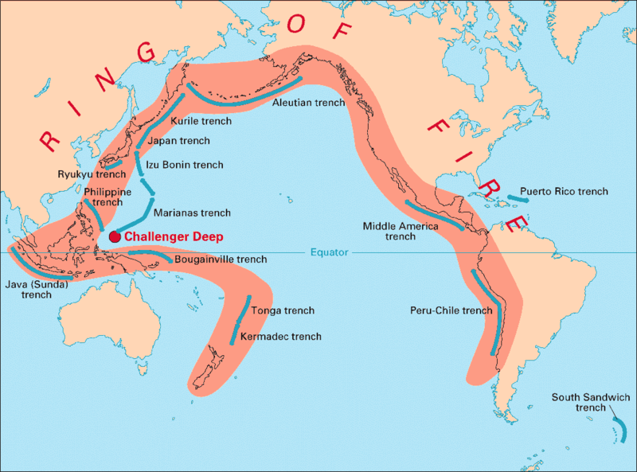

Slide 28
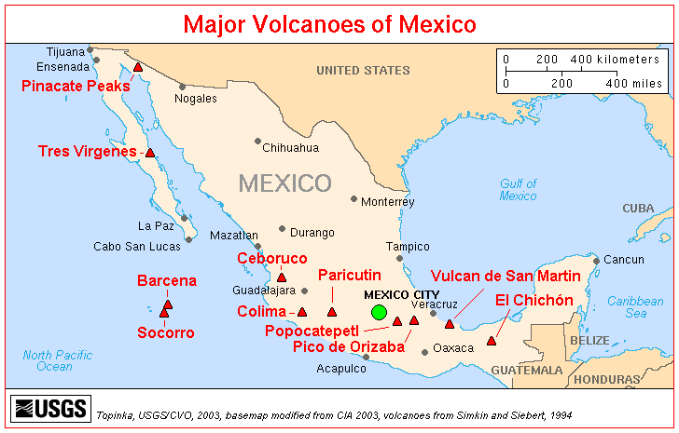

Slide 29
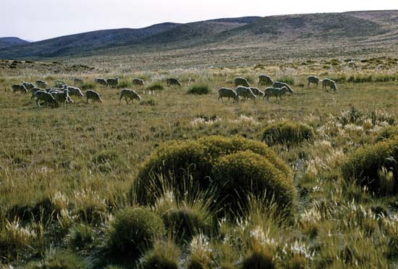
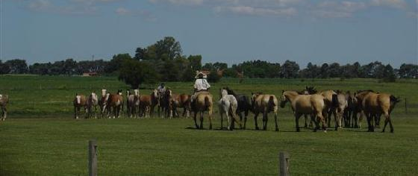
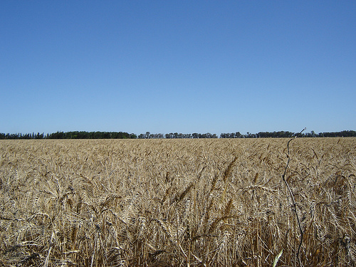
LOWLANDS
PAMPAS
One kind of lowland area in Latin America are pampas. The pampas are grassy plains that stretch from Argentina into Uruguay. The pampas are a productive farming region.

Slide 30
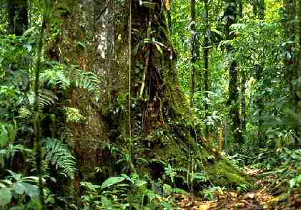
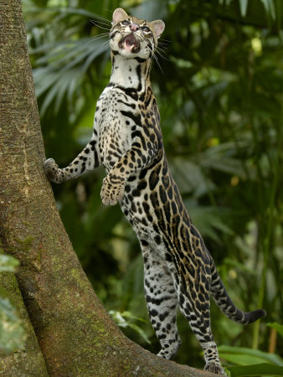
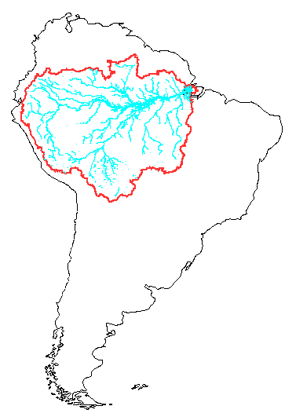
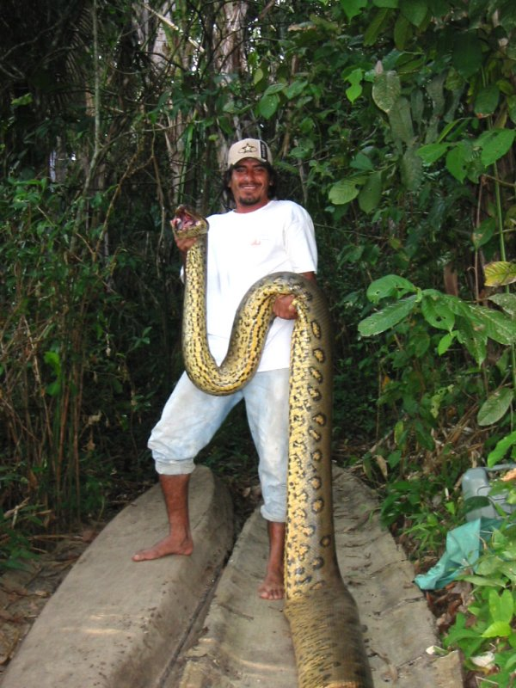
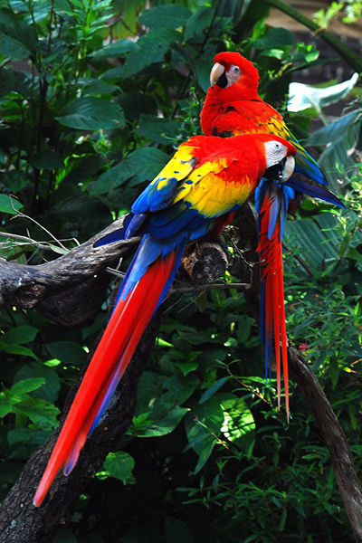
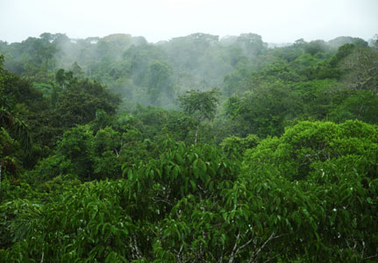
LOWLANDS
Another lowland area in Latin America is the Amazon Basin.
The Amazon Basin is the worlds largest rain forest occupying 40% of South America.

Slide 31
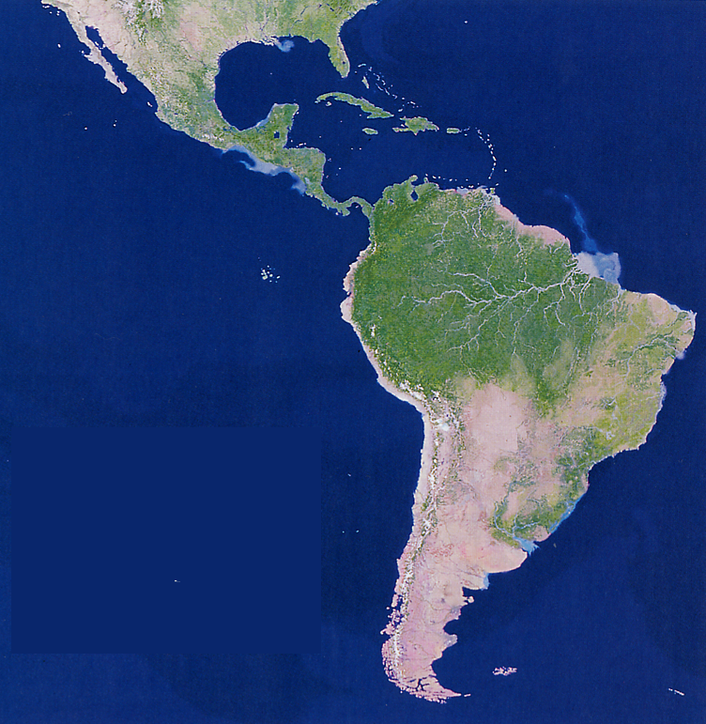

Slide 32
South America has three major river systems that provide important transportation routes: the Amazon river, Orinoco river and, the Rio de la Plata. All these rivers are important transportation routes for people and goods.

Slide 33
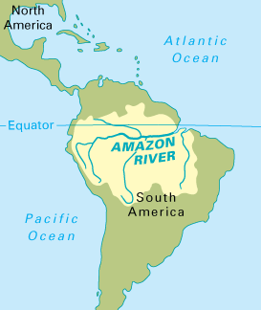
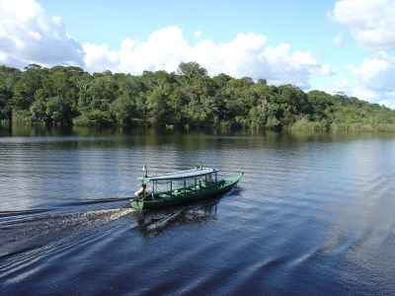
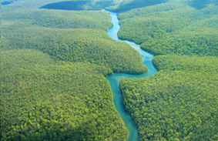
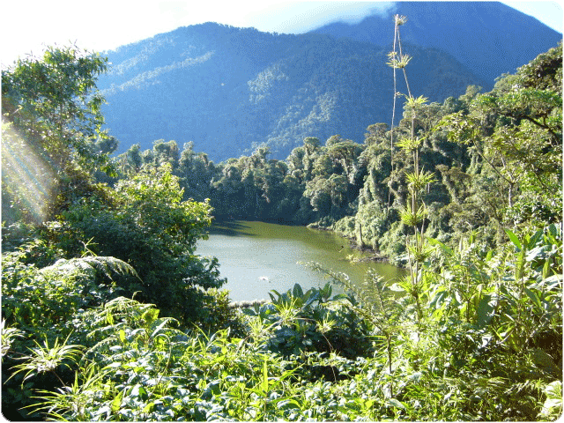
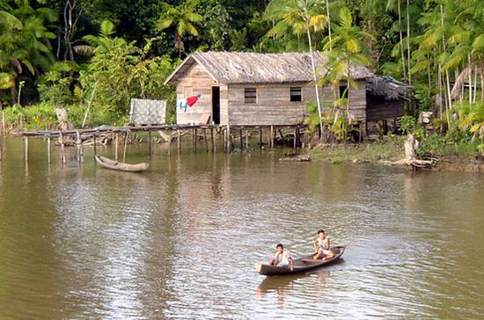
AMAZON RIVER
The Amazon is the largest river system in the world. It begins in the Andes Mountains in Peru and flows east across Brazil.
It is 4,000 miles long.

Slide 34
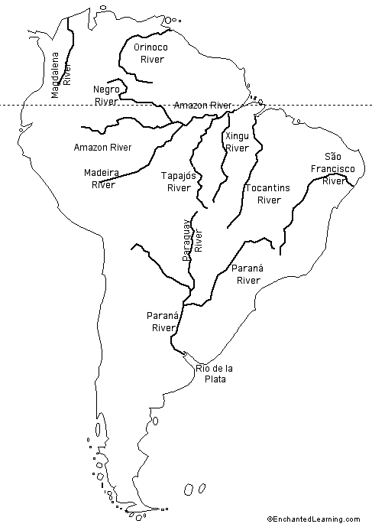
Orinoco River
The Orinoco river starts in the Guiana Highlands and flows north through Venezuela to the Atlantic Ocean. It is the world’s 8th largest river.

Slide 35
Rio de la Plata
The Rio de la Plata (River of Silver) is actually made up of the Paraguay, Uruguay and Parana rivers. It is the widest river in the world It serves as a major shipping route. Buenos Aires, Argentina is the world’s second busiest port.

Slide 36
Dry Climate
Atacama Desert, Chile
Baja Peninsula, Mexico
Patagonian Plateau, Argentina and Chile
The Atacama is one of the driest places on Earth. In some parts no rain has fallen for 400 years.

Slide 37
Altiplano
Where the Andes are widest there are high flat plains called altiplanos. People live and farm in these areas but the temperature is cool all year long and it can be difficult to grow food.

Slide 40
Tropical Climate
In some tropical climates there are warm temperatures and plenty of rainfall all year. This creates rainforests. Rainforests are found in the Amazon Basin, some Caribbean islands and parts of Central America.
Other areas in Latin America are wet and dry and warm all year. For example, lowlands of Mexico, western Central America and southern Brazil.

Slide 41
On the Ground Floor of the Rain Forest

Slide 42
Native Indians of the Amazon

Slide 43
Minerals of the Amazon Region
Amethyst
Bauxite
Quartz
Diamonds

Slide 44
Temperate Climate
In temperate climates, warm seasons alternate with cool seasons. Temperate climates are good area for grazing for livestock and farming. Some areas where there are temperate climates are in Paraguay, Uruguay and northern Argentina.

Slide 45
In Latin America the chief influence on climate is elevation above sea level.
Climate can vary greatly depending on if your are in the lowlands or highlands.
Latin Americans have their own terms for the changes in climate: tierra caliente, tierra templada and, tierra fria.

Slide 46
ELEVATION & CLIMATE
Tierra Caliente (hot land)
-close to sea level
-Yucatan Peninsula, Mexico and Amazon Basin
-good for growing
Bananas
sugar cane

Slide 47
ELEVATION & CLIMATE
Tierra Templada (temperate land)
–areas that lie above 3,000 ft. above sea level
-days are hot, nights are cool
Mexican central plateau and valleys in the Andes Mountains
-good for growing
COFFEE
TOBACCO

Slide 48
ELEVATION & CLIMATE
Tierra Fria (cold Land)
-highlands that are at least 6,000 ft above sea level
-nighttime and winter temperatures are cold
-Mexico City, Mexico and Bogota, Columbia are in the tierra fria.
-good for growing
WHEAT
BARLEY
POTATOES

Slide 50
Sao Paolo, Brazil

Slide 51
Squatter Settlements in Major Latin American Cities

