Slide 1
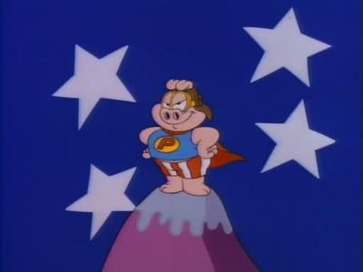
The Supreme Court and Judiciary
Mr. Kilbourn

Slide 2
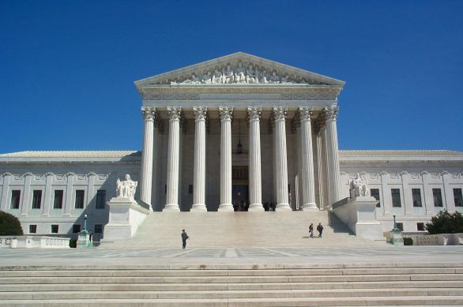
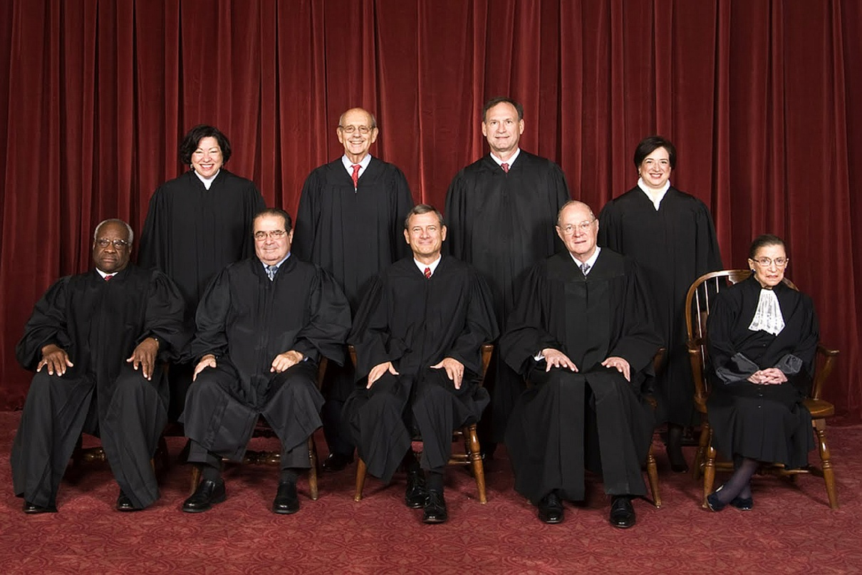

Slide 3
Structure of the Federal Courts

Slide 4
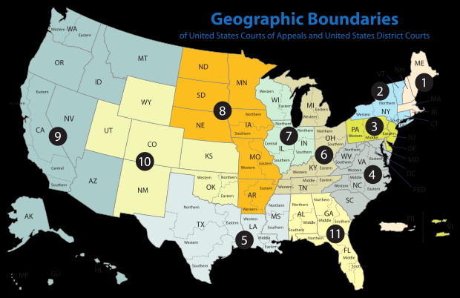

Slide 5
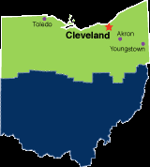
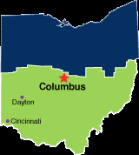

Slide 6
The basic of the basics of SCOTUS
Established by Article III of the Constitution
There are 9 justices
Congress can expand
Serve for life
Can only be impeached
Main job is to interpret Constitution
The court session begins on the first Monday of October and lasts until the next Monday on October
Have two types of Jurisdiction
Original
Appellate

Slide 7
Jurisdiction of the Federal Court
Jurisdiction = what cases the court can hear
The Constitution says what cases they can hear
Federal Question - arising under he Constitution
Diversity – plaintiff and defendant from different states
Everything else goes to the states
Sometimes federal and state courts hear the same case
You have broken Fed and State laws
Most district court decisions do not create

Slide 8
Getting to the Supreme Court
Most cases start in the federal courts
Usually don’t affect policy
Gideon v. Wainright
650 judges heard 500,000 cases
If there was a problem in the district case you can go to the Appeals Court
You cannot raise new issues on appeal
The Supreme Court gets to pick which cases it wants to hear on appeal
They issue a Writ of Certiorari to hear the case

Slide 9
Getting to the Supreme Court
Getting a Writ of Certiorari
The court looks at all petitions
4 justices agree to hear the case
What does the Court look for?
Conflicting decisions from different decisions
State Supreme Court involved in Constitutional issue
SCOTUS will read over 7000 petitions
Will hear @100 for oral arguments
Some will receive a written decision
Want to settle an important issue
Most are not dealt with, meaning lower decision up held

Slide 10
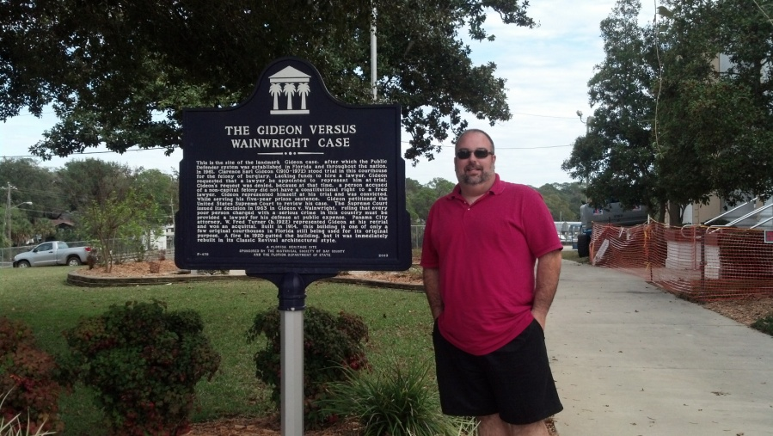
Getting to the Supreme Court
Costs can be high
$300 filing fee for certiorari
40 copies of the petition
Attorney's fees
Can apply in forma pauperis
Gideon V. Wainright
Criminal cases get an attorney appointed
Not criminal might get an interest group
The interest group may have “organized” the case
Example Heller v. D.C.

Slide 11
Getting to court (Misc. Stuff)
There is no taxpayer standing – you can’t sue because you’re a taxpayer
Sovereign Immunity – You generally cannot sue the government without their permission
Some statutes give permission ahead of time
Class action suits – Case brought not only for themselves but a “class” of people
Mesothelioma ads

Slide 12
Getting to court
Each side pays their own costs
A plaintiff may recover costs from defendant in certain cases
The plaintiff must have “standing” or who can bring the case
Actual case or controversy
No advisory or hypothetical opinions
Harm or threat of harm
No 3rd party plaintiffs
A decision will solve the problem

Slide 13
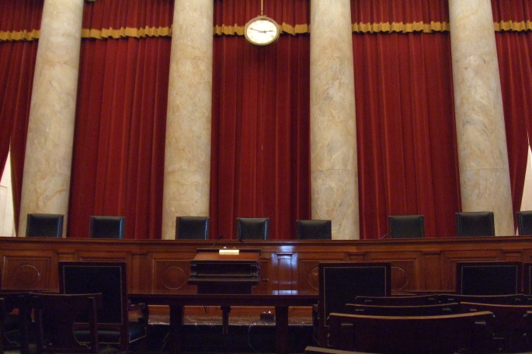
Arguing the Case
The lawyers submit briefs to the court
Brief – facts, lower decisions, arguments and case law
Oral Arguments
½ hour
Emphasize important points
Justices pepper with questions
Have to think “on the fly”
Governments lawyer is the Solicitor General
3rd in the DoJ
Approves every case where the government is the plaintiff

Slide 14
Arguing the Case
Amicus Curie Brief
Friend of the court
Not involved but interested in the case
These can influence the court
Other influences
Law journals
Law professors

Slide 15
Deciding the case
Fridays the justices meet in secret to discuss cases heard
The Chief Justice directs the meeting
Each Justice makes their argument, in order of seniority
They vote, in reverse order
The Decision
Per Curiam – short unsigned
Majority Opinion (Court’s Opinion) This is the final decision in the case
Chief Justice writes if he’s in the majority
Ranking Justice will write if CJ dissents

Slide 16
Deciding the case
Deciding the Case Cont’
Concurring opinion – Agree with the majority for different reasons
Dissenting opinion – disagree with the majority, the losing side
Sometimes the most important statements are in the footnotes.

Slide 17
The power of the courts
The court has 3 ways to create policy
Interpretation (or re-interpretation) of existing laws or the Constitution
Extend the reach of existing laws
Cover new areas
Creating new remedies
Remember that the decisions of SCOTUS are the law of the land.

Slide 18
Introduction
The courts can play a large role in policy making
Judicial review➔ Review the actions of the legislature and Executive and declare them unconstitutional
Unconstitutional ➔ inconsistent with the constitution and without force of law
Part of the system of checks and balances

Slide 19
Interpreting the Constitution
Strict Constructionist ➔ Judges are bound by the words of the Constitution
Activist (loose constructionist) ➔What are the underlying principles
Not a matter of liberal and conservative politics
Can be conservative and activist
Just remember “who’s ox is being gored. “

Slide 20
Phases of the Court
SCOTUS has experienced 3 different phases
National Supremacy and slavery 1789 – 1861
Established the supremacy of the Federal government
The relation between the Government and the economy 1861 – 1936
Then government can reasonably control business
Government and Liberty 1936 – present
Expand and protect liberties and freedoms

Slide 21
National Supremacy and Slavery
The Court is helping to establish the primacy of the Federal Government and maintain slavery
Marbury v. Madison 1803 - The Supreme Court has the power to declare laws unconstitutional
McCulloch v. Maryland 1819 - Federal law declared superior to state law
Gibbons v. Ogden 1824 – Interstate commerce is the realm of the Federal Government
Dred Scott 1856 – Several decisions
Blacks could not become citizens
Only states could outlaw slavery
Congress outlawing slavery in the territories violated the 5th amendment
This case is a factor in the beginning of the civil war

Slide 22
Government and the Economy
Could the economy be regulated by the state or federal government?
Main focus the 14th amendment to protect A.A. citizenship claims from state action
Main phrase “deprive any person… due process of law”
Also corporate property
Person = business

Slide 23
Once SCOTUS ruled person=business they ruled on almost every attempt by the government to regulate business
Protect private property from unreasonable regulation
71 federal laws and over 1200 State were declared unconstitutional

Slide 24
Government and Liberty
The court always saw themselves as protectors of citizens
After the New Deal it was more liberal
1936-74 no business laws were overturned
36 federal laws were, that dealt w/ freedoms
E.g. speech, citizenship, mail
The shift came with the New Deal
Justices opposed welfare and broad grants of power to the Federal government.
Many of FDR’s programs were declared unconstitutional

Slide 25
1937 Roosevelt wanted to add one justice for each one over 60 that would not retire (He just won big in ‘36)
“Court Packing” Bill
Never passed
Angered many
Results
One justice “changed his mind””
Several justices soon retired
Allowed FDR to nominate “his people”
1953 Earl Warren becomes Chief Justice, court becomes more activist on Social Issues

Slide 26
Selecting Judges
Political affiliation has a general influence on decisions (but not always) and on selection
All nominees are “qualified”.
Senatorial Courtesy, applies to district court judges, if the Senior Senator of the state “approves” of the nominee, they are approved by the Senate
Litmus Test – President selects candidates supported by the party and ideologically the same.

Slide 27
The power of the courts
How is the power to change policy measured?
# of laws declared unconstitutional
Congress could pass a new version of the law
# of previous decisions overturned
Not following Stare Decisis or precedent
Precedent is important because
Continuity of the law
Similar cases decided the same
The court handling more political questions
E.g. congressional district size

Slide 28
The power of the courts
Court imposed remedies
Used to apply to that case only
May apply/affect large parts of the population

Slide 29
Judicial Activism
What is it?
The judges getting involved and creating new policies or decisions
Supporters believe
Use courts to correct injustices
Courts are the last resort
Critics believe
Judges are not experts
No accountability on decisions
Not elected

Slide 30
Judicial Activism
Why the increase?
Adversarial culture – us vs. them
Laws have made easier to get standing
Growth of government
Activist beliefs of judges

Slide 31
Legislation and the Courts
The Constitution and laws have vague language
E.g. Due process, equal protection
Government decisions lead to more court fights
Government Agencies affect rights
Government tends to be the defendant

Slide 32
Checks on Judges
The courts have no enforcement power
The executive might ignore decisions
Depends on how visible the case is
Congressional checks
Confirmation and impeachment of judges
Change the number of justices
Revising unconstitutional laws
Changing jurisdiction and limiting remedies
Constitutional Amendments
Think about this➔ Could the courts declare an amendment unconstitutional?

Slide 33
Public Opinion
Judges are people too
Read the paper
Don’t like to be called names
May be called elitist by the other side
Don’t like to overrule earlier court decisions (usually)

