Slide 1
World Geography
People and Places
1-5
Mr. Kilbourn

Slide 2
Section 1
The Elements of Culture

Slide 3
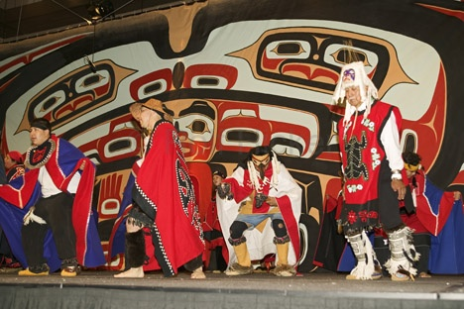
Defining Culture
Knowledge, attitudes, behaviors shared over generations is culture
Society is a group that shares geographic region, identity, culture
An ethnic group shares language, customs, common heritage

Slide 4
Culture Change and Exchange
Innovation is creating something new with existing resources
- Example: weaving baskets from reeds to solve storage problem
Spread of ideas, inventions, patterns of behavior called diffusion

Slide 5
Culture Change and Exchange
Spread of ideas, inventions, patterns of behavior called diffusion

Slide 6
Culture Change and Exchange
Cultural Hearth—site of innovation; origin of cultural diffusion
- Example: Nile River civilizations in Africa
Acculturation—society changes because it accepts innovation

Slide 9
Language
Language enables people within a culture to communicate
Language helps establish cultural identity & unity
Language can also divide people, cause conflict

Slide 10
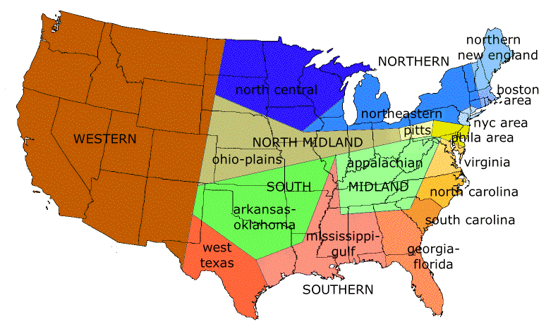
Language
Between 3,000 and 6,500 languages worldwide
- Similar languages belong to same language family
- Dialect—a version of a language, like Southern drawl
Language can spread via trade routes, migration

Slide 13
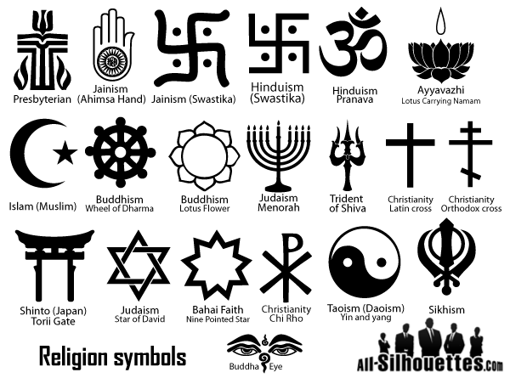
Religion
Religion—belief in supernatural power that made, maintains universe
Monotheistic faiths believe in one god
Belief in many gods called polytheistic
Animistic, or traditional, faiths believe in divine forces of nature
Religion spreads through diffusion and conversion
- Conversion—some religions try to recruit others to their faith

Slide 14
Major Religions
Judaism - Monotheistic; holy book called the Torah
Christianity -Evolved from Judaism; based on teachings of Jesus Christ
- Largest religion—2 billion followers worldwide

Slide 15
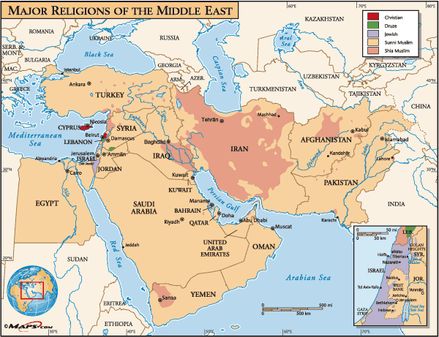
Major Religions
Islam - Monotheistic; based on teachings of Prophet Muhammad
- Followers, called Muslims, worship God, called Allah
- Holy book called the Qur’an

Slide 16
Major Religions
Hinduism - Polytheistic; evolved in India around 5,000 years ago
- Hindu caste system has fixed social classes, specific rites/duties
Buddhism - Offshoot of Hinduism; evolved around 563 B.C. in India
- Founder Siddhartha Gautama, called the Buddha, or Enlightened One
- Rejects Hindu castes; seeks enlightened spiritual state, or nirvana

Slide 17
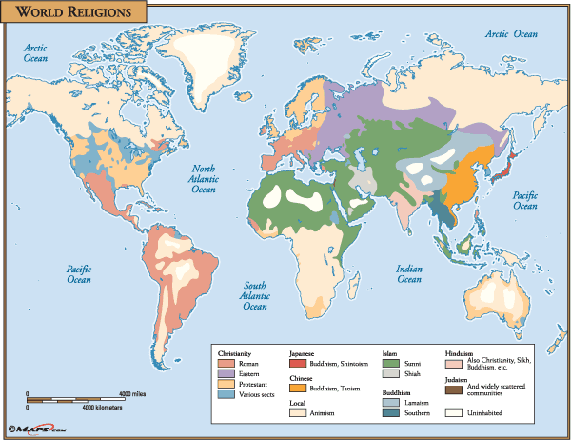

Slide 19
Section 2
Population Geography

Slide 20
Worldwide Population Growth
Birth and Death Rates - Number of live births per thousand population is the birthrate
Fertility rate—average, lifetime number of children born to a woman

Slide 21
Worldwide Population Growth
mortality rate - Number of deaths per thousand people is the
Infant mortality rate—deaths under age 1 per 1,000 live births
Population growth rate, or rate of natural increase, figured by:
- subtracting the mortality rate from the birthrate

Slide 22
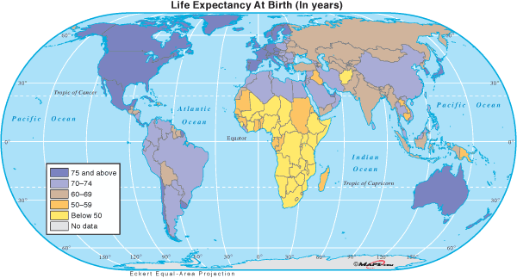

Slide 23
Worldwide Population Growth
A population pyramid shows a population’s sex, age distribution
- Enables the study of how events (wars, famines) affect population

Slide 24
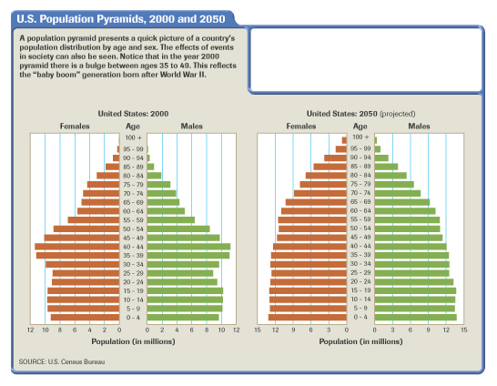

Slide 25
Population Distribution
2/3 of world’s population lives between 20°N and 60°N latitude
Dense where temperature and precipitation allow agriculture
Also dense along coastal areas and in river valleys
More sparse in polar, mountain, desert regions

Slide 26
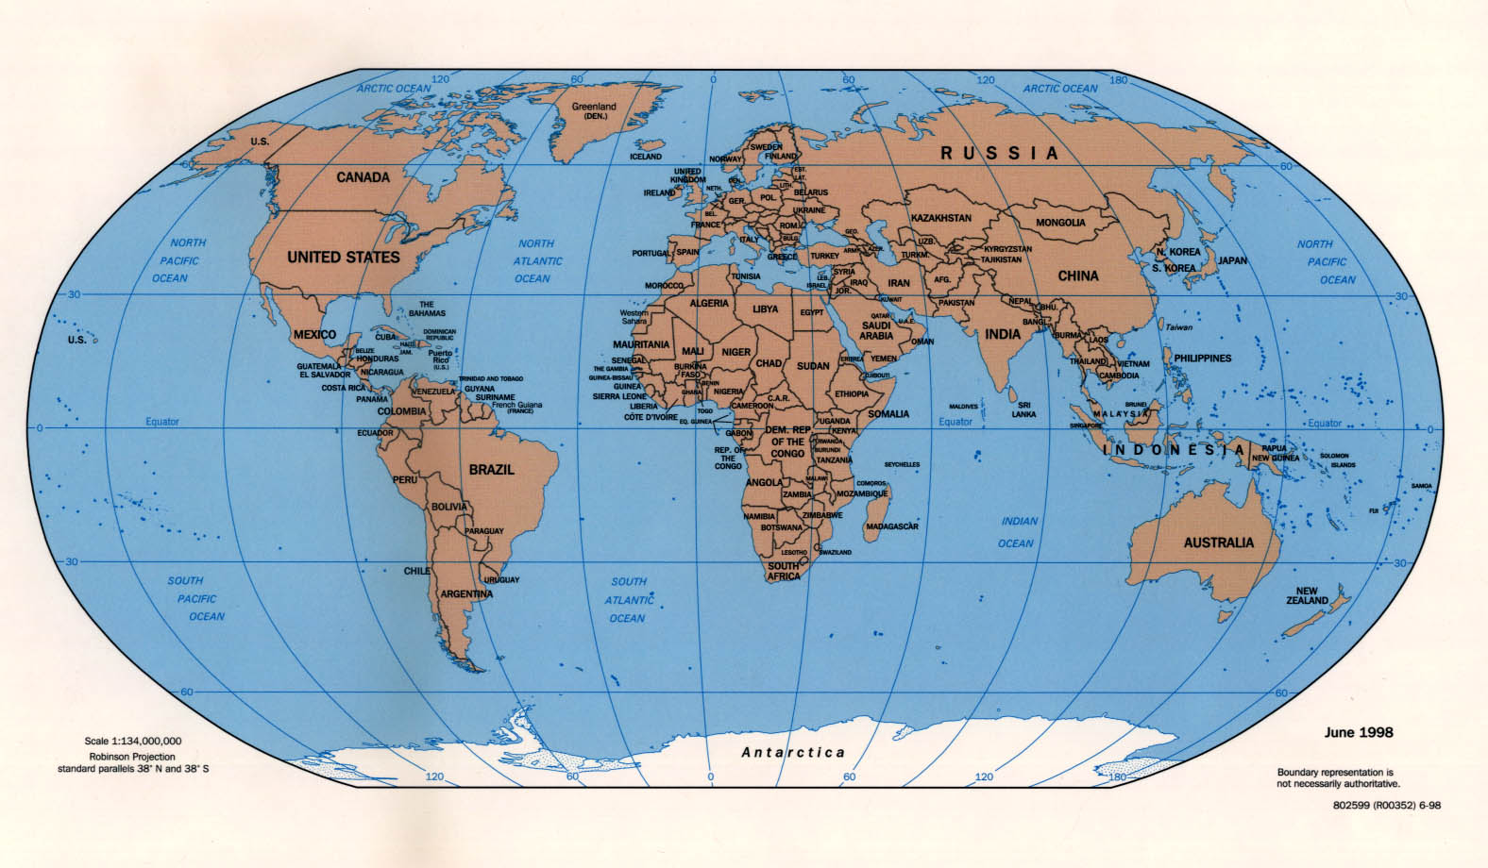

Slide 27
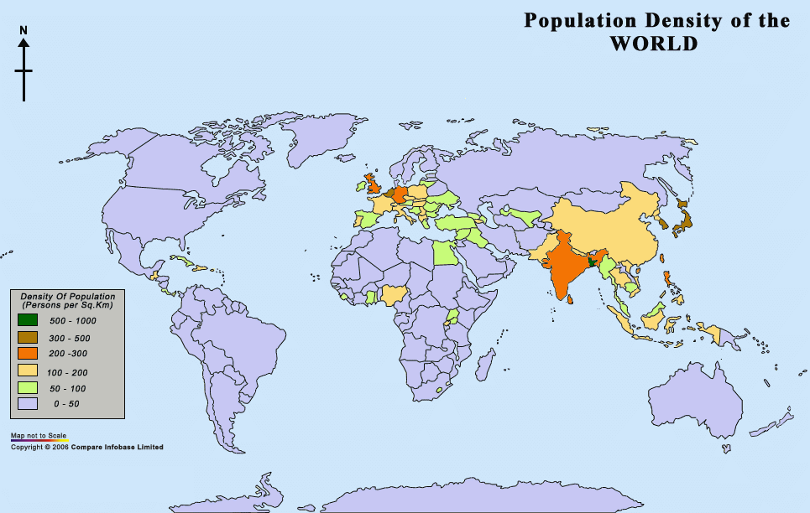

Slide 28
Population Distribution
Urban–Rural Mix - More than half of world’s population rural; rapidly becoming urban
Migration - Reasons for migrating sometimes called push-pull factors
- Push factors (drought, war) cause migration from an area
- Pull factors (favorable economy, climate) spur migration to an area

Slide 32
Estimating Population

Slide 33
Estimating Population
Population density is the average number of people living in an area

Slide 34
Estimating Population
Carrying capacity is the number of organisms an area can support
- affected by fertile land, level of technology, economic prosperity

Slide 37
Section 3
Political Geography

Slide 38
Nations of the World
An independent political unit, a state, or country:
- occupies specific territory
- controls its internal, external affairs
Nation—unified group with common culture living in a territory
A nation and state occupying same territory is a nation-state

Slide 40
Types of Government
Democracy - citizens hold political power
Monarchy - Political power held by a king or queen
Dictatorship - a group or individual holds all political power
Communism - is a governmental and economic system
- political, economic power held by government in people’s name

Slide 41
Geographic Characteristics of Nations
Size - Physical size does not accurately reflect political, economic power
Shape - Shape affects governance, transportation, relations with neighbors
Location - A landlocked country has no direct outlet to the sea
- may limit prosperity, as shipping and trade bring wealth
- Hostile neighbors necessitate increased security

Slide 42
National Boundaries
Natural Boundaries - Formed by rivers, lakes, mountain chains
Artificial Boundaries - Fixed line, generally following latitude, longitude:
- Example: 49 degrees N latitude separates U.S. from Canada
- often formally defined in treaties

Slide 44
Regional Political Systems
Countries divide into smaller political units like cities, towns
Smaller units combine regionally into counties, states, etc.
Countries may join together to form international units:
examples: United Nations, European Union

Slide 45
NATO: North Atlantic Treaty Organization

Slide 46
EU: European Union

Slide 47
Section 4
Urban Geography

Slide 48
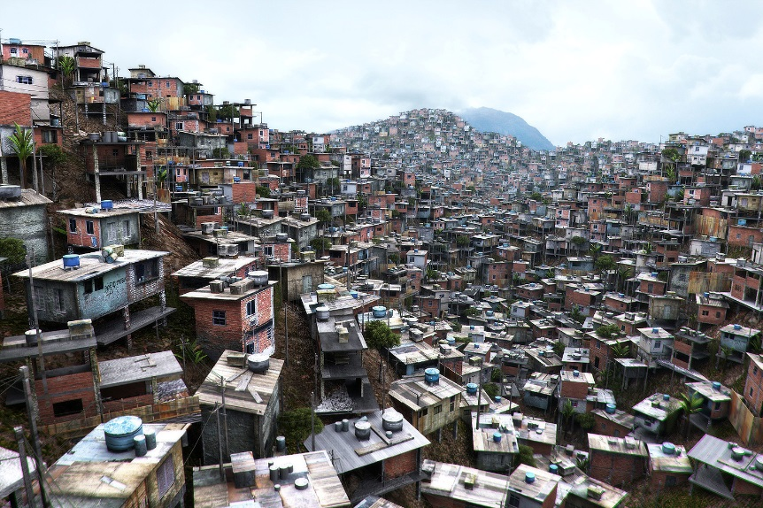
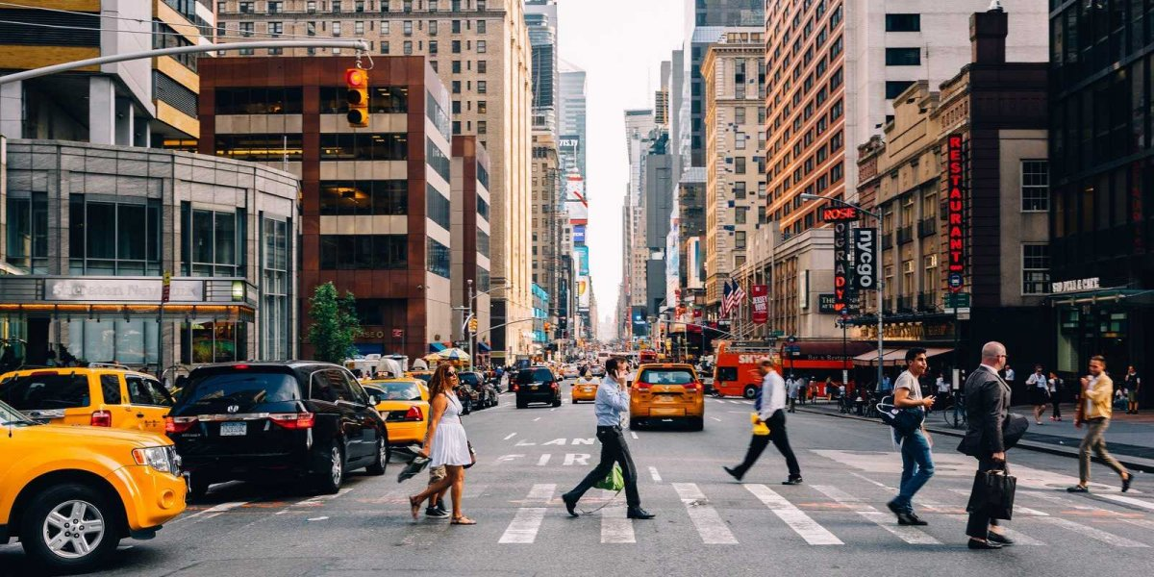
Growth of Urban Areas
Urban geography is the study of how people use space in cities
Cities are populous centers of business, culture, innovation, change
Urban Areas - Urban area develops around a central city

Slide 49
Growth of Urban Areas
suburbs—border central city, other suburbs
- exurbs - have open land between them and central city
Central city plus its suburbs and exurbs called a metropolitan area
Urbanization—rise in number of cities, resulting lifestyle changes

Slide 50
City Locations
Cities are often located near:
- good transportation—lakes, rivers, coastline
- plentiful natural resources
As a result, cities tend to:
- become transportation hubs
- specialize in certain economic activities

Slide 51
Land Use Patterns
Basic land use patterns found in all cities:
- residential (housing)
-industrial (manufacturing)
-commercial (retail)
Central business district (CBD)—core area of commercial activity
The Functions of Cities
- Shopping, entertainment, government services
- Educational, recreational, and cultural activities
- Transportation is essential to accomplish functions

Slide 52
Section 5
Economic Geography

Slide 53
Economic Systems
Economy—the production and exchange of goods and services
Economies are local, regional, national, international
Geographers study economic geography by looking at:
- how people in a region support themselves
- how economic activity is linked regionally

Slide 54
Types of Economic Systems
Economic system: way people produce and exchange goods, services
Four types of economic systems:
- traditional, or barter, economy
- command, or planned, economy
- market economy, also called capitalism
- mixed economy, a combination of command and market

Slide 55
Types of Economic Activities
Subsistence agriculture - food is raised for personal consumption

Slide 56
Types of Economic Activities
market-oriented agriculture - Raising food to sell to others is called
Cottage industries - involve small, home-based industrial production
Large industrial production - comes from commercial industries

Slide 57
Four Levels of Economic Activity
Primary - involves gathering raw materials for immediate use
Secondary - adds value to material by changing its form
Tertiary - involves business or professional services
Quaternary - provides information, management, research services

Slide 58
The Economics of Natural Resources
Natural Resources—Earth’s materials that have economic value
Materials become resources when they can be turned into goods (3 types)
renewable - (trees, seafood) can be replaced naturally
nonrenewable - (metals, oil, coal) cannot be replaced
inexhaustible -(sun, wind) are unlimited resources

Slide 59
Economic Support Systems
Infrastructure—basic support systems to sustain economic growth
- power, communications, transportation systems
- water, sanitation, and education systems
- Communications systems and technology both critical to development

Slide 60
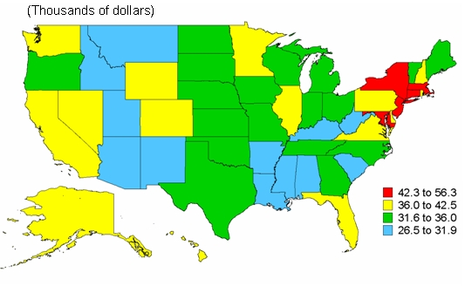
Measuring Economic Development
Per capita income: average earnings per person in a political unit

Slide 62
Measuring Economic Development
Gross national product (GNP)—statistic to measure the total value of goods, services produced by a country, globally
Gross domestic product (GDP) -statistic to measure the total value of goods and services produced within a country

Slide 63
Measuring Economic Development
Developing nations have low GDP& per capita income
Developed nations have high GDP & per capita income

