Slide 1
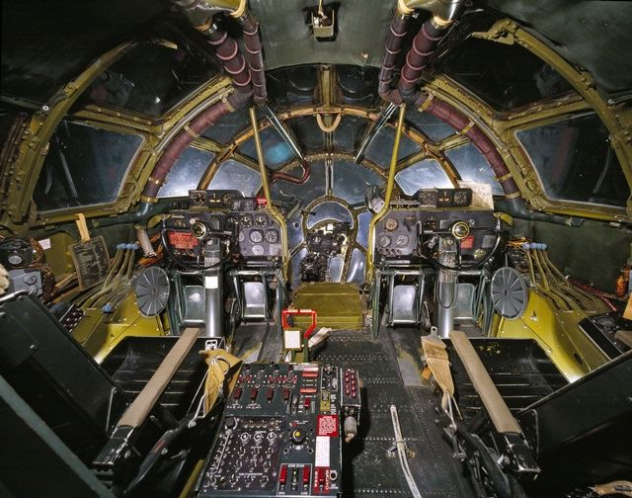
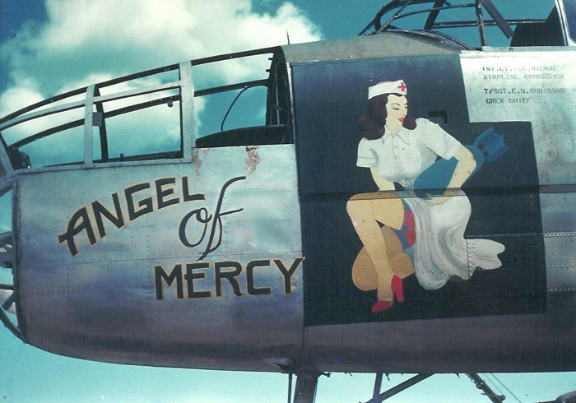
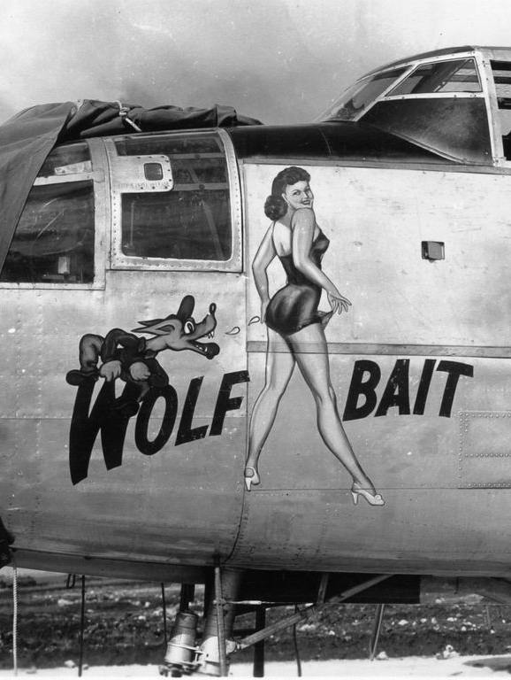
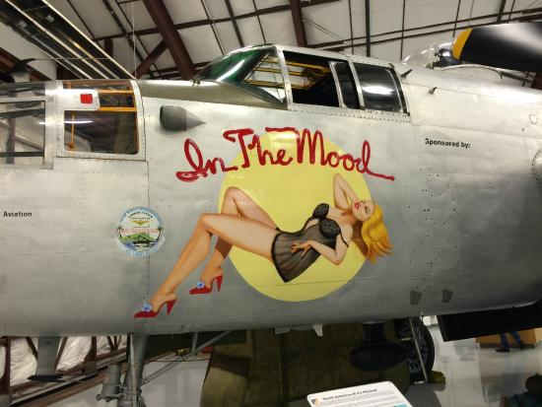
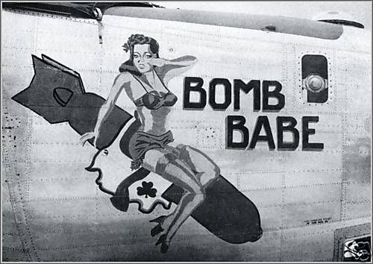
WWII: The
Rest Review

Slide 2
Why would FDR not help the USSR repel Germany?
afraid to be caught helping a communist nation

Slide 3
Which 2 Japanese cities had the Atomic bomb dropped on them?
Hiroshima
Nagasaki

Slide 4
Where is Manchuria on a modern day map?
N.E. China

Slide 5
What was the last Japanese offensive?
Battle of Midway

Slide 6
The Axis… Who were the big 3?
Germany
Japan
Italy

Slide 7
Which country lost the most people in WWII?
Russia

Slide 8
What were the findings of the Nye Committee?
the US entered WWI for profit, not policy
Made people want to remain neutral

Slide 9
Including the Allied attack that landed in _________________________ on D-Day, the Allies were attacking Axis held Europe from which directions?
Normandy France

Slide 10
What was the largest battle of WWII?
Stalingrad

Slide 11
Why were the Mariana Islands important to the Allies during WWII?
Just close enough to fly and drop bombs on Japan

Slide 12
What did the Neutrality Acts do?
made it impossible for the US to give loans to nations at war
allow any belligerent to buy on credit
sell any military goods to belligerent nations

Slide 13
Who are the “Big Three” (people) in the Yalta Conference?
FDR
Winston Churchill
Joseph Stalin

Slide 14
What technological advance helped the Allies sink submarines?
Radar

Slide 15
What Pacifically were the 2 bloodiest battles of the Spacific?
Iwo Jima
Okinawa

Slide 16
What was the largest sea battle ever?
The Battle of Leyte Gulf

Slide 17
What event led the US to quit being neutral in WWII?
Japan attacking Pearl Harbor

Slide 18
Which President ordered the dropping of the Atomic Bombs?
Harry S. Truman

Slide 19
Where is Indochina on a modern day map?
S.E. Asia (Vietnam, Cambodia, Laos, Thailand, Burma)

Slide 20
What happened to the leaders of the Axis countries?
Hirohito – stayed Emperor till death in 1989
Hitler – Suicide
Il Duce – Shot and then Hung

Slide 21
What part did the Spanish Civil War play in WWII?
Germany and Italy use Spain as a practice playground to for their future war plans…

Slide 22
What city in China did Japan utterly destroy by raping and killing the population?
Nanking

Slide 23
Which battle kept Japan from overtaking Australia?
Battle of Coral Sea

Slide 24
What 2 things were agreed upon at the Casablanca Conference?
That the Allies would worry about Europe before Asia
Allies would only accept unconditional surrender

Slide 25
What was the largest sea borne invasion in history?
D-Day invasion of Normandy France

Slide 26
What was the last German offensive of WWII?
Battle of The Bulge

Slide 27
Why is May 8, 1945 called V-E Day and what does that stand for?
Germany surrendered
Victory in Europe day

Slide 28
What 3 things were agreed upon at the Yalta Conference?
to split Germany into 4 zones and to also split the capital city, Berlin.
to allow free elections in the nations his army liberated from Germany.
Stalin agreed to enter the war against Japan soon after the German surrender.

Slide 29
Which American General led the American Effort in the Pacific?
Douglas MacArthur

Slide 30
What was the first major battle that Japan lost?
Coral Sea

Slide 31
What was it called when the U.S. led Allies began re-taking all the Japanese held Islands of the Pacific?
Island Hopping

Slide 32
What is a Kamikaze?
Suicide pilots who crashed their explosive planes wherever they could do the most damage after using all their ammunition

Slide 33
What was the name of the Bomber that carried the Atomic Bomb to Hiroshima?
Enola Gay

Slide 34
How many died in the bombing at Hiroshima?
140,000 People

Slide 35
In what way did Joseph Stalin break the Yalta Agreements?
No free elections in East Germany
Eastern Europe made Communist

